Slide 1

On-boarding
Session #1

Slide 2
Bell Performs 360
Introduction
Fuel Distributors

Slide 3
Introduction – Our Commitment
Provide a top quality line of products and support services speciﬁcally designed for your customers’ needs & based.
Focus:
  Products
  Support
  Profitability

Slide 4

Bell Performs 360

Slide 5

Who We Are
Celebrating 111 Years
Providing a Full Line of Specialized Chemical Fuel & Oil Treatments
Commercial & Industrial Grade Applications
Bell FTS - Fuel & Tank Services

Slide 6
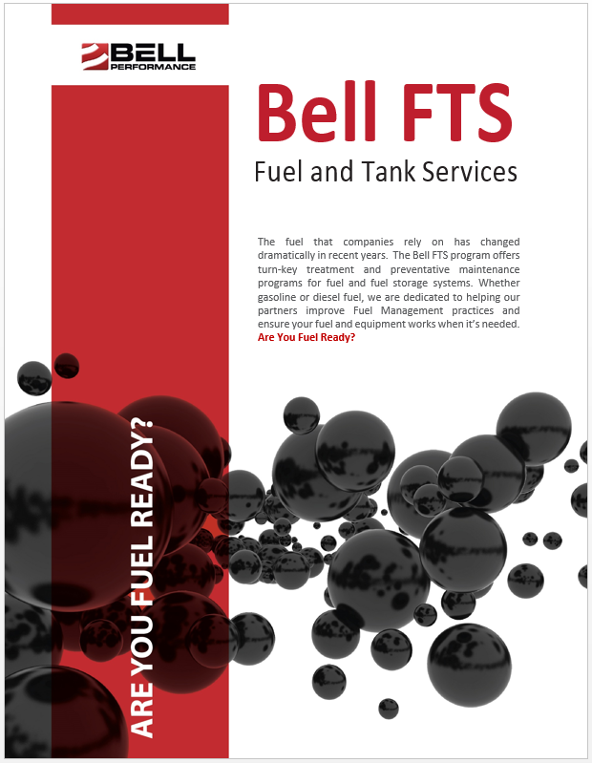
Bell FTS – Fuel & Tank Services
Three Components of Managing Fuel Quality
In-field Sampling & Testing
Chemical Treatment
Mechanical Tank Cleaning & Fuel Filtration

Slide 7
Bell Performs 360
Fuels Market Overview: Diesel Fuel Contamination

Slide 8
Diesel Contamination – Why?
Ongoing fuel quality management is essential to ensuring operations aren’t impacted by contamination
Why Contamination Occurs
Effects of Contamination
Best Practices: Remediation & Prevention
or Guardian Fueling Technologies 904-680-0850

Slide 9
Why Contamination Occurs?
Quality of Crude
Advanced Refining Process
Government Regulation: Advent of ULSD
Water Intrusion
Introduction of Bio-Diesel
or Guardian Fueling Technologies 904-680-0850

Slide 10
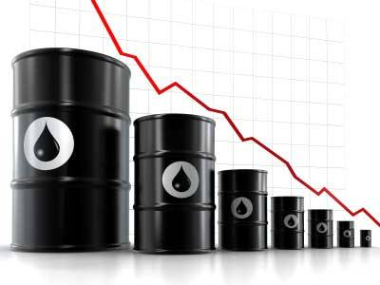


Why Contamination Occurs - Quality of Crude
Crude Quality
Supply
Demand
or Guardian Fueling Technologies 904-680-0850

Slide 11
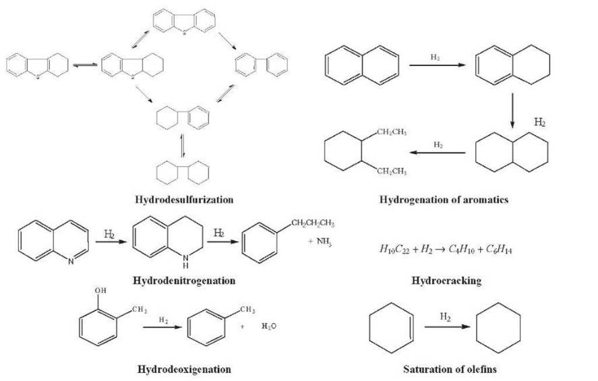
Why Contamination Occurs - Advanced Refining Process
Strict specifications and goal to produce as much fuel at lowest cost creates an unstable fuel
Mostly distillation < 2006
More catalysts introduced after 2006, hydrocracking/hydrodesulfurization
or Guardian Fueling Technologies 904-680-0850

Slide 12
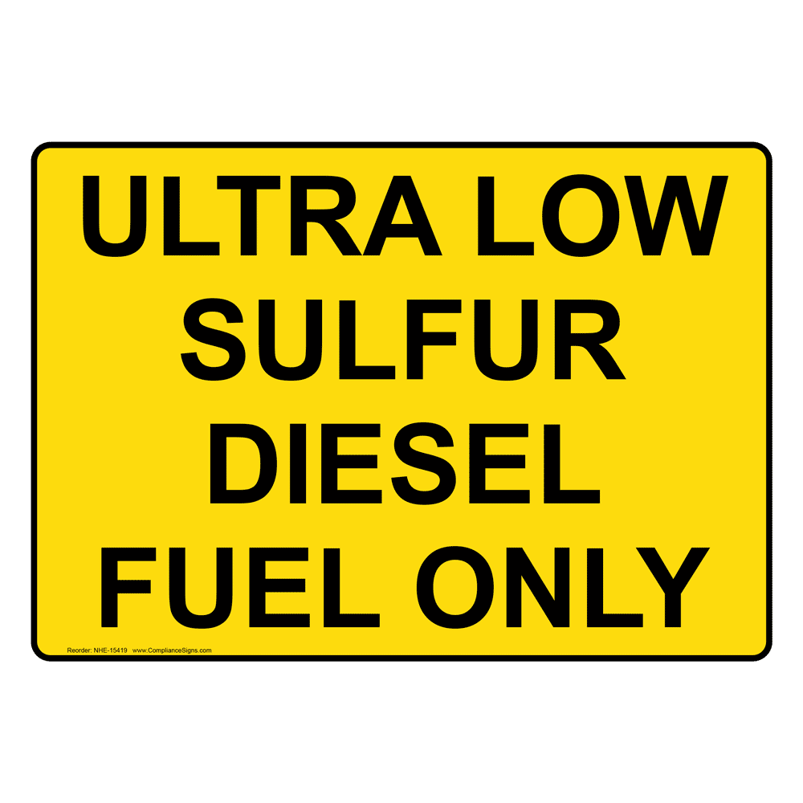
Why Contamination Occurs - ULSD
2006 EPA Clean Air Act: Required sulfur in diesel fuel to be reduced to from 5000ppm to15ppm.
Hydrodesulfurization removes chemistry essential to preventing microorganism growth.
Sulfur – Lubricating Agent for Injectors & Seals
or Guardian Fueling Technologies 904-680-0850

Slide 13
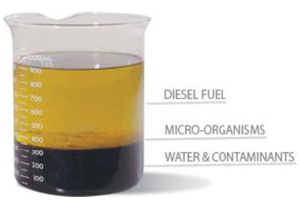
Why Contamination Occurs - Water Intrusion
Not a new issue, but new problem
Low sulfur and unstable fuel creates environment for microbial contamination and quick degradation
Microbes degrade fuel quality, advance tank and component corrosion
or Guardian Fueling Technologies 904-680-0850

Slide 14
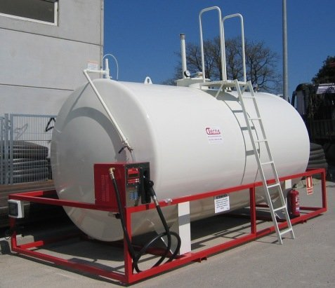
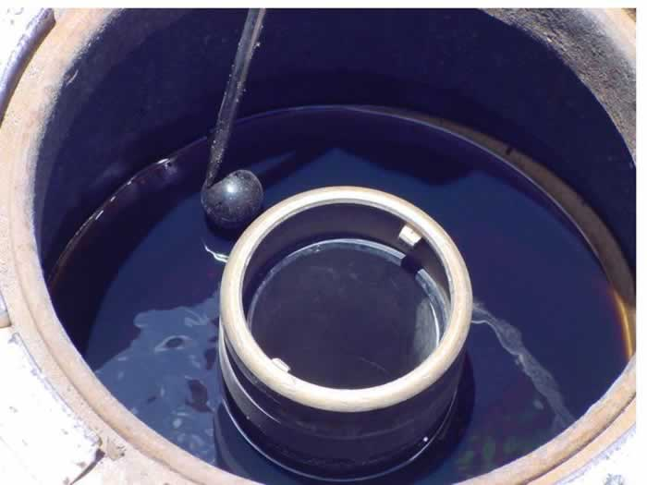
Water Intrusion – How?
More Water in Fuel from the Refinery
Condensation Formed on Tank Walls
Tank Vents, Expose Fuel to Humidity & Water Absorption
Water from Fuel Distributor Tanker
Spill Buckets Full of Water
or Guardian Fueling Technologies 904-680-0850

Slide 15

Why Contamination Occurs – Introduction of Biodiesel
Most common biodiesel concentrations are B2, B5, & B20
Biodiesel has a higher lubricity rating than straight diesel but contains less energy
Biodiesel has one-fourth the shelf life that straight diesel has and is more susceptible to microbial growth
Biodiesel tends to gel at higher temperatures than straight diesel
Biodiesel chemistry bonds easily with water
or Guardian Fueling Technologies 904-680-0850

Slide 16
Diesel Contamination in Generators - Effects
Ongoing fuel quality management is essential to ensuring operations aren’t impacted by contamination
Why Contamination Occurs
Effects of Contamination
Best Practices: Remediation & Prevention
or Guardian Fueling Technologies 904-680-0850

Slide 17

Diesel Contamination - Effects on Engines
Fuel Filter Plugging
Combustion Chamber Deposits
Lacquering of Injection System Components & Valves
Excessive Soot Accumulation in DP Filters
Reduced Engine Power
Greater Engine Wear due to Particulate
Reduced Fuel Economy
Critical System Power Failure
Related to Poor Fuel Quality
or Guardian Fueling Technologies 904-680-0850

Slide 18
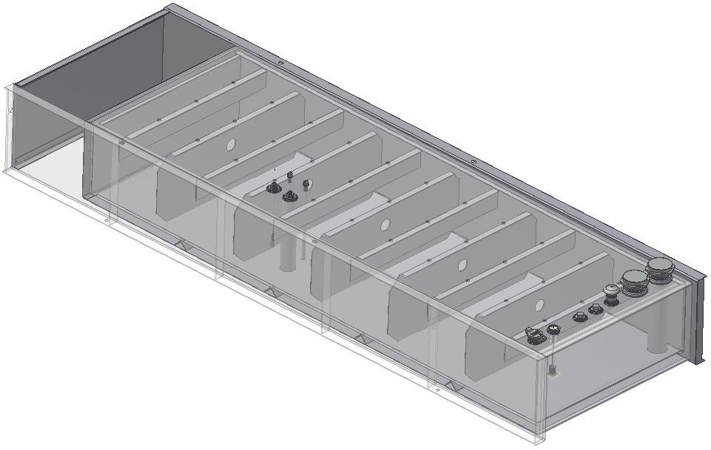
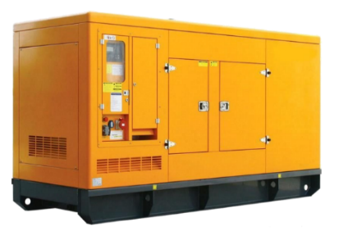
Diesel Contamination - Effects
Critical Power Systems
Low Fuel Turnover
Sub-base Fuel Tank
(Interior Construction Features)
Limited Access
or Guardian Fueling Technologies 904-680-0850

Slide 19
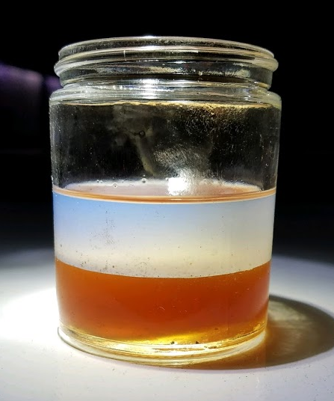
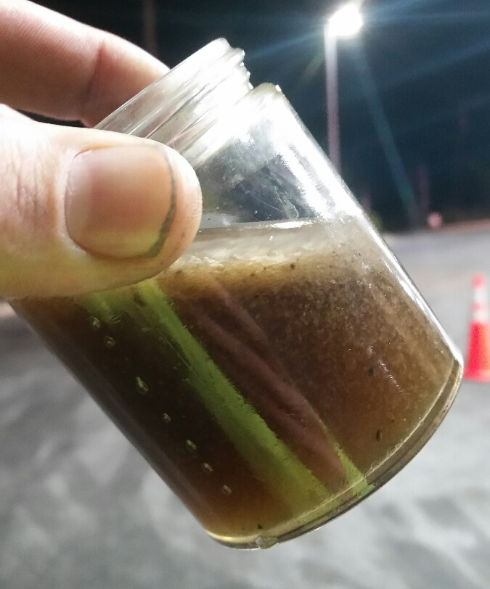
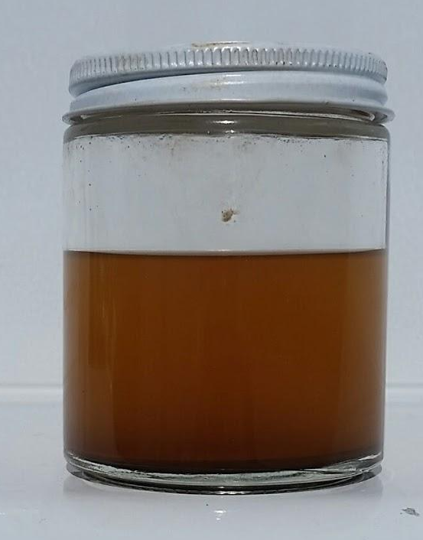
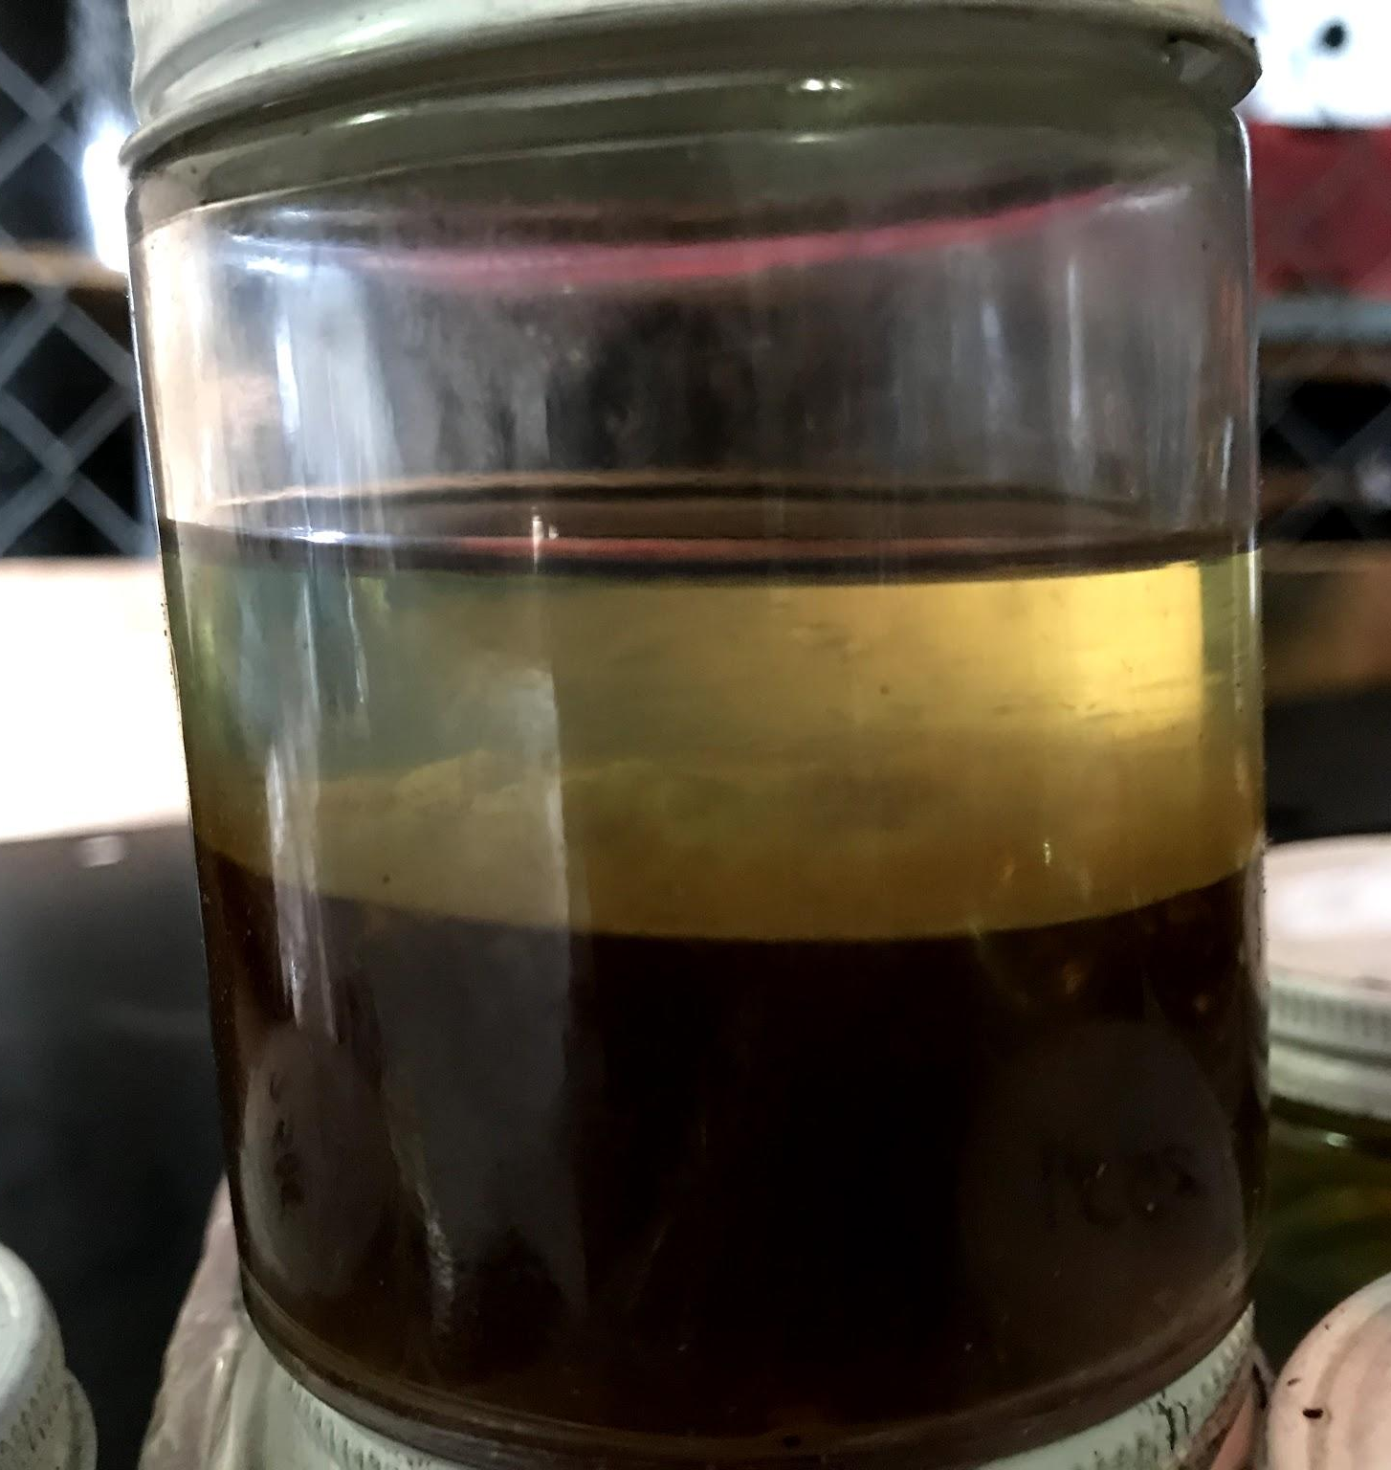
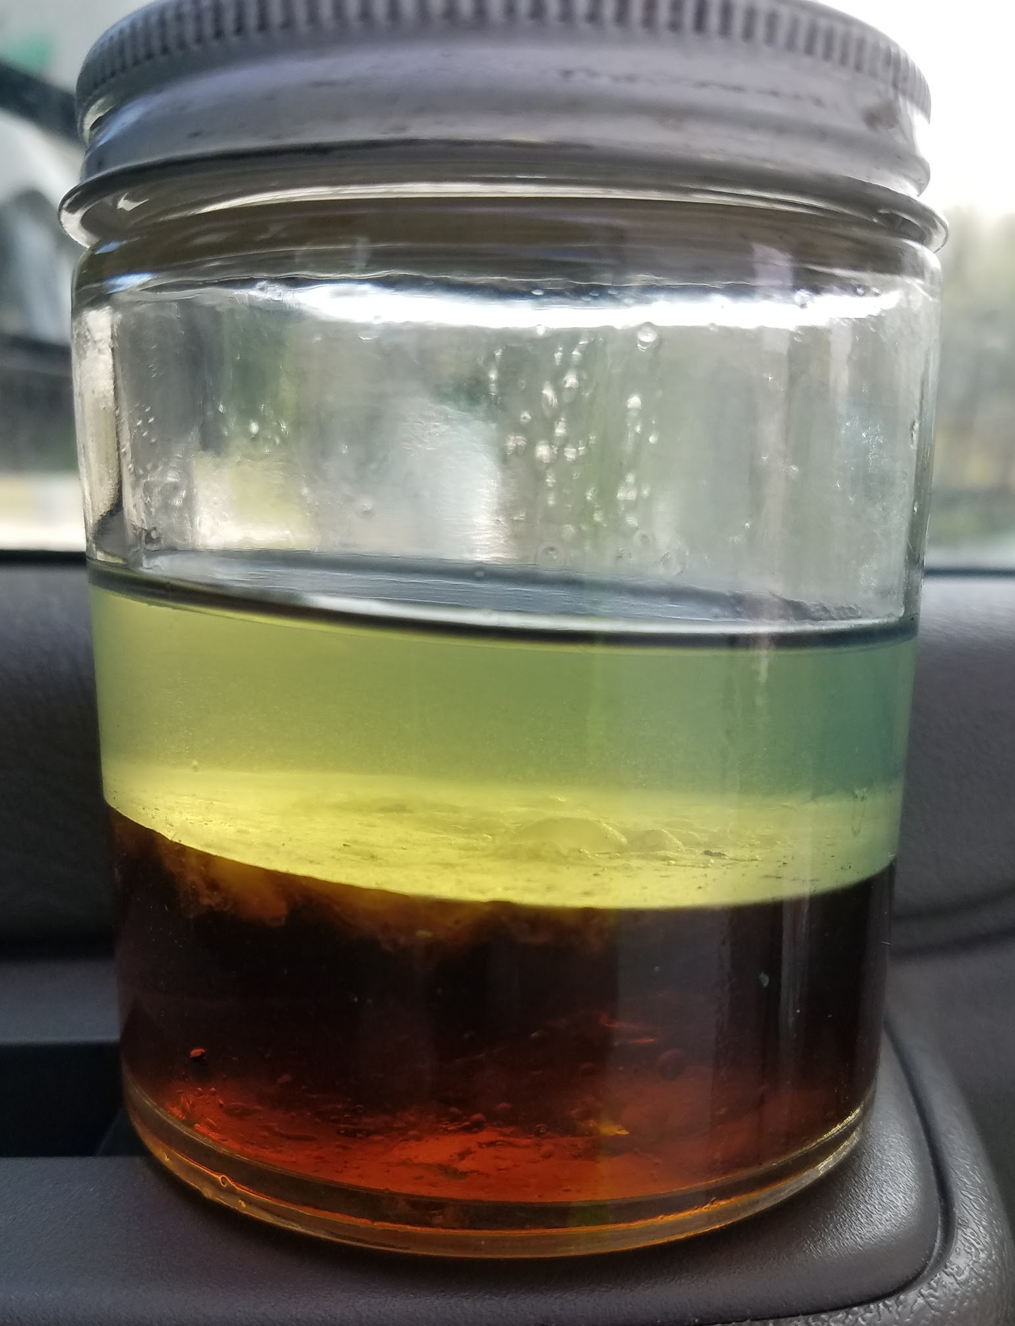
Why Contamination Occurs - Water Intrusion
What we see in the field
or Guardian Fueling Technologies 904-680-0850

Slide 20
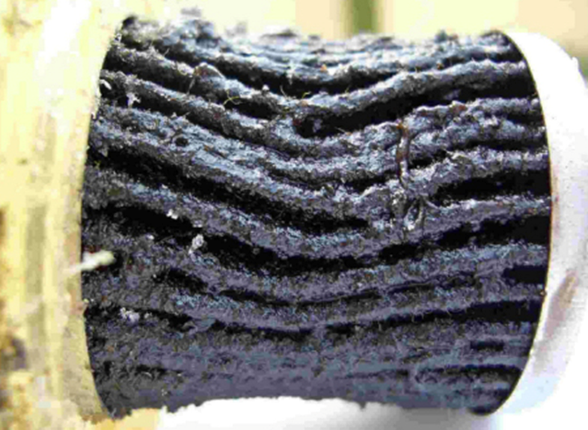
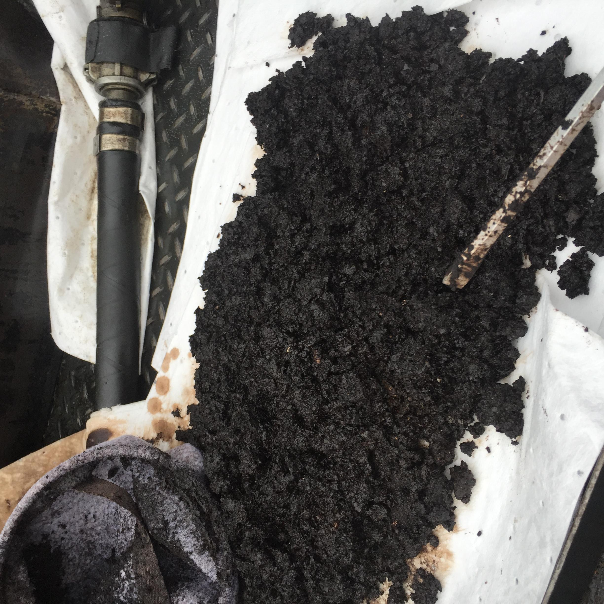
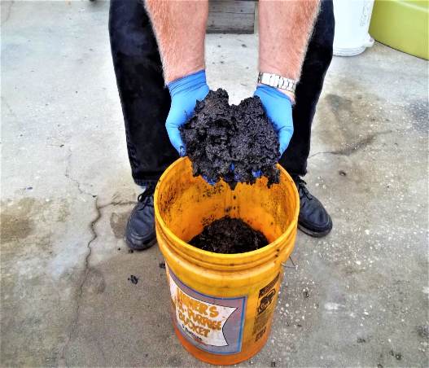
Diesel Contamination - Effects
Plugged fuel filter caused by
bio-mass & microbe excreted waste
Asphaltenes removed from tank bottoms developed due to unstable fuel
or Guardian Fueling Technologies 904-680-0850

Slide 21
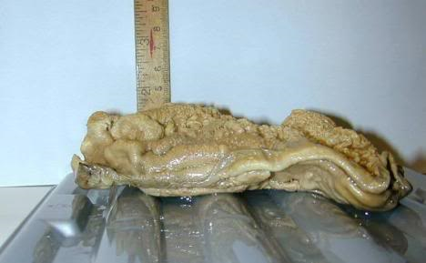
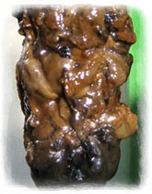
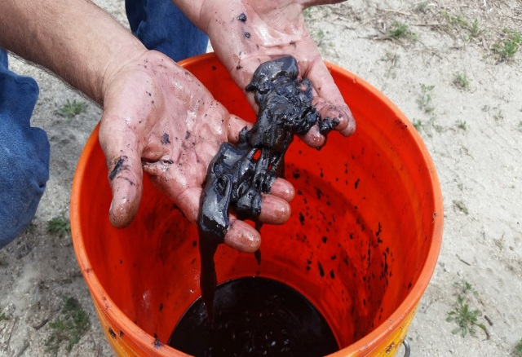
Diesel Contamination - Effects?
Biomass: Microbes can multiply from one cell to 246,000 in six hours
Microbes can come from the air, moisture or during tank filling
or Guardian Fueling Technologies 904-680-0850

Slide 22
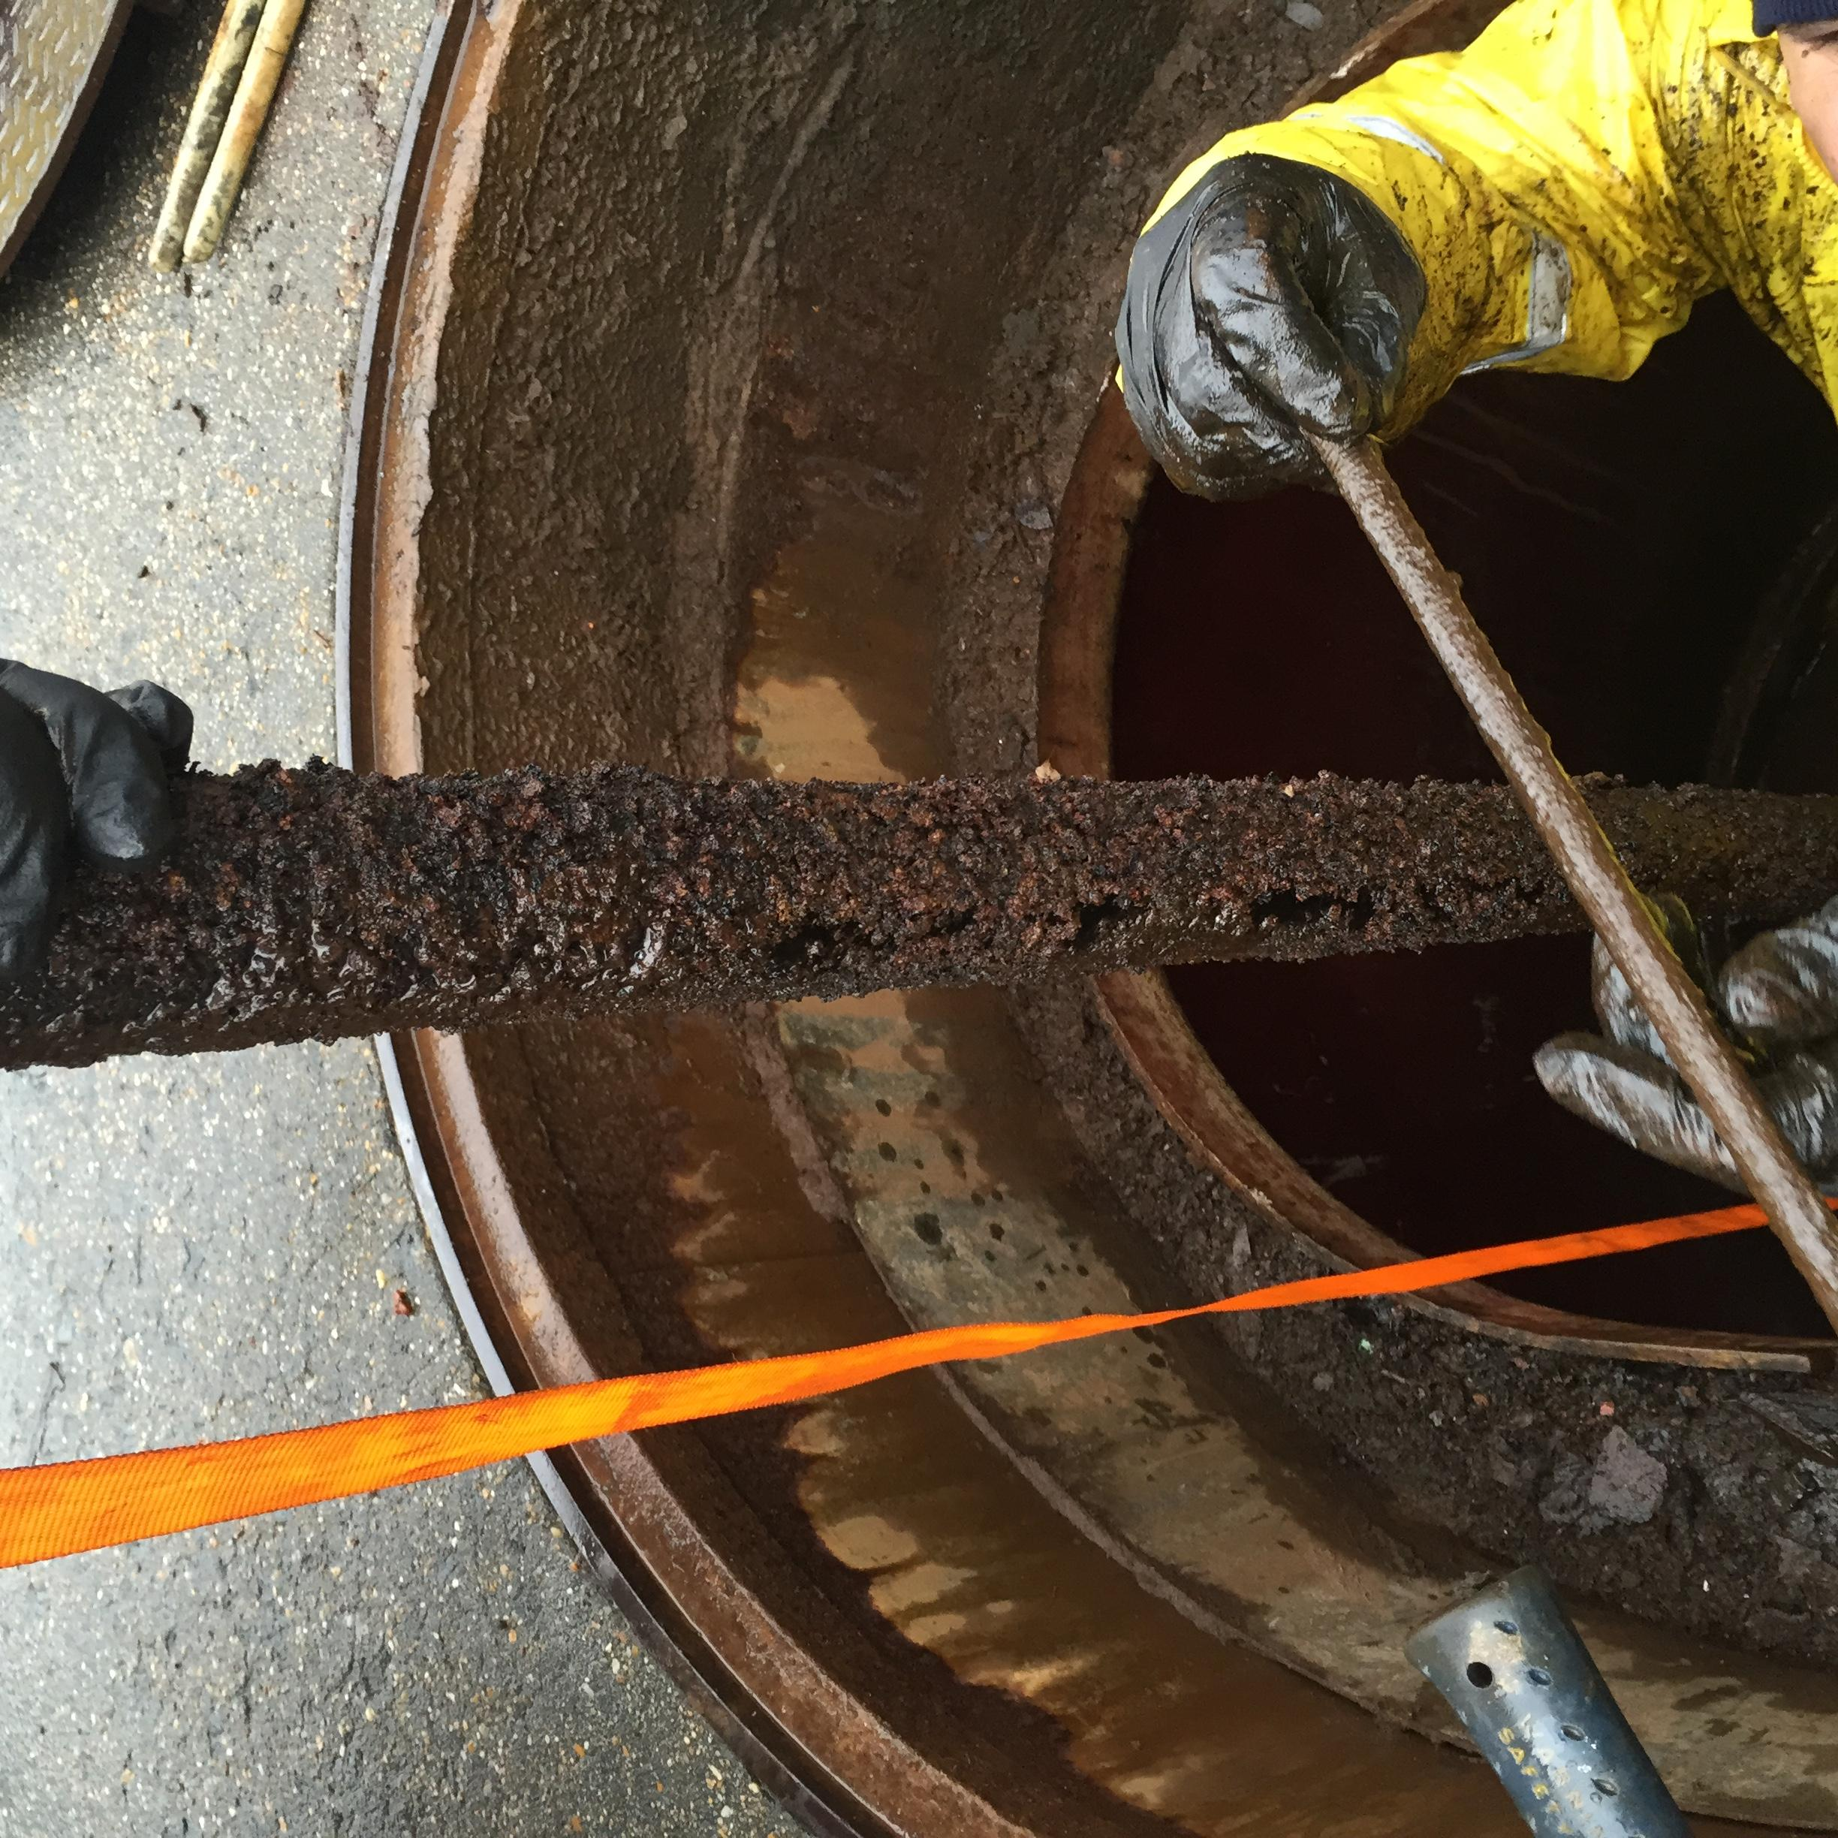
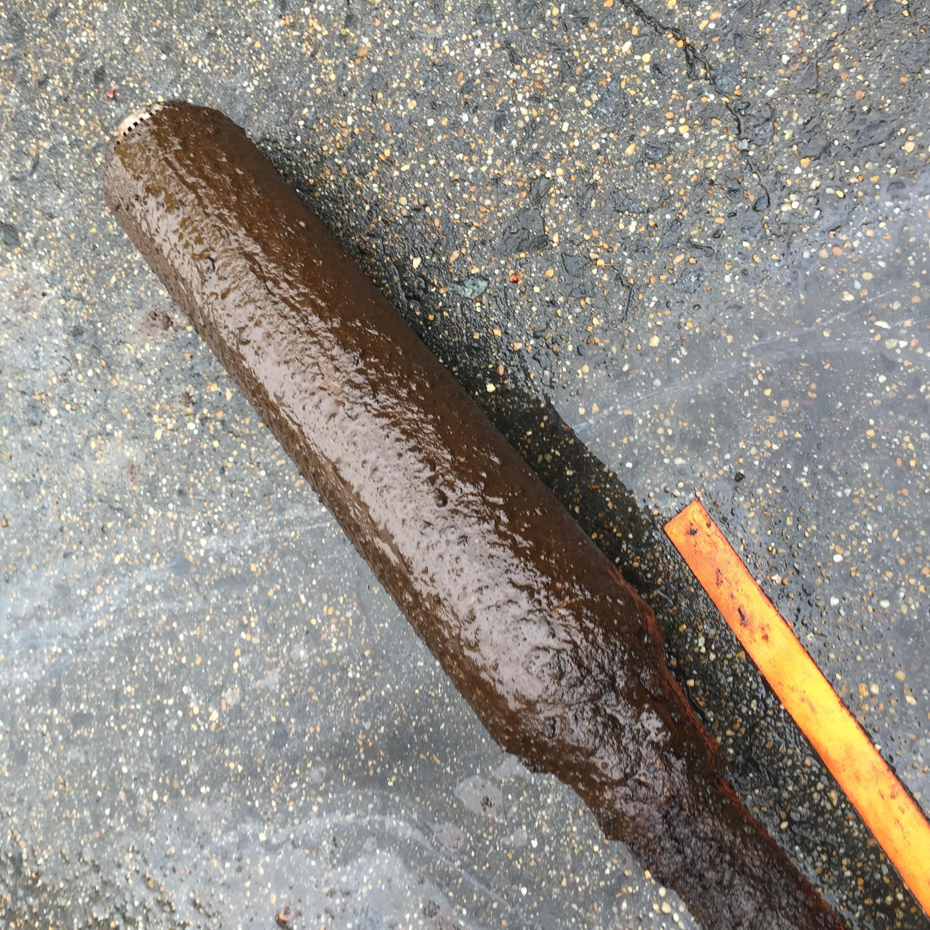
Diesel Contamination - Effects?
Corrosion on
Submersible Turbine Pump
Bottom of STP
or Guardian Fueling Technologies 904-680-0850

Slide 23
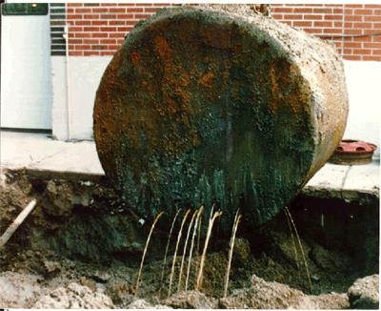
Diesel Contamination - Effects
Bacteria excrete acids that can corrode metal parts
Fuel tanks, pipes, injectors, injector pumps & fuel lines can be severely damaged
or Guardian Fueling Technologies 904-680-0850

Slide 24
Diesel Contamination – Best Practices
Ongoing fuel quality management is essential to ensuring operations aren’t impacted by contamination
Why Contamination Occurs
Effects of Contamination
Best Practices: Remediation & Prevention
or Guardian Fueling Technologies 904-680-0850

Slide 25
Diesel Contamination – Best Practices
Initial Treatment
On-going Maintenance
or Guardian Fueling Technologies 904-680-0850

Slide 26
Diesel Contamination – Best Practices
Three Components of Managing Fuel Quality
In-field Sampling & Testing
Chemical Treatment
Mechanical Tank Cleaning & Fuel Filtration
or Guardian Fueling Technologies 904-680-0850

Slide 27
Diesel Contamination – Best Practices
Sampling & Testing
or Guardian Fueling Technologies 904-680-0850

Slide 28
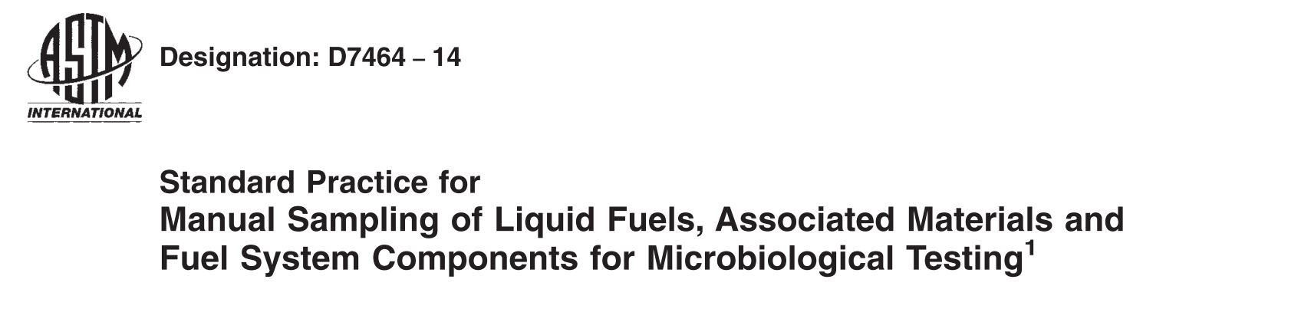
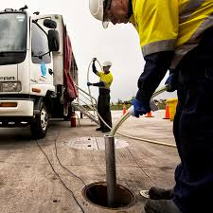
Condition Monitoring & Sampling – Methodologies
Sampling practices
ASTM D4057 vs. D7464
Bottom and 3-phase samples
Proper handling of instruments
Sterilization between samples
Temperature Control
Time Sensitive Testing
or Guardian Fueling Technologies 904-680-0850

Slide 29
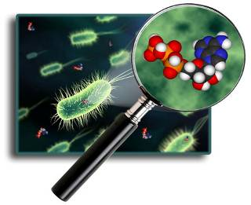
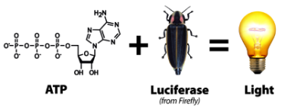
Condition Testing – ATP Microbial Analysis
ASTM D7687 – Measurement of ATP by Filtration
Isolation & measurement of microbial ATP
Filtration of sample, washing of impurities
Extraction of microbial ATP
Dilution and addition of light-producing enzyme
Detects 70% of microbes, instant and QUANTITATIVE results
or Guardian Fueling Technologies 904-680-0850

Slide 30
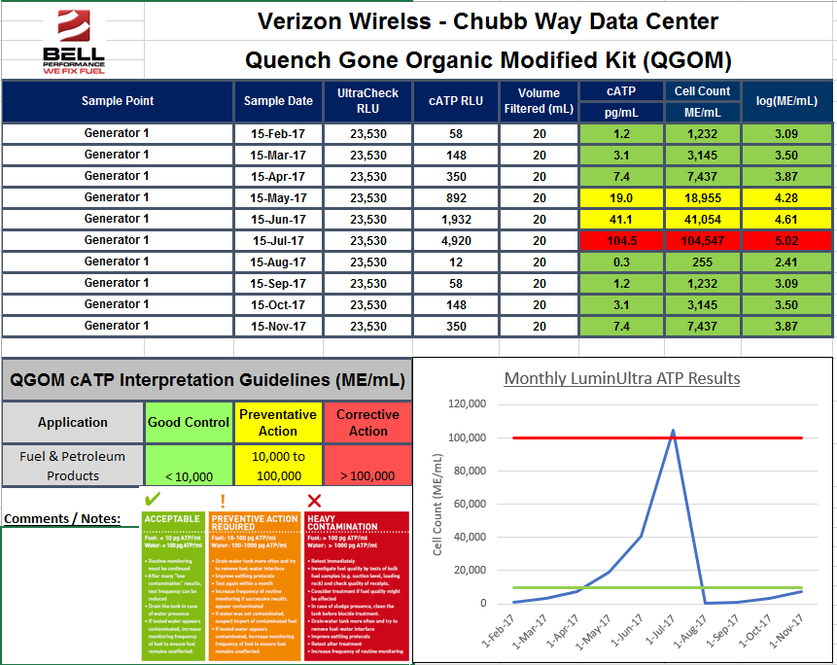
Testing & Analysis – Fuel-Pulse ATP Reporting
Predictive Testing
Data Driven
Establishes Fingerprint & Trends
Provides Treatment Triggers
or Guardian Fueling Technologies 904-680-0850

Slide 31
Bell Performs 360
Chemical Suite

Slide 32
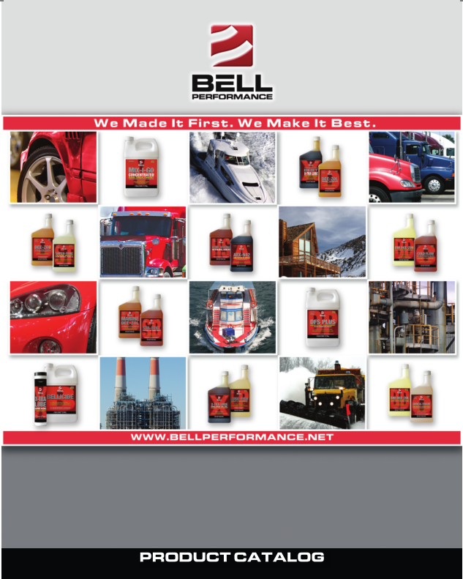
Chemical Suite
Products Include:
  Bellicide
  Tank Treatment SDF
  Demulsifier EB
  Dee-Zol Life
  Cold Flow Improver

Slide 33
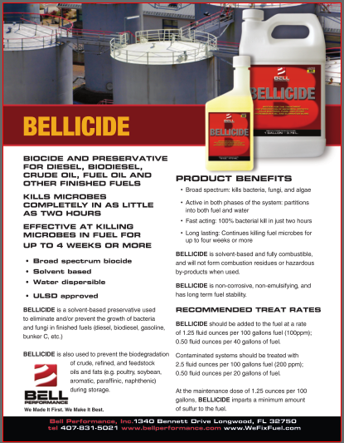
Bellicide – Single Function
Broad-spectrum Fuel Micro-biocide
A Must-have for Microbial Contamination
Recommended by EPA
Highly Regulated

Slide 34
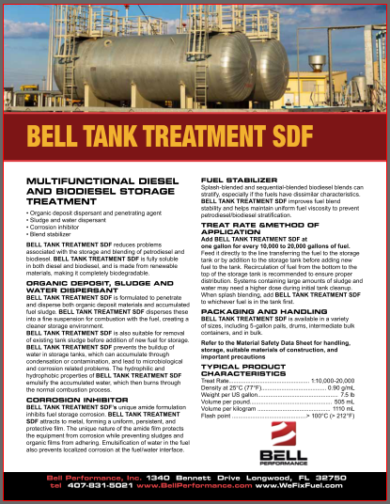
Tank Treatment SDF – Multi-function
Sludge Dispersant
Biomass Dispersant
Corrosion Inhibitor
Recommended by EPA

Slide 35
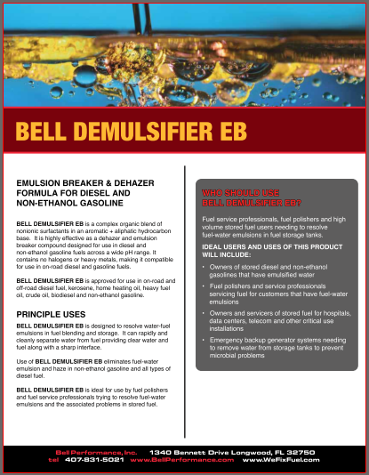
Demulsifier EB – Single Function
Water De-mulsifier
Drops emulsified water to tank bottom
Aids in Mechanical Remediation
Essential for HPCR Diesel Engines

Slide 36
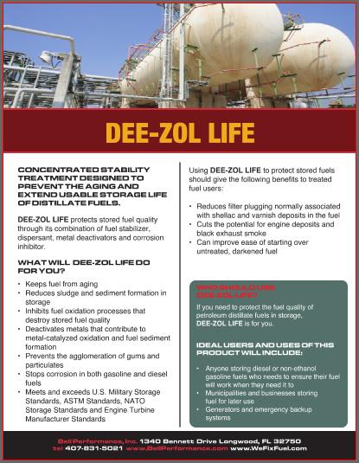
Dee-Zol Life – Single Function
3-4X Stability vs. Untreated Diesel Fuel
Reduces Formation of Solids & Particulates
Essential for Standby Power Supply

Slide 37
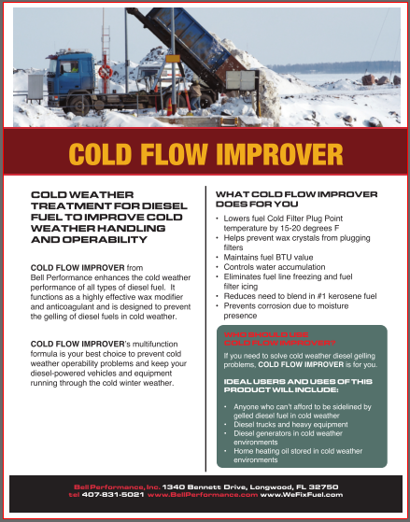
Cold Flow Improver – Single Function
Diesel Fuel Anti-Gel
Drop in CFPP & Cloud Point of Approximately 20 Degrees F
More Essential Today Given Evolved Diesel Engine Filtration

Slide 38
Bell Performs 360
Sales Support

Slide 39
Bell Performs 360
We work with our Partners to create a turnkey Fuel Treatment Vertical designed for your customers’ needs that:
Solves Customer’s Fuel-Related Problems
Helps Establish Value & ROI for Customers
Enhances Your Brand
Differentiates from Competitors
Creates a High-Margin New Revenue Channel
Let our dedicated team help provide the solutions
your customers have been searching for!

Slide 40
Sales Support
Focus: Align, Integrate & Execute

Slide 41
Bell Performs 360
Marketing Support

Slide 42
Marketing Support
Fundamental Considerations:
  Unique Vision
  Value Proposition
  Multi-Faceted Process

Slide 43
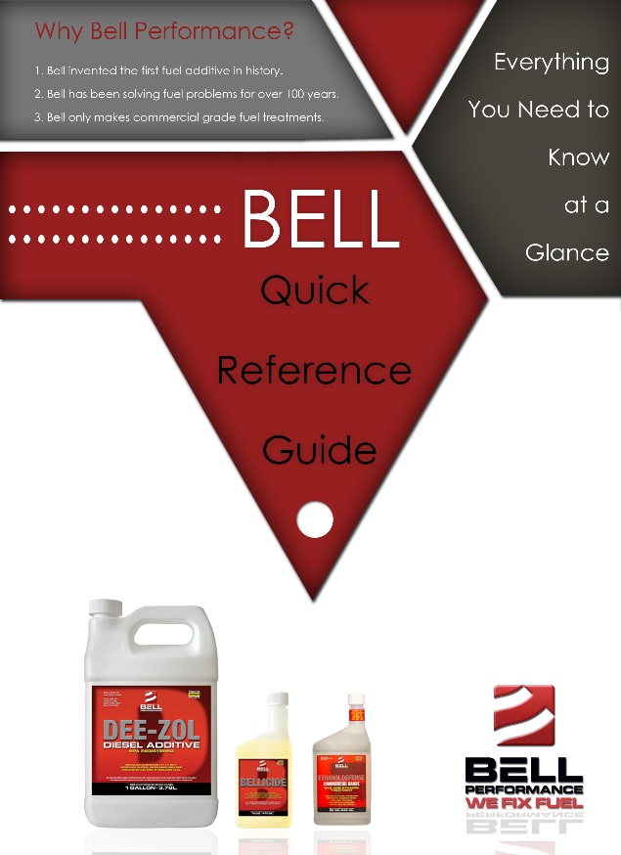
Quick Reference Guide
Everything You Need to Know at a Glance
  Sales Agents
  Customer Service Representatives
  Field Technicians

Slide 44

Customer Education Sessions
Utilize our expertise and training resources, bring customers together and maximize your efforts:
  On-Site Training Sessions
  Lunch & Learns
  Join.me Online Tutorials
  Webinars
  Group Conference Calls

Slide 45
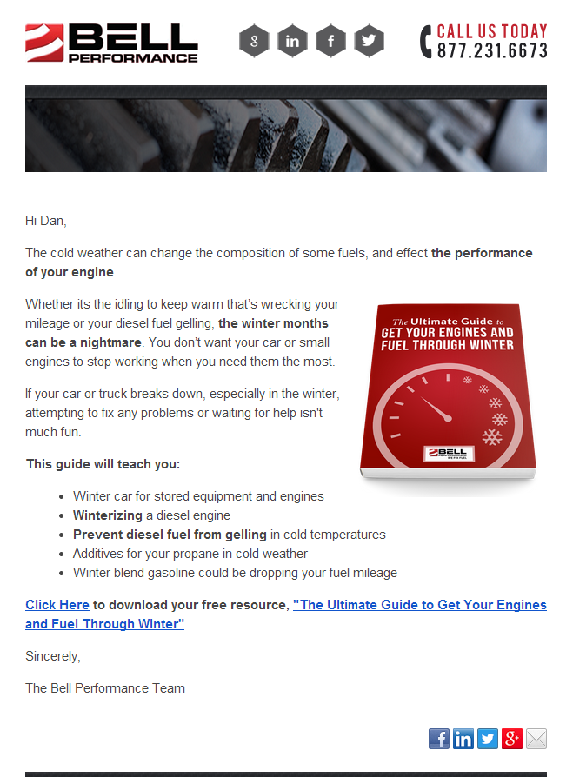


Email & Blog Content (Diesel Fuel Storage)
How To Ensure You Are Prepared For This Hurricane Season
http://www.bellperformance.com/blog/how-to-ensure-you-are-prepared-for-this-hurricane-season
The Importance Of Protecting Your Stored Fuel For Emergency Use
http://www.bellperformance.com/blog/the-importance-of-protecting-your-stored-fuel-for-emergency-use
Diesel Storage Shelf Life Isn't What It Used To Be
http://www.bellperformance.com/blog/bid/117614/Diesel-storage-shelf-life-isn-t-what-it-used-to-be
Fuel Storage And Diesel Generator Problems: Fuel Microbes
http://www.bellperformance.com/bell-performs-blog/diesel-generator-problems-fuel-microbes
Diesel Fuel Degradation In Storage - The Signs
http://www.bellperformance.com/blog/bid/117621/Diesel-fuel-degradation-in-storage-the-signs
Low Sulfur Diesel Problems: Corrosion In Storage And Dispensing
http://www.bellperformance.com/bell-performs-blog/ultra-low-sulphur-diesel-problems-corrosion-in-systems-storing-and-dispensing

Slide 46
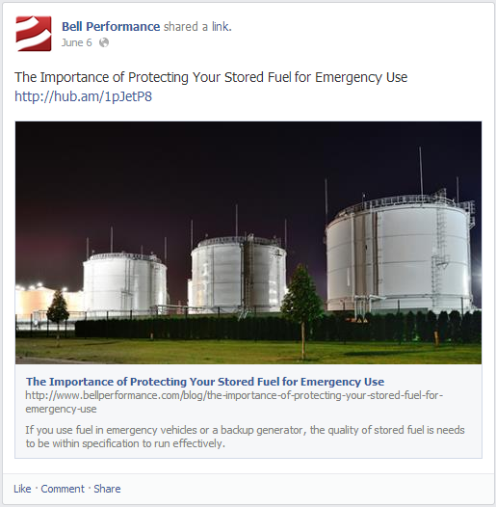
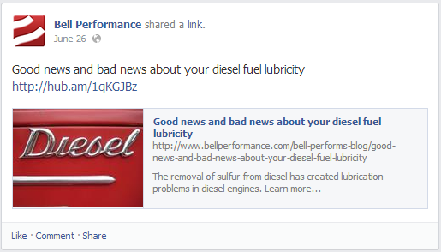
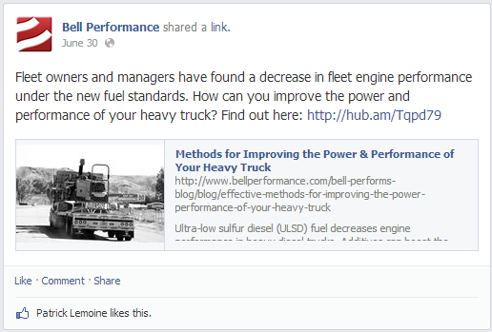
Social Media-Facebook.com/BellPerformance

Slide 47

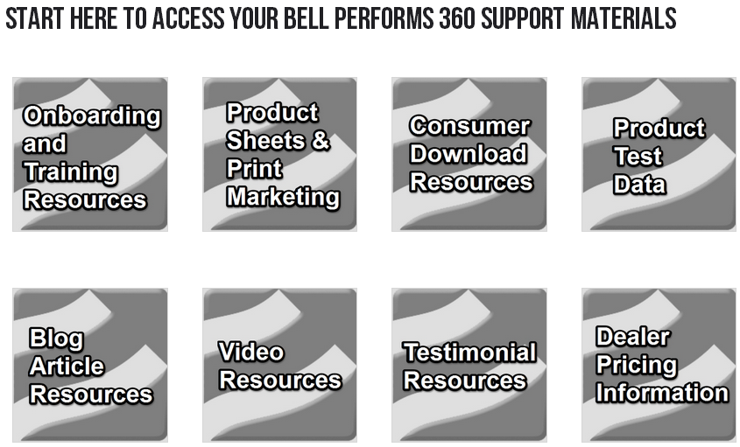
Bellperforms.com
Available exclusively to our Strategic Partners 24 hours a day, 7 days a week, 365 days a year. Access includes:
  Training Documents
  Sales & Marketing Support
  Video Library
  CUSTOMIZED WITH YOUR CONTENT

Slide 48
Useful Website Addresses
www.wefixfuel.com
www.bellperformance.com
or Guardian Fueling Technologies 904-680-0850

Slide 49

Thank You!

