Slide 1
Presented by: Bill Diver

Slide 2
Are you Fuel Ready?
Three Components of Fuel Maintenance
Sampling and Testing
Chemical Treatments
Mechanical Remediation

Slide 3
Diesel Contamination – Why?
Ongoing fuel quality management is essential to ensure operations aren’t impacted by contamination.
Why Contamination Occurs
Effects of Contamination
Best Practices: Remediation & Prevention

Slide 4
Why Contamination Occurs?
Quality of Crude
Advanced Refining Process
Government Regulation: Advent of ULSD
Water Intrusion
Introduction of Bio-Diesel

Slide 5
Why Contamination Occurs - Quality of Crude
Crude Quality

Slide 6
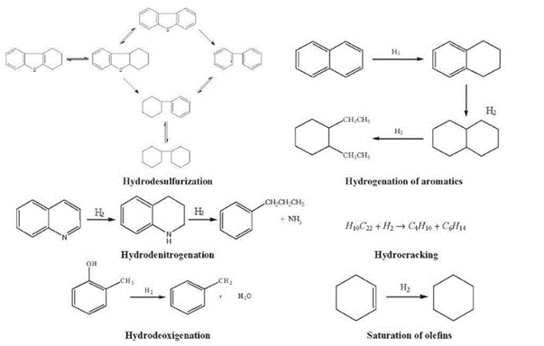
Why Contamination Occurs – Advanced Refining Process
Strict specifications and goal to produce as much fuel at lowest cost creates unstable fuel
Mostly distillation < 2006
More catalysts introduced after 2006
Hydrocracking / hydrodesulfurization

Slide 7
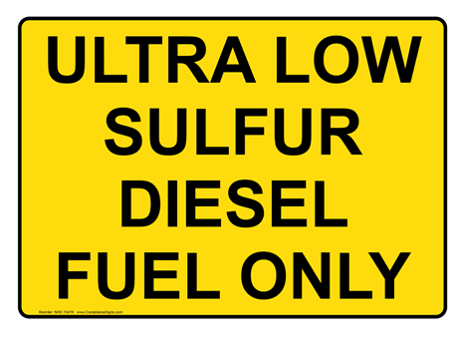
2006 EPA Clean Air Act: Required sulfur in diesel fuel to be reduced to from 5000ppm to15ppm.
Contamination Occurs - ULSD
Hydrodesulfurization removes chemistry essential to preventing microorganism growth.

Slide 8
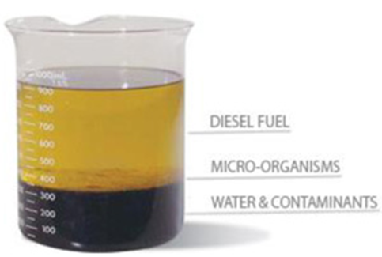
Why Contamination Occurs – Water Intrusion
Not a new issue, but a new problem
Low sulfur and unstable fuel creates environment for microbial contamination and quick degradation
Microbes degrade fuel quality, advance tank and advance corrosion

Slide 9
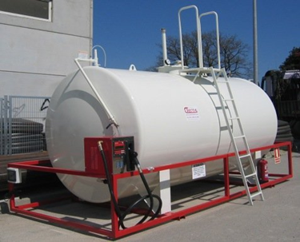
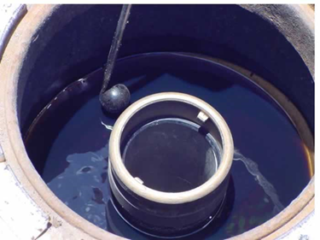
Water Intrusion – How?
More Water in Fuel from the Refinery
Condensation Formed on Tank Walls
Tank Vents, Expose Fuel to Humidity & Water Absorption
Water from Fuel Distributor Tanker
Spill Buckets Full of Water

Slide 10
Why Contamination Occurs – Introduction of Biodiesel
Most common biodiesel concentrations are B2, B5, & B20
Biodiesel has a higher lubricity rating than straight diesel but contains less energy
Biodiesel has one-fourth the shelf life than straight diesel has, and it is more susceptible to microbial growth
Biodiesel tends to gel at higher temperatures than straight diesel
Biodiesel chemistry bonds easily with water

Slide 11
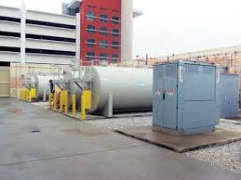
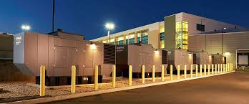
Diesel Contamination in Generators - Effects
Ongoing fuel quality management is essential to ensuring operations aren’t impacted by contamination
Why Contamination Occurs
Effects of Contamination
Best Practices: Remediation & Prevention

Slide 12
Diesel Contamination - Effects on Engines
Fuel Filter Plugging
Combustion Chamber Deposits
Lacquering of Injection System Components & Valves
Excessive Soot Accumulation in DP Filters
Reduced Engine Power
Greater Engine Wear due to Particulate
Reduced Fuel Economy
80%
Related to Poor Fuel Quality
Critical System Power Failure

Slide 13
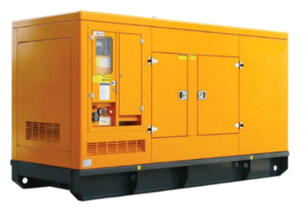
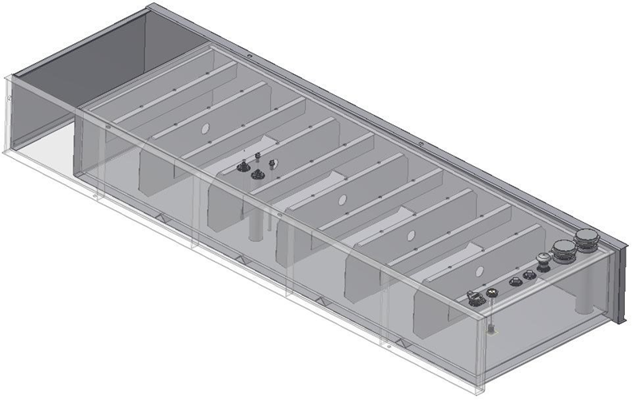
Diesel Contamination - Effects
Sub-base Fuel Tank
(Interior Construction Features)
Low Fuel Turnover
Limited Access

Slide 14
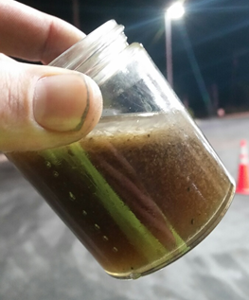
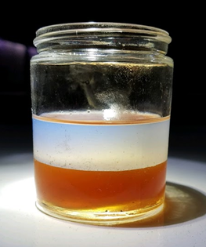
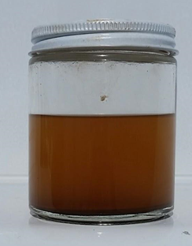
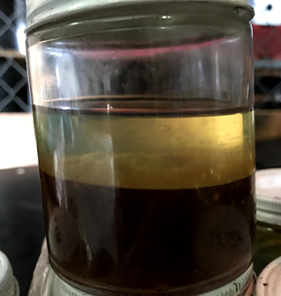
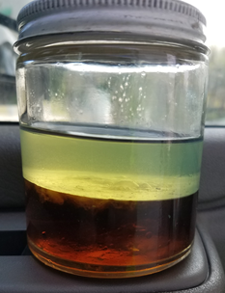
Why Contamination Occurs – Water Intrusion
Examples of what we see in the field…

Slide 15
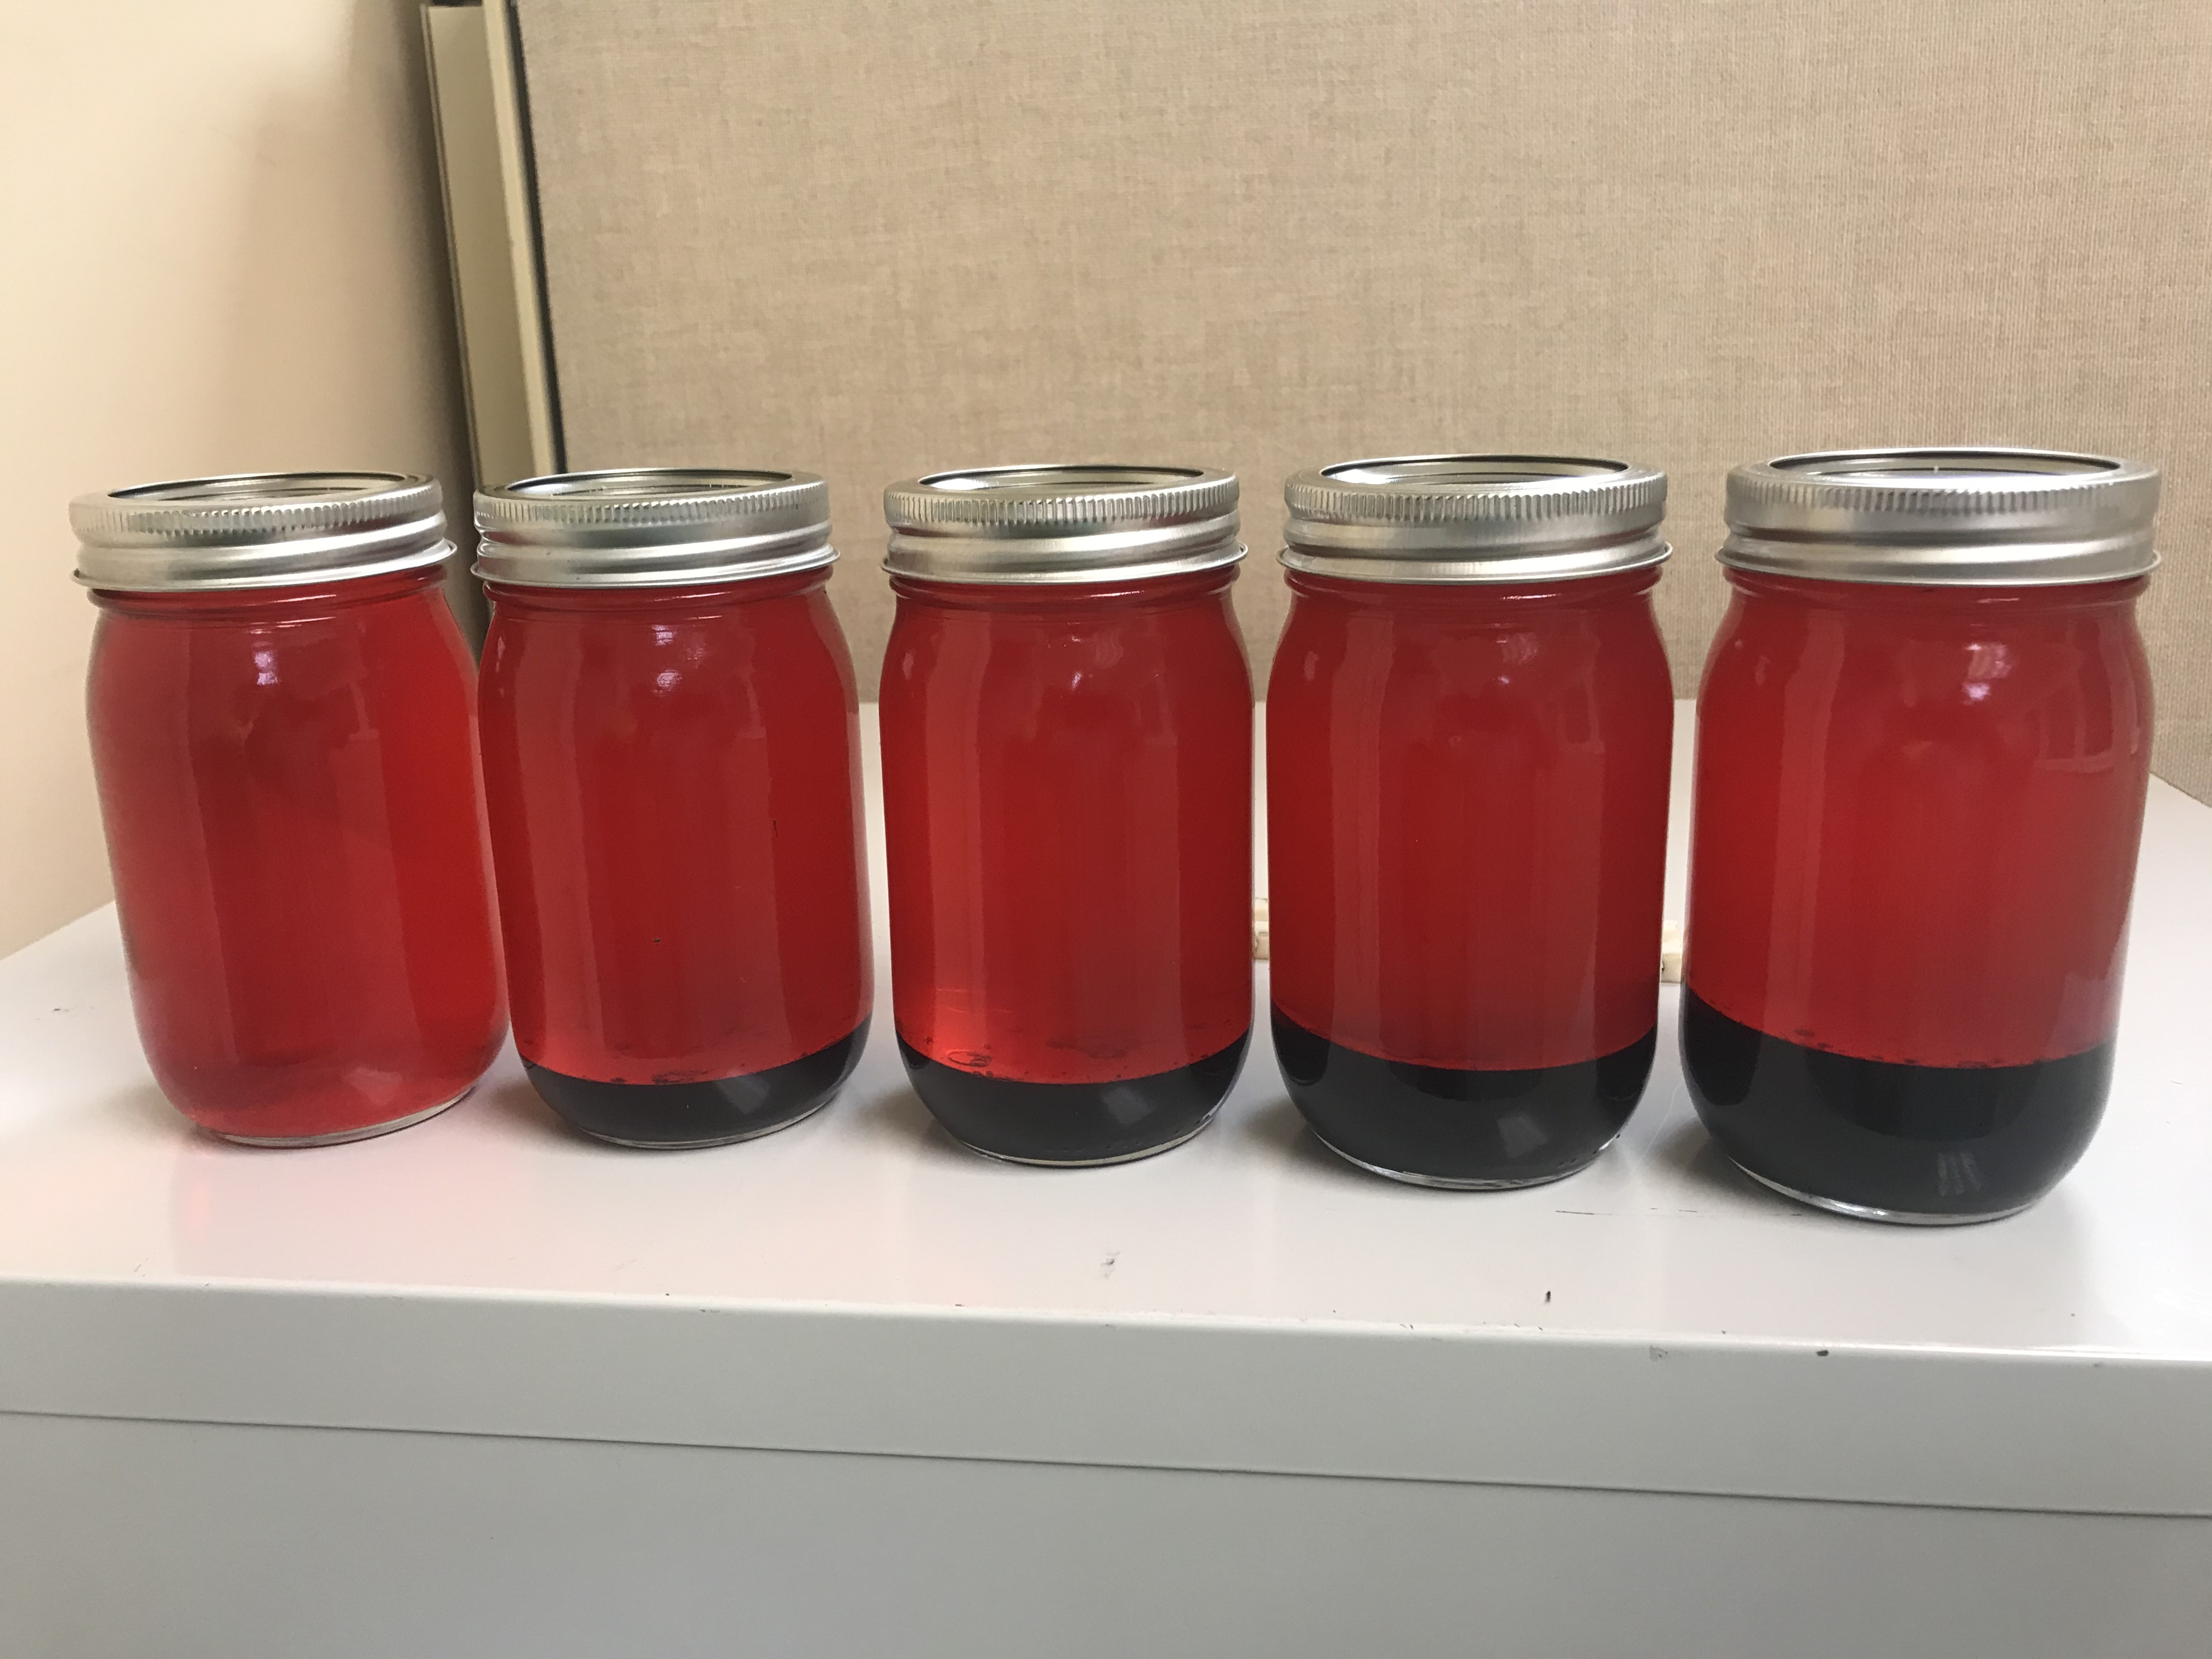
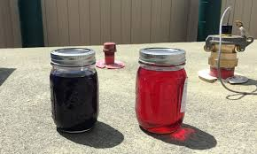

Slide 16
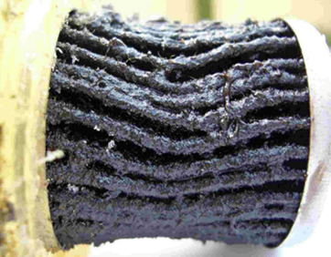
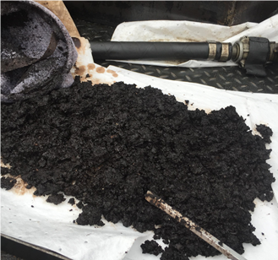
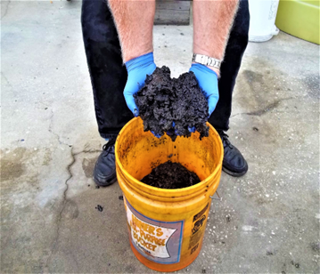
Diesel Contamination - Effects
Plugged fuel filter caused by
bio-mass & microbe excreted waste
Asphaltenes removed from tank bottoms developed due to unstable fuel

Slide 17
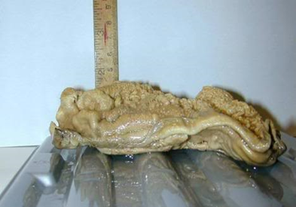
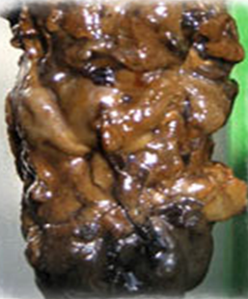
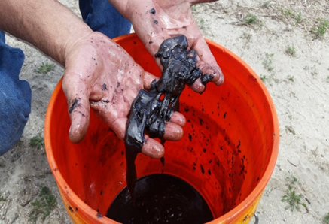
Diesel Contamination - Effects
Biomass: Microbes can multiply from one cell to 246,000 in six hours
Microbes can come from the air, moisture or during tank filling

Slide 18
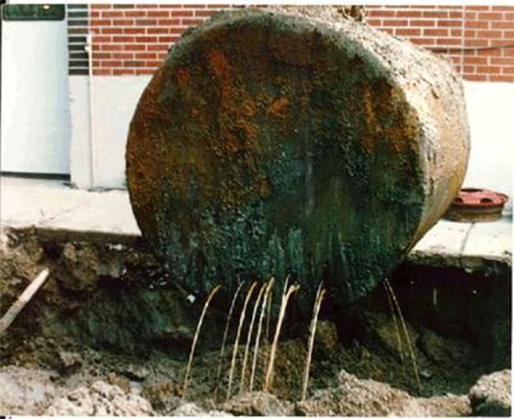
Diesel Contamination - Effects
Bacteria excrete acids that can corrode metal parts
Fuel tanks, pipes, injectors, injector pumps & fuel lines can be severely damaged

Slide 19
Diesel Contamination – Best Practices
Three Components of Managing Fuel Quality
1. In-field Sampling & Testing
2. Chemical Treatment
3. Mechanical Tank Cleaning & Fuel Filtration

Slide 20
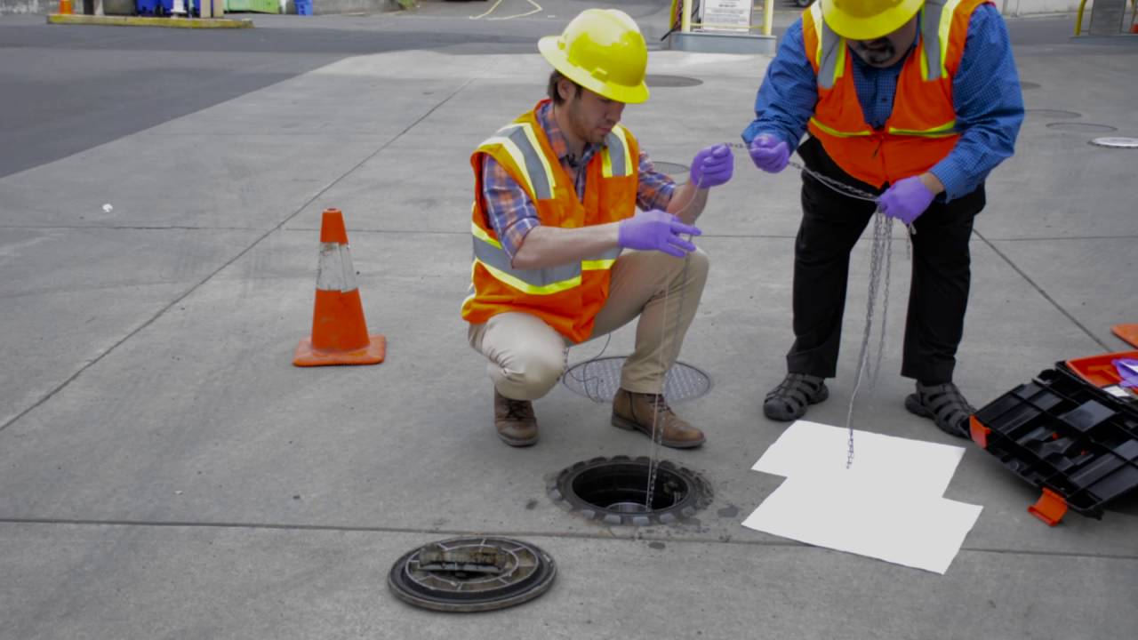
Diesel Contamination – Best Practices
Sampling & Testing
Notes:
DAN -

Slide 21
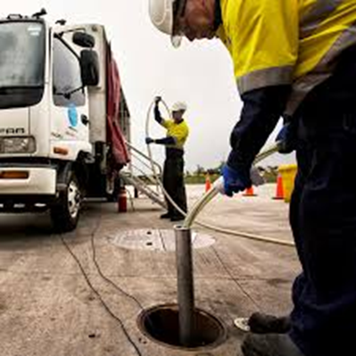
Condition Monitoring & Sampling - Mythologies
Sampling practices
ASTM D4057 vs. D7464
Bottom and 3-phase samples
Proper handling of instruments
Sterilization between samples
Temperature Control
Time Sensitive Testing
Notes:
Dan -

Slide 22
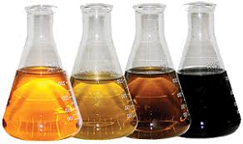
Suggested “Mission Critical” Testing Criteria
Testing Consists Of…
D86 Distillation
D93 Flash Point
D130 Copper Strip Corrosion
D287/D4052 API Gravity
D976 Cetane Index
D2709 Water & Sediment
D6304/D7546 Water by Karl Fischer
D2622/D5453/D7035 Sulfur Content
Notes:
Dan -

Slide 23
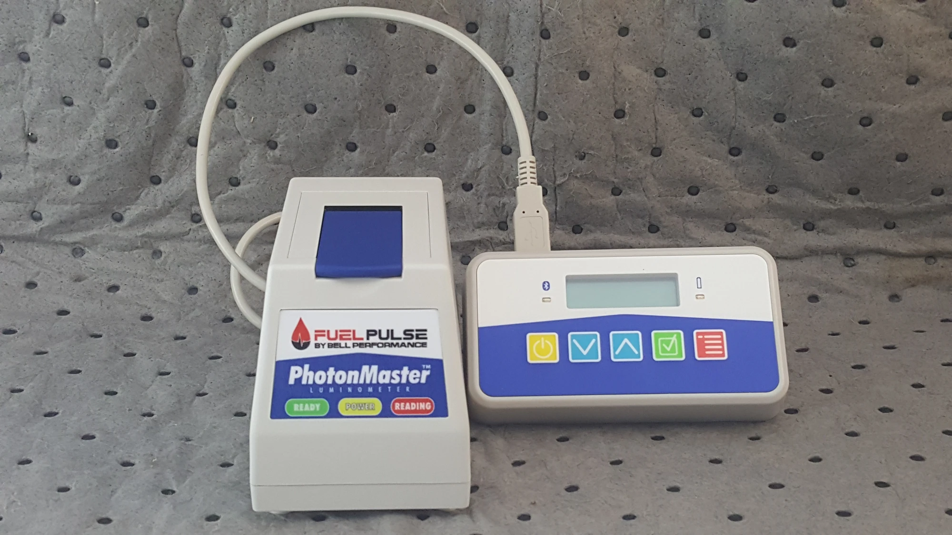
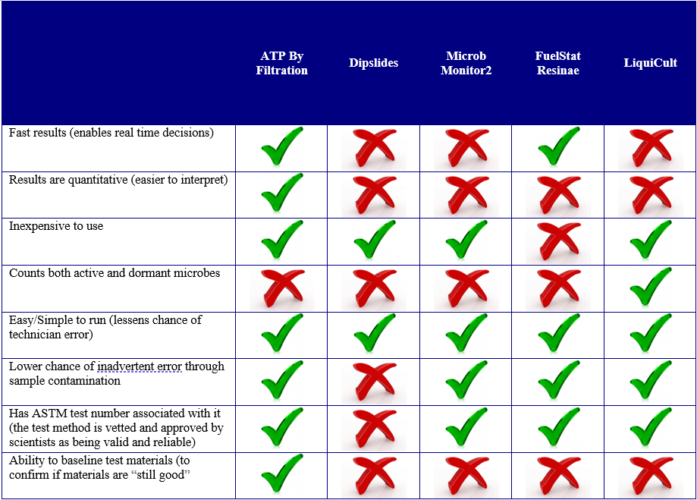
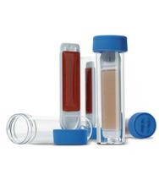
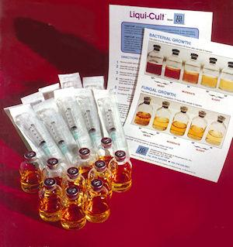
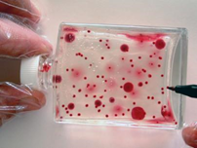
Other Testing Methods
Notes:
Dan -

Slide 24
Chemical Solutions
Notes:
Bill one of the three components of fuel maintenance Chemical application

Slide 25
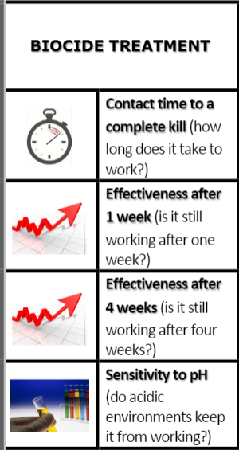
Bellicide Biocide
Choosing the right biocide is important. Solving bacteria and fungus problems is serious business. It’s important to make the right decision.

Slide 26
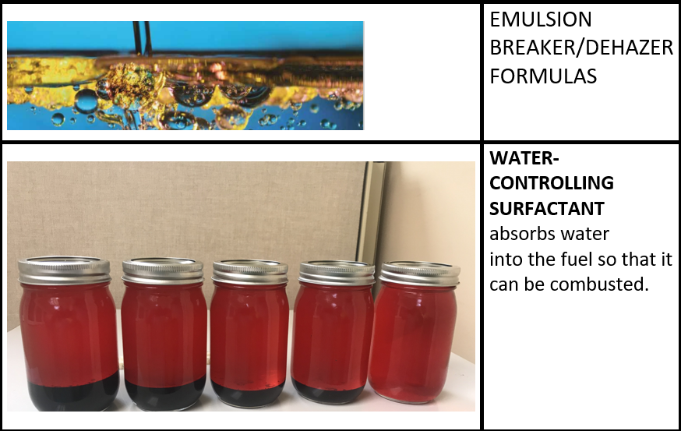
DFS Plus and Demulsified EB Water Control Chemistry

Slide 27
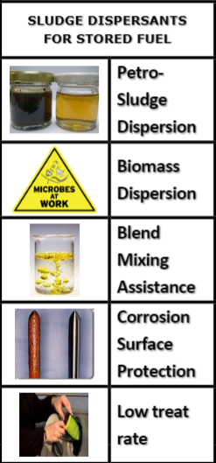
Bell SDF
Sludge Dispersant
Sludge dispersants are an important tool for the health of your stored fuels.

Slide 28
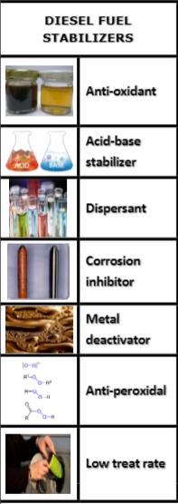
Dee Zol Life & Bio Dee-Zol Life Stabilizer
Fuel stabilizers are essential for stored fuel health. When it comes to stability improvers for diesel fuels, there are lots of options to consider.
Notes:
Bill

Slide 29
Additional Chemical Solutions
Cold Flow Improver
Super - Tane
Dee-Zol
Bio Dee Zol
Ethanol Defense
Notes:
Bill

Slide 30
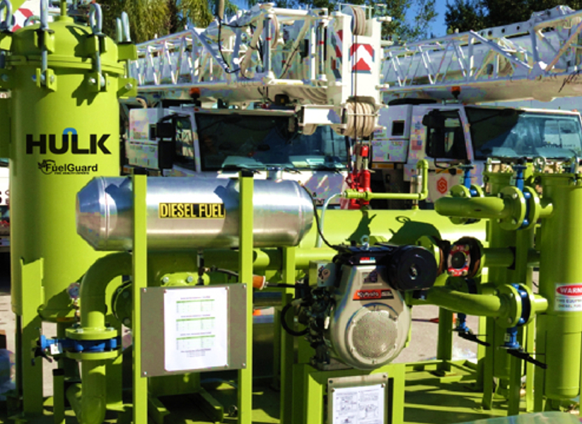
Mechanical Remediation
Sweep / Chemically Treat / Aerate
Full Filtration
Phase Separation
Notes:
Bill

Slide 31
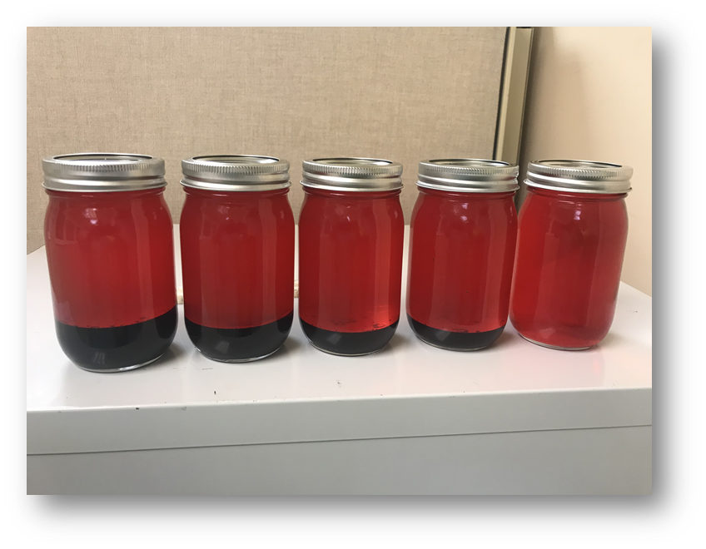
Real World Examples
Sweep Treat Aerate
Notes:
James

Slide 32
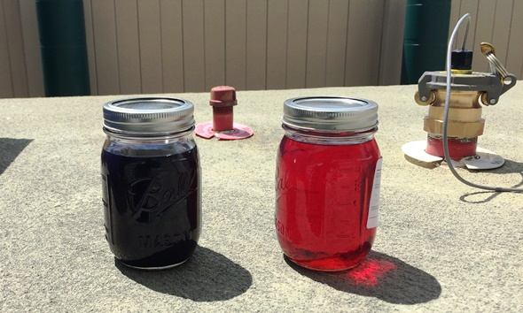
Real World Examples
Full Filtration
Notes:
James

Slide 33
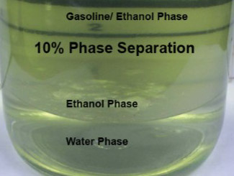
Real World Examples
Phase Separation
Notes:
James

Slide 34
Thank You For Your Time
Questions?
Bill Diver
Email: bdiver@bellperformance.net
Phone: 407-831-5021

