Slide 1
TANK CORROSION &
BELL TANK TREATMENT SDF
Sales Meeting Training – February 2017
Notes:
In our training today, we’re going to talk about fuel storage tank corrosion and Tank Treatment SDF. You may remember the training we had in Q4 of last year where we review the 2016 report from the EPA on diesel tank corrosion. That report was very important but it also raised some questions that, as a sales team, it might be useful for us to revisit in a little more depth.
Q. What do you remember about what the EPA study told us?

Slide 2
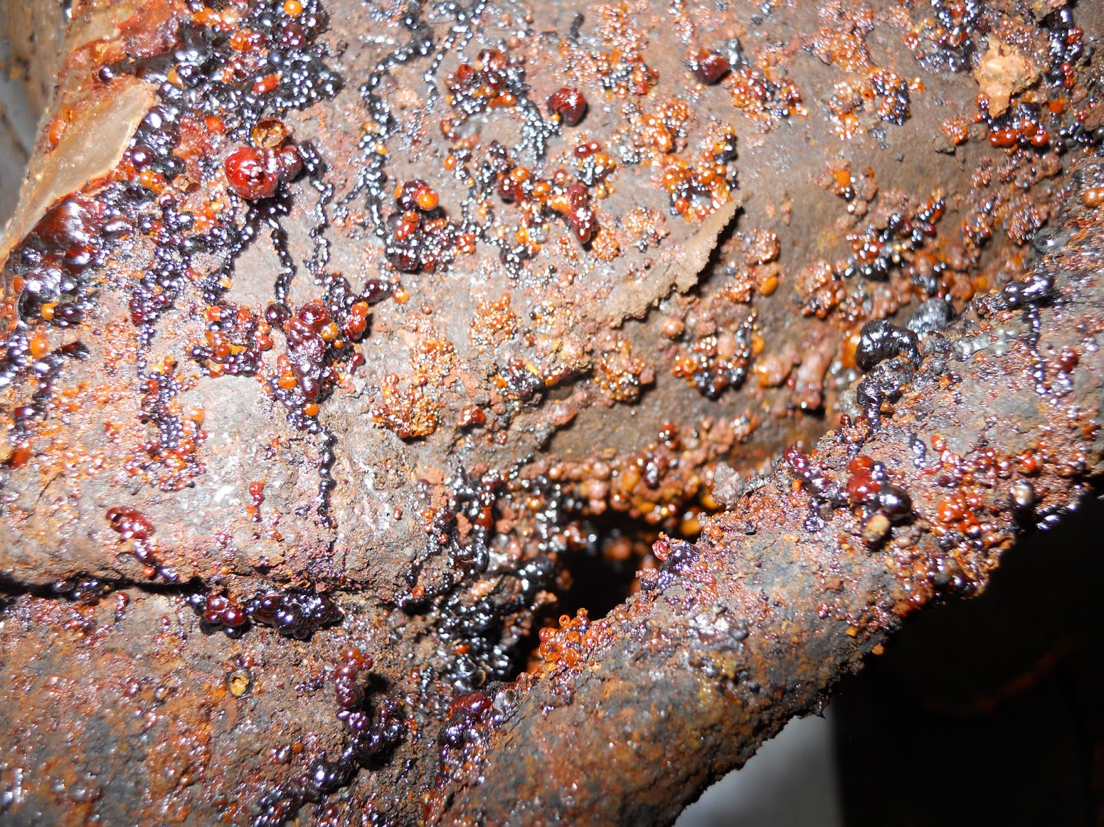
What We Will Cover Today
Review of Results of the EPA Study on Tank Corrosion
Factors That Influence Corrosion
How Corrosion Happens
Liquid Corrosion Inhibitors
Sales Points for Tank Treatment SDF
Notes:
So we’ll start with a review of what’s been done already.
How the EPA studied the issue and what they found
Types of storage tank corrosion addressed by the EPA study
The difference factors that influence corrosion in storage tanks
How corrosion happens
Liquid corrosion inhibitors and how they work
Sales points for Tank Treatment SDF

Slide 3
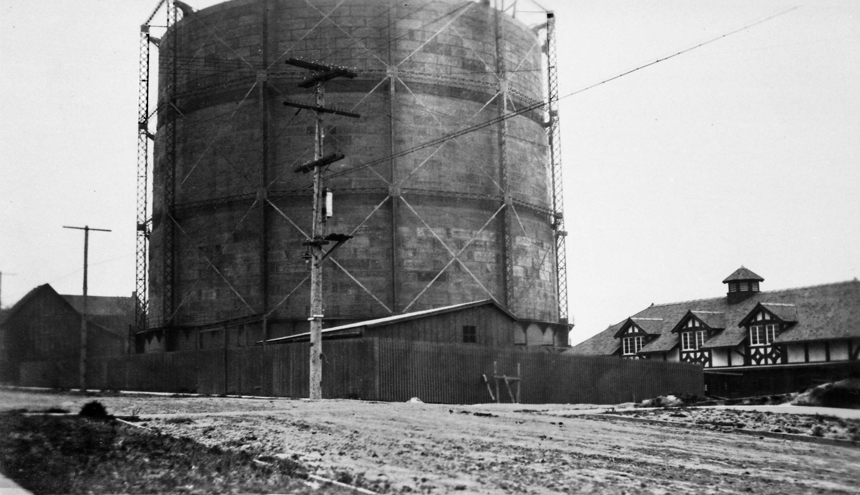
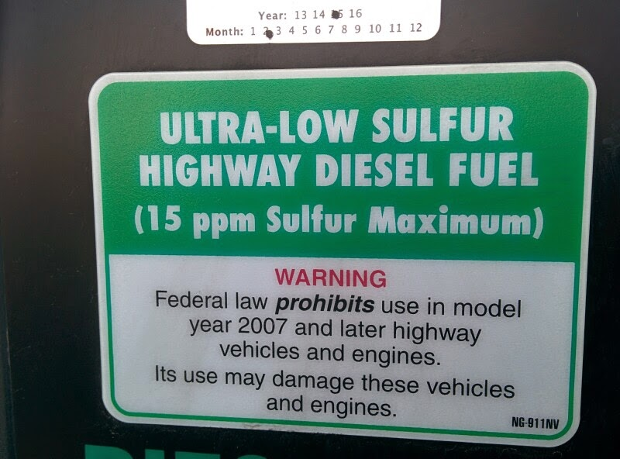
The Past Situation
Pre-2007: Tank Corrosion Not Considered a Huge Problem
Vapor-Space Corrosion Reports (2007)
Changes To The Fuel: Consequences of ULSD
Sulfur Removal
Reduced aromatic & olefin content – MORE MICROBIAL GROWTH
Increased Saturates – MORE MICROBIAL GROWTH
Higher Free/Dissolved Water – MORE MICROBIAL GROWTH
Notes:
During the last training, we noted that for a long time, tank corrosion was only considered a minor issue.
When it did happen, it only happened below the fuel line, in the wetted portion of the storage tank.
You get to around 1984, the EPA starts including corrosion control rules for underground storage tanks.
2007 is when things really start to change…..
This started changing in 2007 when reports started coming in of vapor space corrosion of metal components above the fuel line. This was a key change. Now corrosion was being seen above the fuel line.
2007 was also about the time that there were some major changes in the nation’s fuel supply. These changes had some wide-ranging consequences when it came to stored fuels, specifically, how microbes interact with them.
Changes in ULSD had certain consequences. We are well familiar with the big change concerning sulfur, but there were other additional changes in the fuel that had a direct impact on the fuel’s level of interaction with microbes.
We know what effect sulfur had (explain “natural biocide”)
Reduction in aromatic and olefin content leads to more microbial growth b/c aromatic and phenolic compounds are growth inhibitors
Increased saturates (single-bonded) leads to more microbial growth b/c microbes prefer saturates as a food source
Increased free/dissolve water increases microbial activity b/c it increases the free water availability

Slide 4

Previous Corrosion Studies
2012 – Clean Diesel Fuel Initiative
Microbes & acid production
2013 – Association of State & Territorial Solid Waste Management Officials
Specific effects from ethanol storage on fiberglass
Notes:
As we reviewed in the last training, this led to a couple of small studies in the years following, including the 2012 study commissioned by the CDFI (Clean Diesel Fuel Initiative) and a 2013 study by the Association of State and Territorial Solid Waste Management Officials, both of which observed significant instances of tank corrosion and damage.
The CDFI study looked at six systems and found evidence in them to support certain hypotheses regarding the relationship between microbes, different kinds of fuels, and corrosion.
The Waste Management study looked at 22 cases of tank corrosion, of which 10 were in storage tanks that held biofuels. The most interesting thing to come out of that was that 9 of the 10 were fiberglass tanks that had been attacked by stored ethanol fuel, resulting in damage manifested as cracks, blisters and delamination of the inside tank surface.
This research eventually led, in 2015, to the EPA conducting the largest study to date on the issue of diesel tank corrosion.

Slide 5

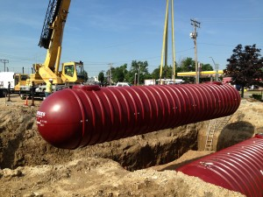
2015 EPA Study Characteristics
42 USTs studied across the country
Metal & fiberglass
Visual in-tank inspections
Analysis of fuel, water and vapor samples
Aiming to better understand the corrosion problem & its potential consequences
Notes:
They studied 42 underground storage tank systems distributed across the country. Contained both metal and fiberglass storage tanks. They used in-tank cameras to visually inspect levels of corrosion they could observe in storage tanks. They also noted the places in the tanks and the specific kinds of tank equipment and components where the corrosion could be observed.
Beyond observation, they also took material samples of the fuel in the tank, the water bottoms (if they could) and the vapor in the vapor space, testing the composition and characteristics of these samples to see if anything stood out that might be a causal or contributing link to the problem.
They (the EPA) had three primary aims:
To understand how serious the corrosion problem might be
Identify predictive factors between tanks with corrosion and tanks that did not have a problem
Develop a better understanding of the potential risks to both the environment and to human health that this evolving corrosion problem in diesel tanks might pose

Slide 6

Key Findings of the EPA Study
General Findings
Majority of tanks with at least substantial corrosion
Not many tank owners knew they had a problem
Metal & fiberglass tanks have equal problems
Details from Sample Composition
Presence of gasoline, biodiesel, ethanol
Glycerol
Notes:
The EPA study yielded a lot of valuable information, both in the scope of the general incidence of corrosion that could be derived from the results, but then also concerning the characteristics of the corrosion they found (which is what they were hoping to shed more light on).
They wanted better answers to the questions of…..How serious potentially is the corrosion problem nationwide, and is there any evidence that points to any specific thing or combination of things that might be causing it?
When the dust settled…..The findings of the EPA study in 2015-2016 confirmed some notable details, which we can review.
First, the general details:
The majority of tanks (80%) had at least some amount of substantial corrosion presence in them
Only 25% of the owners of these tanks knew they had an existing problem
Corrosion incidence was equally distributed between metal and fiberglass storage tanks
Second, details relating to the composition of the samples they took. When those samples were analyzed, a sizeable portion of either the fuel or the water bottom samples contained presence of the following:
Gasoline – analyzed through breakdown of the sizes of molecules. C4-C8 molecules present in the samples would indicate presence of gasoline.
Biodiesel – most of the fuel samples showed some level of biodiesel content. Which stands to reason since most onroad diesel fuel today contains some amount of biodiesel.
Ethanol - Analysis of fuel and water samples taken from the tanks showed ethanol presence, which infers the activity of acetobacters that metabolize the ethanol into acetic acid.
Glycerol - Their analysis also showed the presence of glycerol, a byproduct of which is also metabolized by other kinds of microbes into low-MC acids like glyceric.
Presence of any/all of these was hypothesized to be possible contributing factors to microbial activity in storage tanks that would lead to tank corrosion - due to microbial tendencies to metabolize them and produce acids as a result.

Slide 7
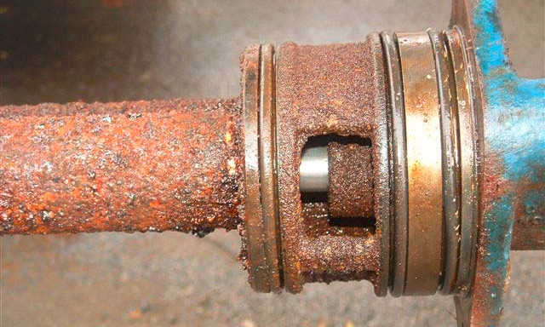
Key Findings of the EPA Study
Widespread acid presence across sample analysis
Acetic, glyceric, formic, lactic
Links to vapor-space corrosion
Other visually-observed corrosion characteristics
More corrosion higher in the tank
Corrosion observed across all kinds of equipment
Notes:
Analysis of the samples found widespread presence of certain kinds of acids - Acetic, glyceric, formic, lactic.
Q. Besides being “acidic”, what was a defining commonality between these?
A. They’re all low-MW acids whose presence can be detected in fuel and water samples such as the ones the EPA collected in this study. And they all were thought to contribute to the specific kind of corrosion – vapor space corrosion above the fuel line – that was observed universally in the EPA’s test subjects.
QUESTION FOR THE AUDIENCE: what is it about low-MW acids that makes them able to do this?
A. All of these low-MW acids are light enough that they can turn into vapor (volatilize), and the acidic vapor rises and settles on metal surfaces, causing corrosive damage over time.
Third, the study results yielded additional details relating to the characteristics of observed corrosion
The higher you went in the storage tank, the more corrosion was observed
Corrosion was seen on all kinds of equipment in the fuel tanks, (FORWARD TO NEXT SLIDE, THEN COME BACK)
Transition: And so from these results, the EPA made some recommendations for tank owners and operators to lessen the chances of having problems from tank corrosion.

Slide 8
Susceptible UST Elements
Notes:
Corrosion was observed on all types of metal components in the tank – turbine pump shafts (the most common place corrosion was observed), tank gauge probe shafts, flapper and ball valves, bungs, fuel suction tubes and the tank inner walls. The corrosion was most often describe as looking like layers of tubercles coating the metal surfaces of the equipment
Reports ranged from just localized pockets of corrosion in small areas to uniform coverage of metal surface by corrosion in the vapor space.

Slide 9
Characteristics of Storage Tank Corrosion
What influences whether corrosion happens in a storage tank?
What mechanisms does the corrosion process use?
How do the major influencers of tank corrosion - water, microbes – govern the process?
Why did the EPA recommend that tank owners use corrosion inhibitors along with biocides?
Notes:
Pursuant to the EPA’s recommendations (inspecting your tanks, partinering with a service provider, fixing damaged compionents, removing water), they really didn’t go into much detail on how exactly this kind of damage happened. We know the end results, but we don’t have that much of an understanding on HOW the contributors to corrosion actually do that. And that’s our second purpose here today.
What influences whether corrosion happens in a storage tank
How corrosion happens in a tank - the mechanisms
Some of the major influencers of tank corrosion, like water, microbes, even the kind of fuel being stored (how do microbes cause corrosion? It’s a little more complicated than just saying they make acid)
Why the EPA recommended that tank owners use corrosion inhibitors along with biocides
Obviously we know the corrosion in tanks is a problem. But what’s the difference between vapor space corrosion and traditional wetted corrosion? We know about microbes, but not all microbes are the same.
The more we know about the details, the more authoritative we are and the better case we are able to make for some of the things that we have which the EPA also recommends for use in preventing this problem.

Slide 10

Things That Influence Tank Corrosion – Biodiesel Presence
Biodiesel presence detected across most samples
Stored fuel health impacted through biodiesel affinity for water
Water’s effect on FAME molecules
Salt, soap and peroxide formations leading to microbial activity
Notes:
Recall that the fuel samples in the EPA study showed presence of biodiesel. And we know that widespread addition of biodiesel to the nation’s diesel fuel supply has been one of the major changes we’ve seen, a change which has impacted how stored fuels behave in storage.
Specifically, biodiesel presence impacts stored fuel health because of its interaction with water and other things. Biodiesel leads to higher incidences of fuel system corrosion because of its affinity for water, higher susceptibility to microbes and increased solvency on pre-existing deposits.
If biodiesel is present, water has a greater effect on the fuel blend.
Dissolved water in biodiesel will hydrate FAME molecules, which changes their properties and leads to hydrolysis of the biodiesel. The molecule breaks apart, leading to further reactions forming salts, soaps and peroxides, all of which have been shown to increase microbial activity.
NOTE that Sodium levels exceeding 0.1% in tank water bottom samples are linked to corrosion and soap formation, which happens when acidic components combine with sodium and other cations to form soaps. These soaps lessen the overall effectiveness of the fuel’s corrosion inhibitors if they form from breakdown of those.

Slide 11
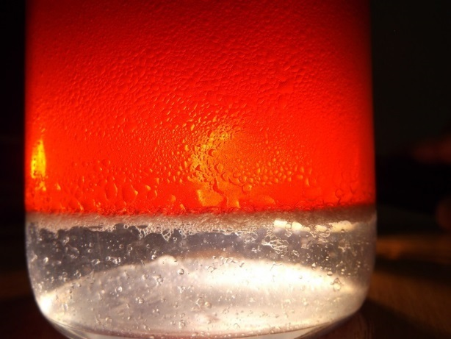
Things That Influence Tank Corrosion – Water Issues
EPA best practice recommendation – regular monitoring and removal of water levels
Microbes need access to water to grow
How much water can be a problem?
Notes:
Speaking of water, that’s the big one we need to understand as much as we can on. One of the EPA’s best practice recommendations for tank owners was to monitor water levels regularly and get rid of it as much as possible.
It’s well known that microbes need access to water in order to grow. And there are some things about water that we need to more fully understand if we’re going to give the best recommendations and implement the most effective processes for our customers.
How Much Water Can Be A Problem?
Less than 0.25 inches of water is more than sufficient to promote microbial growth.
For water finding paste readings, if the test shows 1 inch or more, make arrangements for the water’s immediate removal. If it is 2 inches or more, they recommend not selling the product to customers until the water has been removed.

Slide 12
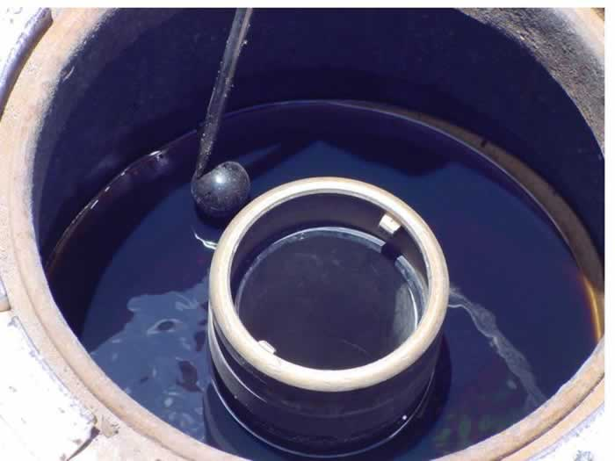
Water Presence in Storage Tanks & Distribution Systems
Ways that water can enter fuel systems
Damaged fill boxes or fill cap gaskets
During transportation from refineries
Loose fittings or plugs
Spill buckets & tank sumps
Tank orifices that aren’t tight
Condensation
What about high volume fuel distribution systems?
Notes:
Ways water can enter the system
Damaged fill boxes or fill cap gaskets
During transportation from refineries to service stations
Loose fittings or plugs
Spill buckets
Rainwater in tank sumps
Tank orifices that aren’t tight
Condensation
AUDIENCE QUESTION: What about high volume fuel distribution systems? Do they experience water problems?
Yes, they certainly can (which is in opposition to conventional logic that these systems move fuel too quickly for water to be a problem).
Fuel systems that have high throughput (fuel gets turned quickly) are more likely to have water in them because there’s less time for the water to settle out.
Water can build up in distribution because the fuel is warmer as it passes through the refining and distribution arms of the system. It dissolves more water at this time, but is cooler when it reaches the end user, and the water falls out (could be an audience question?)

Slide 13
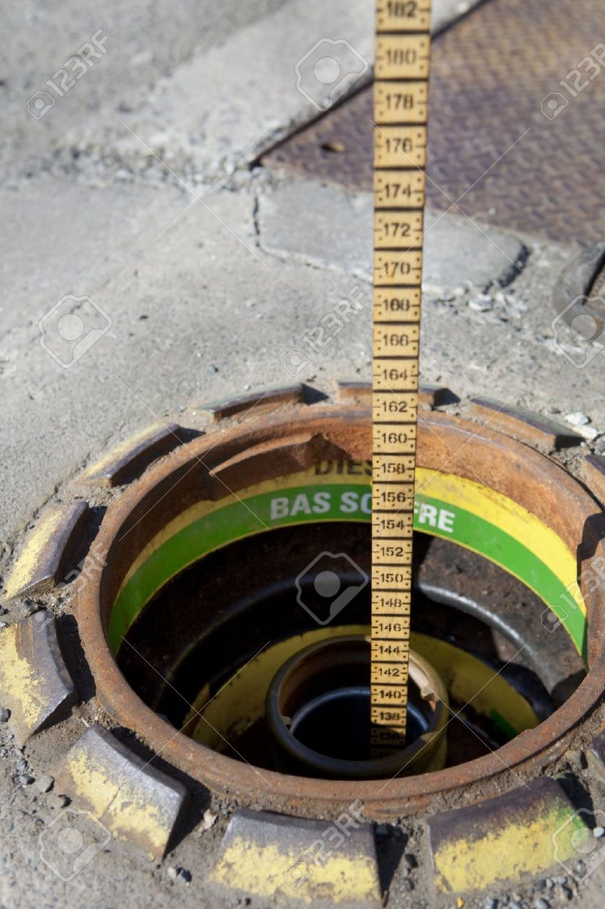
Removing Water Is Important
Proper sample, proper monitoring, proper removal
Checking for water frequently
Tank sampling
Pull from low end of the tank, take samples from multiple locations
Be wary of using fill tube as sampling port
Water removal is critical, but you can never get 100%
Notes:
Removing Water Is Important
So the EPA recommends monitoring and staying on top of water levels in storage tanks as an essential measure to minimizing corrosion problems.
Staying on top of water problems means proper sampling, proper monitoring, and then proper removal.
Tank owners should check for water as frequently as possible, at a minimum, after each fuel delivery.
Automatic tank gauging (ATG) systems are good, as long as the sensors are maintained to be functional. You should compare the ATG readings with a manual tank gauge.
Guidelines for sampling the tank
Pull from the low end of the tank (many tanks are installed with a slight slight to allow water to run to the low point)
Be wary of using the fill tube as the sampling port if it is not located at the low end of the tank. Also be careful if the tube is not installed straight, which can skew the amount of water or sludge detected.
The best place to sample a tank may be under the submersible turbine pump
Take samples from more than one location, if possible. Many tanks have two openings at different ends for inspection and sampling purposes.
For water removal, even though the EPA and the industry both agree that water removal is ciritical, they also acknowledge that water removal is known never to be 100% effective because of:
Flat and convex bottoms of ASTs that retain water after draining
Most USTs are installed level but settle and tilt over time
Diurnal breathing introduces moisture
So it’s important to get as much out as you can, but you have to have the reasonable expectation that you, as a storage tank operator, are not going to be able to get 100% of the water out.
Transition: Of course, the primary purpose of controlling free water content in the storage tank is that you don’t have microbe problems. Microbes don’t require much water to grow. Being 0.5 to 3 microns in size, they are less than 1/1000th the size of a 3 mm film of water. Therefore, it only takes something like a small spot of condensation on a tank wall to support growth.

Slide 14
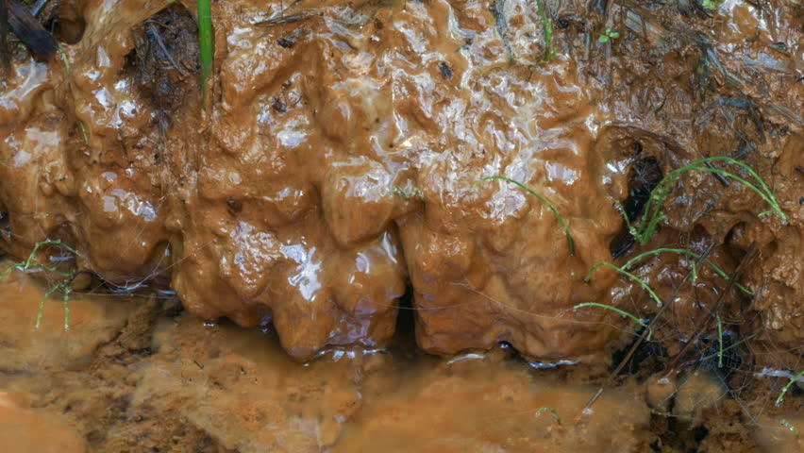
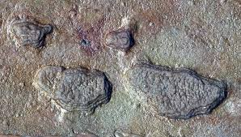
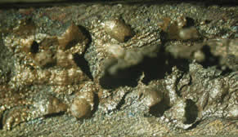
Microbes in Fuel & Storage Tanks
Different types of microbes that contribute to tank corrosion
Aerobic bacteria – slime-forming
Anaerobic bacteria – grow in absence of oxygen
Sulfate-reducing bacteria (SRBs) – metabolize molecular oxygen and produce H2S
Notes:
Types of Microbes (and what they do)
There are different kinds of microbes that contribute to tank corrosion. What are the different classes or categories of microbes that play a role in storage tank corrosion?
Aerobic bacteria are the ones that form slime (extra-cellular polysaccharide capsules). They require a source of free oxygen to grow, so they grow in the presence of oxygen.
Anaerobic bacteria live at the fuel-water interface away from the oxygen. They metabolize oxygen from compounds instead of using dissolved oxygen in the water phase. They grow only in the complete absence of free oxygen.
SRBs – Sulfate-reduce bacteria. If there are sulfates present, certain kinds of anaerobic bacteria will use the oxygen contained therein, which changes the sulfates into Hydrogen Sulfide H2S. H2S acts in an extremely acidic manner. Sulfate-reducing Archaea are other microbes, similar to SRBs, that obtains their lifecycle energy by consuming organic compounds while reducing sulfate compounds to sulfides like H2S. In this manner, they contribute to corrosion of iron and steel in these systems.
So anaerobic bacteria tend to be responsible for tank corrosion that happens below the fuel line.

Slide 15
What Else Do Microbes Do?
Establish Biofilm communities
Production of Biosurfactants leading to inverted emulsions
Increasing water content in tank sludge
Notes:
Microbes establish communities called Biofilms, which are layers of microbes that multiply at phase interfaces. They accumulate both at the water-fuel interface but also on tank walls and surfaces, including above the liquid surface. A 1=mm thickness of biofilm is 100-1000 times the longest diameter of fungi and bacteria.
Interestingly, some these microbes can also live in the tank bottom water, and they will produce biosurfactants that generate inverted emulsions of water in the fuel. This distributes water into the fuel phase and makes fuel molecules more readily available for microbes to use as a food source.
Microbial activity that degrades HCs increases the water content in tank sludge, which can exceed 10%.

Slide 16
Signs of Microbial Activity & Growth in Fuel Systems
Problem | Principal types of microorganisms
Blockage of pipes, valves, filters, incorrect fuel probe readings Increased water content Sludge formation Surfactant production, causing oil/water emulsification, entry of cells into the oil phase and coalescer malfunction Corrosion of storage tanks and lines Production of suspended solids in the fuel Breakdown of hydrocarbons Shortened filter life (< 6 months) Fouling of injectors Increased sulfur content of fuel Shortened life of engine parts Penetration of protective tank linings | Fungi; polymer-producing bacteria All All Fungi and aerobic bacteria Fungi and anaerobic bacteria All Fungi and aerobic bacteria All Aerobic bacteria and fungi SRB Undetermined Fungi

Slide 17
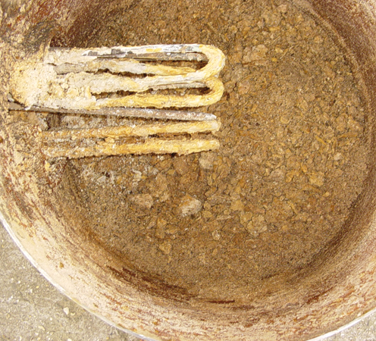
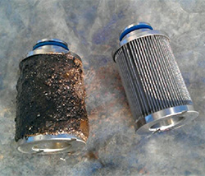
Certain Deposits May Indicate Microbial Activity
Solid & semi-solid contaminants – MICROBIAL ACTIVITY
Black, Brown, Semi-Solid contaminants – FUEL DEGRADATION
Non-Uniform or Leopard Spotting of Water Coalescers – MICROBIAL ACTIVITY
Notes:
The presence of certain kinds of deposits in samples can also be a sign of microbial activity.
Solid and semi-solid contaminants – scaly, gritty deposits which may be reddish-orange material may be indicative of corrosion in the tank, which is typically indicative of microbial activity (it’s only rust).
Black or brown or semi-solid deposits can indicate fuel degradation.
Non-uniform or leopard spotting of a water coalescing filter is indicative of microbes.

Slide 18
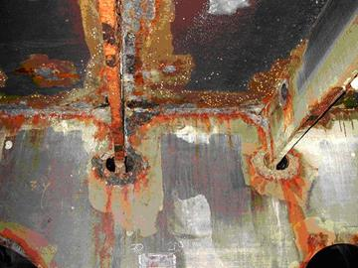
How Tank Corrosion Happens – Mechanisms for Corrosion
Role of water & oxygen
Movement of oxygen from high to low concentration
Localization of high O2 concentration = localized corrosion
Influence of temperature and other factors
Notes:
Since we assume that microbes play a key causative role in tank corrosion, we need to understand how it happens. Which means we need to look at the role of water, oxygen and acids in the corrosion process, as well as the phenomenon of biofilms and galvanic corrosion.
The Role of Water and Oxygen
Someone tells you that removing water is important and you reason that it’s because microbes need it to multiply. But water contributes to corrosion below the fuel line in at least one other essential way.
Oxygen is more soluble in hydrocarbons than it is in water, by 60 ppm vs. 8 ppm. So what happens is that, if you have a free water layer (a water phase), oxygen diffuses or moves from the fuel into the water phase. As this happens, you can get localized areas of high oxygen concentration on the metal surface, which results in localized corrosion and metal loss.
This can also be sped up by temperature, CO2, H2S presence, presence of acids and salts like sodium chloride and calcium chloride.

Slide 19
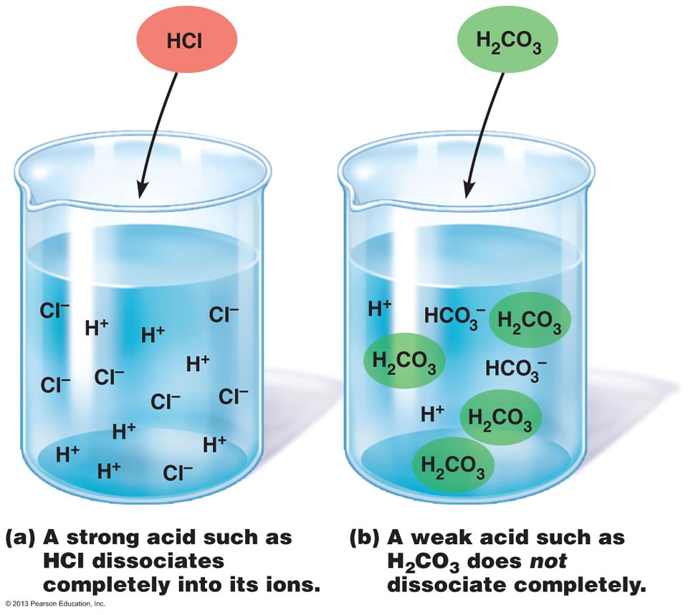
The Role of Acids in Tank Corrosion
Acid-producing Bacteria & Low-MW acid production
Conversion to strong inorganic acids
High-turnover rates = accelerated vapor space corrosion
Localized CO2 production by microbes
Notes:
The 2012 Battelle and 2016 EPA studies seemed to confirm that acids play a role in tank corrosion both above and below the fuel line:
Acid-Producing Bacteria (APB) usually produce short-chain fatty acids, also known as low-MW acids – acetic, formic, lactic. Not only do these contribute to vapor-space corrosion, but they themselves provide nutrients for SRBs to grow.
These Low-MW organic acids are not as aggressive as strong inorganic acids, but will readily react with anions like chloride/sulfate/nitrate to produce strong inorganic acids like sulfuric and nitric. These will cause corrosion and degrade fuel quality.
Other bacterial species actually produce aggressive inorganic acids like sulfuric in aerobic environments (above the wetted line).
With respect to tanks that have high-turnover fuel, this can make vapor-space corrosion worse because tank refilling replenishes the vapor area with water and HC vapors.
Also, microbes also produce localized high concentrations of CO2, which dissolves in water and produces carbonic acid, which is highly corrosive to steel.

Slide 20
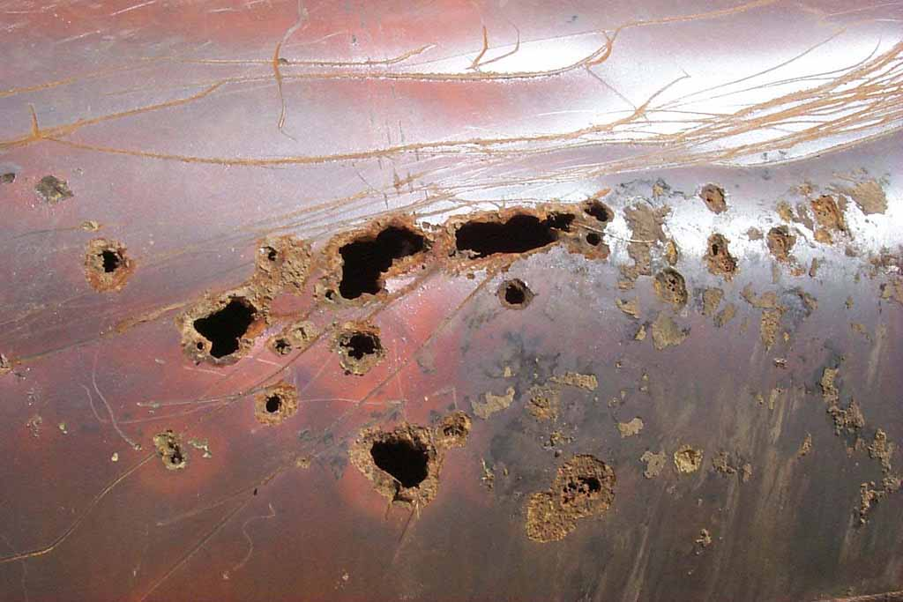
BioFilms & Galvanic Corrosion
Wetted area corrosion below the fuel line: Galvanic-couple formation between steel & iron sulfides
Presence of SRB microbes enables accelerate corrosion to continue
BioFilms lead to electro-potential gradient formation, leading to galvanic corrosion
Notes:
Explaining how tank corrosion happens above the fuel line is pretty simple. Vapor space corrosion happens when light weight acids become vapor and drift upwards onto the metal surfaces in the vapor space.
But what about below the fuel line? The tank areas that, until 2007, were the only areas where tank corrosion was seen? The mechanisms for this wetted corrosion are a little more complicated. But they can make us sound realllllly smart if we can explain them.
The most prevalent mechanism for observed tank corrosion in the wetted area involves formation of a galvanic couple between the tank steel and microbe-produced iron sulfides. Normally, if such a couple is established, it doesn’t last long because the iron sulfide becomes too saturated with electrons. But when you have sulfate-reducing bacteria present, these SRBs remove electrons, enabling the accelerated corrosion reactions to continue.
Biofilm layers create electro-potential gradients between the covered and uncovered surfaces. This creates a difference in electrical potentials, leading to galvanic corrosion, which creates pinhole leaks in steel surfaces.

Slide 21
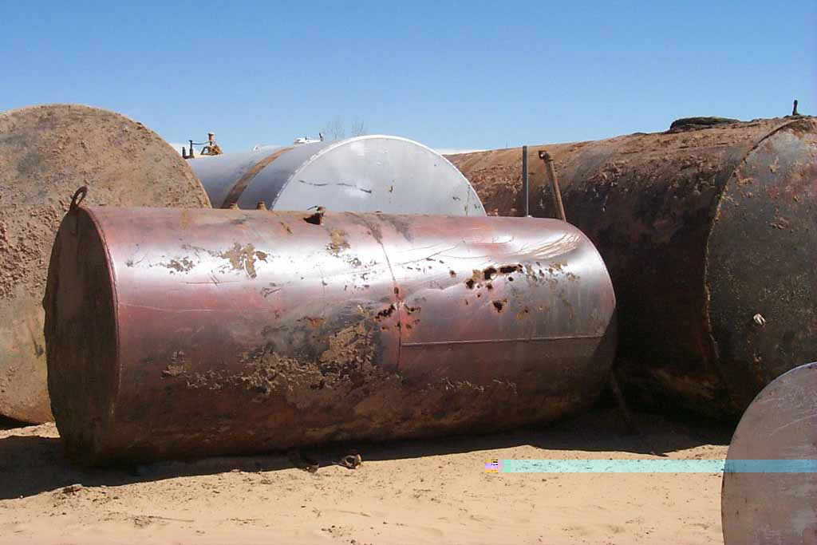
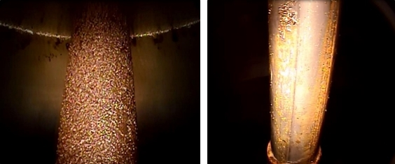
Rates of Corrosion Damage
How quickly can it happen?
1 to 250 mpy in the vapor space
Literature values:
0.5 mm per year on average for fuel oil
0.13 mm per year for gasoline
O2 concentrations accelerate corrosion rates by 70x (25 mpy)
Notes:
What does corrosive damage tend to look like? And how quickly can it happen?
Recall that in the 2016 EPA study, they noted that vapor-space corrosion most often looked like tubercles spread out over the affected surfaces. What about corrosion in other areas?
Microbially-induced corrosion (MIC) usually shows up as localized pitting or pinhole corrosion, at rates between 1 mpy and 250 mpy, at least in the vapor space.
The average literature value for corrosion rates below the wetted line are around 0.3 to 0.5 mm per year, for gas oil, diesel oil and fuel oil. Gasoline tanks have lower corrosion rates approaching 0.13 mm per year.
But it has also been noted that if you have localized higher concentrations of oxygen, it can speed up corrosion rates by up to 70x. Corrosion scenarios that normally would progress at rates of 0.3 mpy can be accelerated to 25 mpy due to this. This is where you can get, for example accelerated corrosion observed in tanks where a 1/8th inch 304 stainless steel plate was perforated in less than one month.

Slide 22
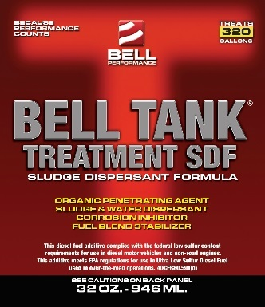
EPA Recommendation: Liquid Corrosion Inhibitors
Use of a liquid corrosion inhibitor additive (along with a biocide) to protect metal surfaces by providing barrier protection
Tank Treatment SDF
Corrosion protection for surfaces
Sludge dispersal
Biomass breakup
Notes:
Among its recommendations from the study, the EPA recommended that tank owners utilize liquid corrosion inhibitors in their stored fuel.
Such an inhibitor protects metal surfaces by laying down a barrier on surfaces that shields them from the action of corrosive agents in the fuel.
This is where we can offer Tank Treatment SDF.
Functions of Tank Treatment SDF
Disperses sludge
Break up biomass when it comes into contact with it, which means it works well when coupled with biocide use
Protects surfaces from corrosion
There are a couple other minor ones, but we don’t need to be concerned with them

Slide 23
The Importance of Mechanical Cleaning & Regular Treatment
Industry Best Practices: Cleaning of tank surfaces
Industry Best Practices: Regular chemical treatment
Notes:
Within the context of SDF’s use as a part of the FTS program, it should be noted that best practices within the industry dictate that Biocides need to be combined with mechanical or chemical cleaning programs to enhance their effectiveness, especially if biofilm is already present.
Deposits and biofilm should be removed so that chemicals can reach the metal surfaces. This speaks to the importance of the overall approach that FTS offers, removing tank sludge and biomass from surfaces in a mechanical process
Microbes can adapt to the effects of chemicals and even learn to metabolize them (question for the audience: why is regular treatment important?). So this speaks to the utility of regular chemical treatment with things like biocide and sludge dispersant (which can help answer the question of “can’t I just treat things one time?”

Slide 24
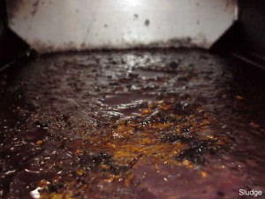
SDF Benefits: Sludge Absorption and Biomass Dispersal
Tank sludge can develop into a larger problem than many realize
Tank Treatment SDF removes sludge over time
Breaks up and disperses biomass into the fuel
Indirectly remediates vapor space corrosion by helping biocides improve efficacy
Notes:
Even trace levels of particulate generated can lead to significant accumulation of sludge over a finite period of time. A retail storage tank receiving 8,000 gallons weekly of fuel with 10 mg/L particulate content would generate 35 pounds per year of solids. A terminal receiving 60,000 barrels per week (2.4 million gallons) of 10 mg/L particulate would accrue more than 11,000 pounds of external solids.
Q: why is this a good thing?
A: because it gets rid of the sludge and enables it to be combusted by the fuel
Q: From a mileage standpoint, would fuel treated with SDF improve mileage or decrease it?
A: You might expect a small drop, because sludge dropout will not burn as completely as virgin fuel. How much of a drop has not been quantified.
Q: would you expect it to draw up 100% of the sludge?
A: you would expect it to draw up most of it, but not always 100%. That’s because sludge is actually a mixture of things, including asphaltenes, which may not always be as soluble as other sludge components.
SDF Benefit #2 – Biomass Dispersal
Breaks up biomass when it comes into contact with it. This enhances the efficacy of biocides that may be used alongside or after its use. Since microbes seem to be related to incidents of corrosion, SDF can be shown to have an indirect effect on vapor space corrosion because of its contribution to microbial presence reduction when used alongside a biocide.

Slide 25
SDF Benefits: Corrosion Protection
Specific EPA recommendation from their report
Lays down barrier layer of protection on tank surfaces to protect against corrosive processes.
Utilizes filming amine chemistry that migrates to metal surfaces through treated fuel
Protects against wetted corrosion, possibly indirect protection against vapor-space corrosion
Notes:
SDF Benefit #3 – Corrosion protection
Lays down a layer of protection on tank surfaces to provide barrier protection against corrosion. This is the key recommendation that the EPA made for tank operators.
Tank Treatment SDF utilizes a filming amine chemistry that migrates to metal surfaces as treated fuel makes contact with them.
This has some key implications:
The treated fuel has to be present in the tank for the protection to be there
This corrosion protection protects against wetted corrosion, not vapor space corrosion.
SDF and Vapor Space Corrosion
SDF probably will not directly influence vapor-space corrosion. So it really functions more to protect against corrosion below the fuel line.
However, it does have an indirect effect by improving the way biocides work. If a biocide is most effective, then it will have the most positive effect upon vapor space corrosion.

Slide 26
Value Propositions & Applying Liquid Corrosion Inhibitors Like SDF
What value propositions can be presented for Tank Treatment SDF?
Application Guidelines
1:10000 or 20000 treat rate
Best application is whatever gets it mixed into the fuel and in contact with the sludge for the longest period of time
Use in conjunction with biocides: Apply SDF first, allow time to disperse, then apply biocide
Notes:
Question for the audience: Given these categories of benefits, what kind of value propositions could we present for SDF? How do these functions translate into value for the user?
Reduced microbial presence
Cleaner fuel distribution system
Protection against tank corrosion damage
How to apply Bell Tank Treatment SDF
The base treat rate is 1:10000 to 1:20000.
Recommendations for best application are whatever will get it mixed into the fuel and in contact with the sludge for the longest period of time. SDF effectiveness can primarily be judged on how well it removes sludge or makes it disappear.
Ideally, you would want to apply it first, before application of biocide. Circulate it into the fuel to allow it time to disperse biomass. Then add biocide with circulation, before allowing the tank to settle for a period of 1 hour per foot or 24 hours, whichever is less.

Slide 27
Factors That Influence Effectiveness
What factors are primary influencers for how well SDF works?
Amount of sludge in tank bottom
Amount of fuel/liquid in the tank
Length of mixing time
Speed at which the liquid moves
Notes:
Question: What factors are primary influencers in how SDF works?
Is it best to base a treat rate on amount relative to the fuel or something else? How do you know which treat ratio is best to use?
The exact treat rate is dependent on several moving factors….
Amount of sludge in tank bottom
If possible, the best practice would be to approximate the amount of sludge in the tank bottom by looking at depth of sludge phase, tank volume, and tank design/dimensions. Refer to the applicable tank chart for more specifics.
Once you know these, you could approximate a better treat rate.
Example – a 3000G Convault tank with 1-inch of sludge on the bottom has 47 gallons of sludge, as much as 23,500 ppm.
Example – a 10000G tank with 6000G of fuel and 2 inches of sludge has 61 gallons or 10000 ppm of sludge.
However, we may not have as much information at this time as we would like to know the full linear relationship between this concurrent factors. So we have to use a certain amount of educated guesswork.
Amount of fuel or liquid in the tank
Liquid volume matters because it is the amount of solvent available to draw the sludge into. Although we do not yet have specific reference figures for this.
What other things can determine how effective it is at removing sludge?
Length of mixing time
Speed at which the liquid moves
Both of these can help determine how much of the SDF contacts the sludge.

Slide 28

Determining The Need For Tank Treatment SDF
What questions can we ask to better enable us to predict correct whether a tank needs SDF or not?
What predictive characteristics should be considered?
Notes:
This is where we need to take what we’ve learned from the field to come up with some criteria.
Are there certain questions that we can ask that will better enable us to predict correctly whether a tank needs SDF or not?
What predictive characteristics should be considered? (this is a question for the audience)

Slide 29

What Did We Learn Today?
Notes:
Name 3 things that you learned today.

Slide 30
What We Learned Today
Changes in ULSD led to development to vapor-space corrosion problems in storage tanks starting in 2007
2015 EPA Study implied a potentially serious nationwide problem with storage tank corrosion
Presence of acids in storage tanks associated with microbial activity and tank corrosion

Slide 31
What We Learned Today
Low-MW acids linked to vapor-space corrosion while providing nutrients for other microbes to grow
Biodiesel presence interacts with water to accelerate microbial growth
Controlling water is essential for controlling microbial growth, and proper sampling methods should be used

Slide 32
What We Learned Today
Different kinds of bacteria contribute to corrosion and tank problems in different ways. Aerobic vs. Anaerobic vs. Sulfate-Reducing.
Some microbes produce low-MW acids while other microbes produce strong inorganic acids, in both aerobic and anerobic environments.
Beyond its role with microbes, water contributes to corrosion by encouraging movement and concentration of oxygen on metal surfaces

Slide 33
What We Learned Today
Tank surfaces below the fuel line also experience corrosion damage through galvanic corrosion, especially in presence of biofilms
Corrosion rates proceed by only 0.1 – 0.5 mm per year under normal conditions, but can be accelerated up to 25 – 250 mm per year under certain conditions
EPA recommends liquid corrosion inhibitors to protect metal surfaces from corrosion damage

