Slide 1
Refinery Fuel Additization Opportunities
NEW DIMENSION LOGISTICS - JANUARY 2015

Slide 2

What We Want To Talk About Today
State of fuels refining today in the United States
What refineries produce
How refineries produce their product
Overview of treatment opportunities

Slide 3
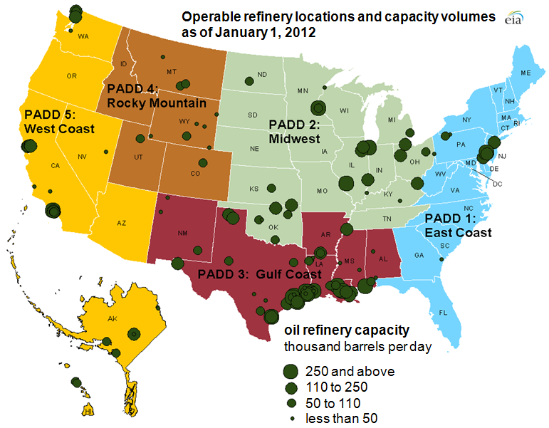
Refining Capacity By Geographic Location
149 U.S. refineries (2010)
Capacity of 17.6 million barrels per day

Slide 4
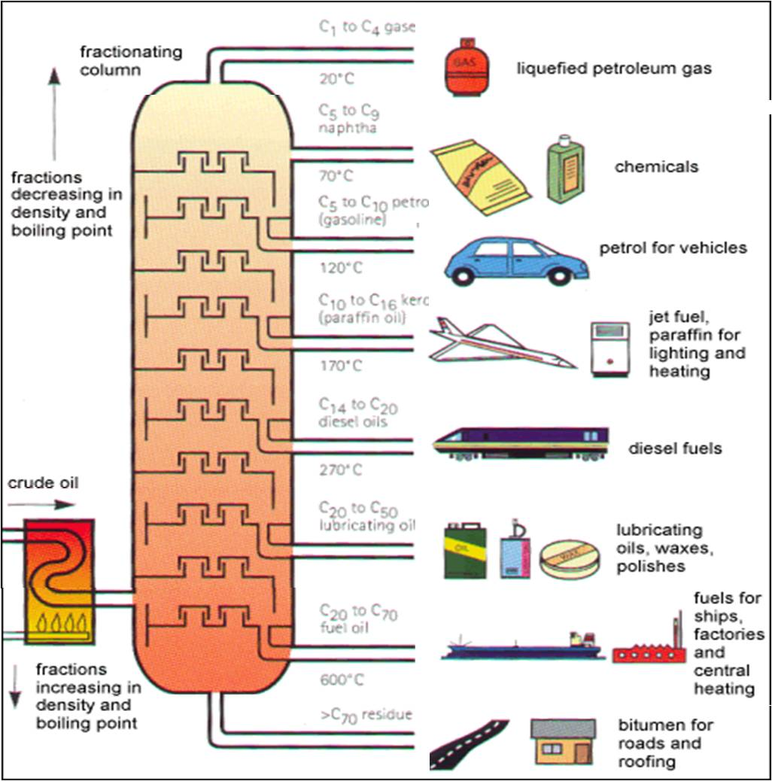
Fuels from Fractionating Columns
Natural gas, naphtha
Gasoline and jet-A, paraffin
#2-#4 diesel fuels
#6 Bunker C heavy diesel oil
Bitumen

Slide 5
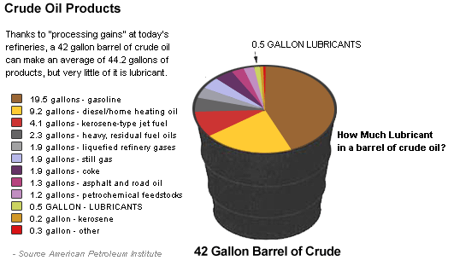
What Do You Get From A Barrel of Crude?

Slide 6
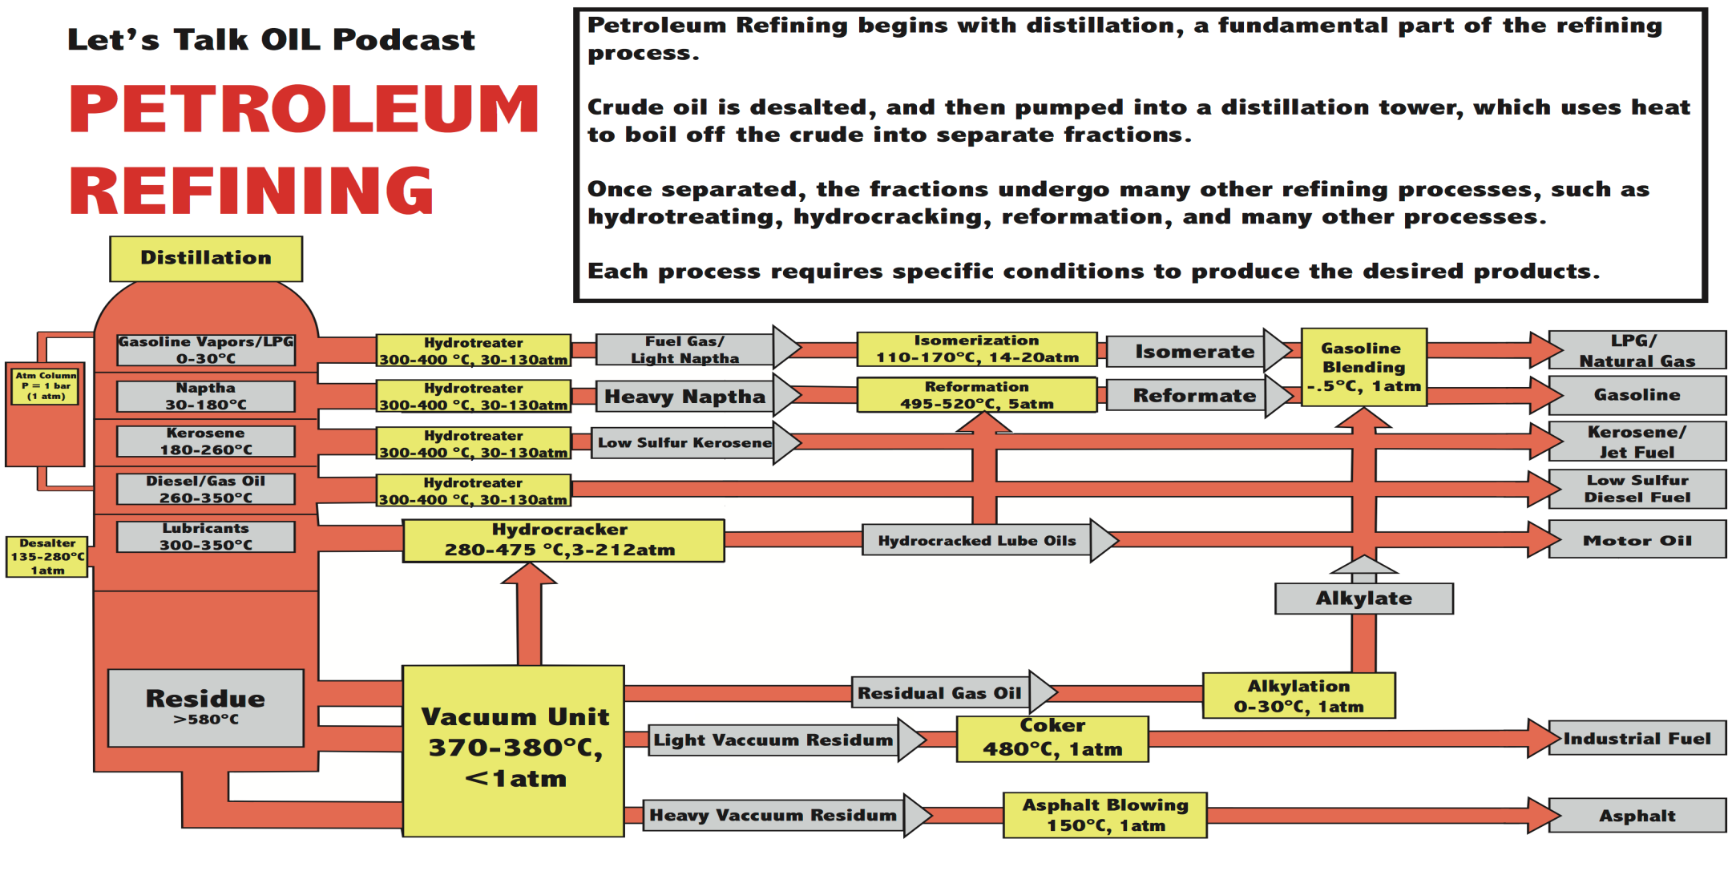
Slide Title

Slide 7
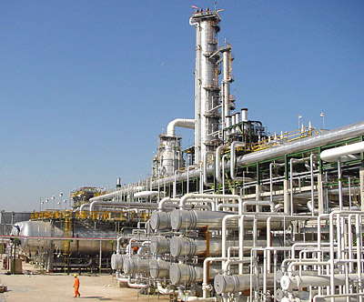
Oil & Gas Refineries
Consume large volumes of additives for gas and diesel
Price competition (fractions of cents per gallon)
Low margins make high volumes essential to profitability

Slide 8
Where Do The Additives Come In?
Some additives are added at the refinery, some can only be added afterwards.
Important Post-Refinery Additives
Cold flow improvers
Oxygenates (Ethanol, MTBE)

Slide 9
Marker Dye
Fuel Stabilizer
Natural Gasoline
Straight Run Gasoline
Blended
Gasoline
Tank
Unleaded
Gasoline
Hydrotreat
FCC
Antiknock
Corrosion inhibitor
Crude
Oil
High Octane
Gasoline
Conductivity Improver
Hydrotreatment
or
MEROX
Raw
Kerosene
Refined
Kerosene
Jet-A1
Antioxidant
Corrosion Inhibitor
JP-8
Cold Flow
Diesel Detergents
Cetane
Conductivity
Cold Flow
Detergents
Diesel Fuel
Hydrotreatment
Middle Distillates
Heating Oil
Refined and Blended
Middle Distillates

Slide 10
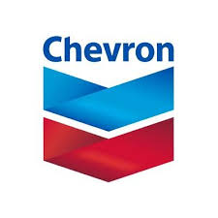


Gasoline Additization Opportunities @ Refinery Level
PFI/Intake Valve Detergency (EPA regulations)
Corrosion Inhibitors
Metal deactivators
Antioxidants
Octane improvers
Many of these supplied by large multinationals i.e. Chevron

Slide 11
Diesel Fuel Additization Opportunities @ Refinery Level
Conductivity/Static Dissipator
Cetane improvers
Lubricity improvers
Bulk diesel fuel additives like cetane and lubricity are areas that Bell Performance may be able to help.

Slide 12

Refinery Fuel Treatment Vertical – The Takeaway
Fuel treatment opportunities exist at the refinery level.
But they represent less margin and require higher sales volumes.
Most of the gasoline treatment commodities are locked up by the “big players”.
Cetane improvers and lubricity agents are sizable opportunities.

