Slide 1
MARINE DIESEL ENGINES & HFO ADDITIVE TREATMENT
DECEMBER 2014

Slide 2
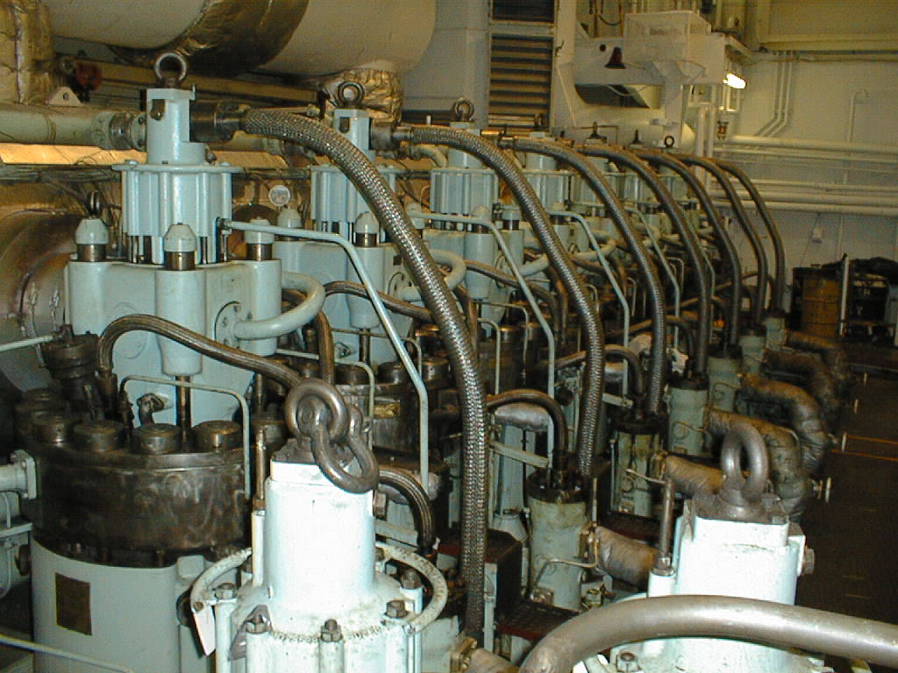
What We Want To Discuss Today
Marine Fuel Oils
Pre-combustion Issues
Combustion problems
Post-combustion concerns
Causes & solutions
What to look for in a solution

Slide 3
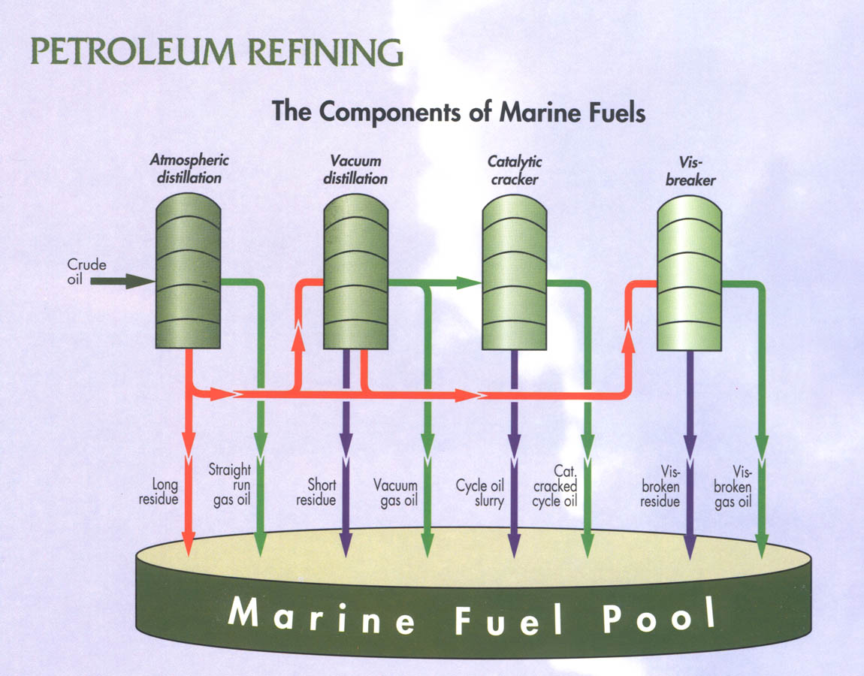
Marine Heavy Fuel Oil
Blended marine fuels created from secondary refining residuals + cutterstock
Characteristics of residual fuels depend on origin of crude oil and refinery process

Slide 4
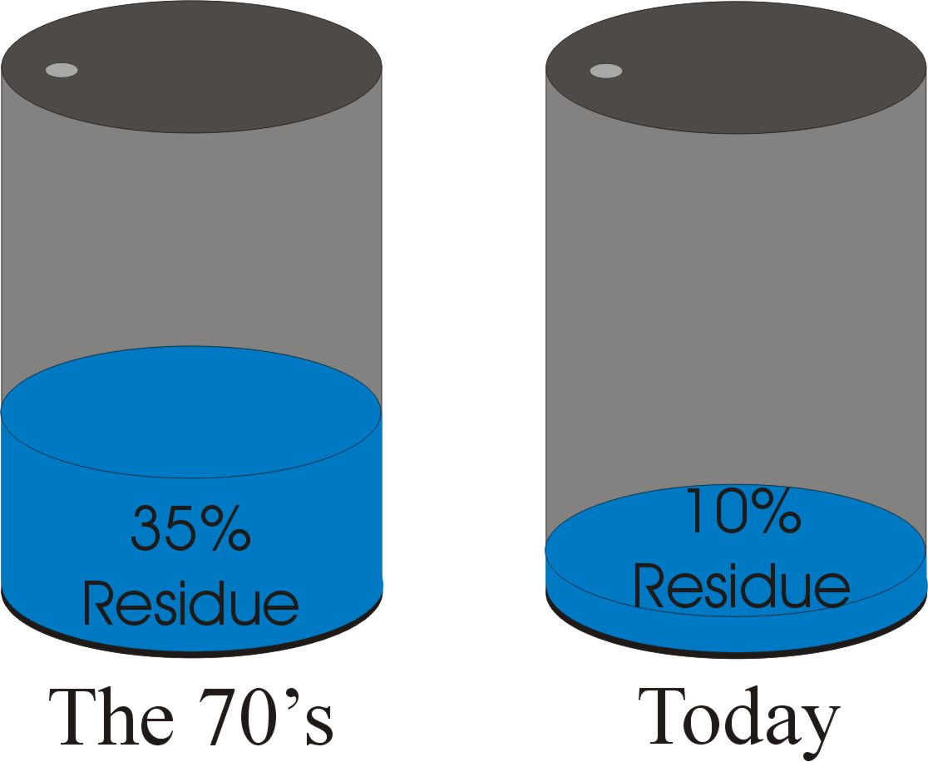
Then vs. Now

Slide 5
Problems Associated With Secondary Refining Products
Heavy sludge formation in the tanks due to precipitation of asphaltenes.
Blocking of filters and centrifuges with sludge.
Poor fuel atomization
Poor ignition and combustion

Slide 6
More Problems With These Fuels
Damage to fuel pumps, piston rings and liners due to catalytic fines from the fuel
Increasing frequency of changing injectors and overhauling pistons, cutting into maintenance budgets
High temperature deposits and erosion of exhaust valves

Slide 7
More Problems With These Fuels
Fouling of turbo-charger nozzle rings and rotor blades
Fouling and corrosion of exhaust gas economizers
Pollution of the environment due to unburned fuel emissions
Incompatibility due to mixing different fuels in the same storage tank
Most of these problems stem from fuel characteristics

Slide 8
Typical HFO Fuel Analysis
Characteristic
RME 25
RMF 25
RMG 35
RMH 35
RMG 35
Density @ 15°C, kg/m3
max: 991.0
max: 991.0
max: 991.0
max: 991.0
988.4
Kinematic viscosity @ 50°C, cSt
max: 225
max: 225
max: 390
max: 390
354
Water % (v/v)
max: 1.0
max: 1.0
max: 1.0
max: 1.0
0.2
Micro carbon residue % (m/m)
max: 15
max: 20
max: 18
max: 22
15.9
Sulphur % (m/m)
max: 5.0
max: 5.0
max: 5.0
max: 5.0
3.48
Total sediment potential % (m/m)
max: 0.10
max: 0.10
max: 0.10
max: 0.10
0.02
Ash % (m/m)
max: 0.10
max: 0.15
max: 0.15
max: 0.20
0.04
Vanadium mg/kg
max: 200
max: 500
max: 300
max: 600
124
Sodium mg/kg
27
Aluminium plus silicon mg/kg
max: 80
max: 80
max: 80
max: 80
34
Iron mg/kg
8
Nickel mg/kg
25
Calcium mg/kg
5
Magnesium mg/kg
1
Lead mg/kg
LT 1
Zinc mg/kg
LT 1
Flash point °C
min: 60
min: 60
min: 60
min: 60
GT 70
Pour point °C
max: 30
max: 30
max: 30
max: 30
6
Calculated Values
Nett energy mj/kg
39.97
CCAI
848

Slide 9
Marine Fuel Stability & Compatibility
Instability & incompatibility are related to asphaltene presence in the fuel
Stable fuels have high resin to asphaltene ratio
Stability is the fuel’s ability to resist change as function of time and temperature
Compatibility is the ability of the fuels to remain stable when blended

Slide 10
Asphaltenes in Marine Fuel – The Cause of Instability
Hydrocarbon macro molecules with high C/H ratio
Exist as micelles in fuel and are stabilized by natural resins
Stable fuels have high resin to asphaltene ratio
Unstable fuels are often a result of severe visbreaking that results in lower resin content thus creating instability

Slide 11
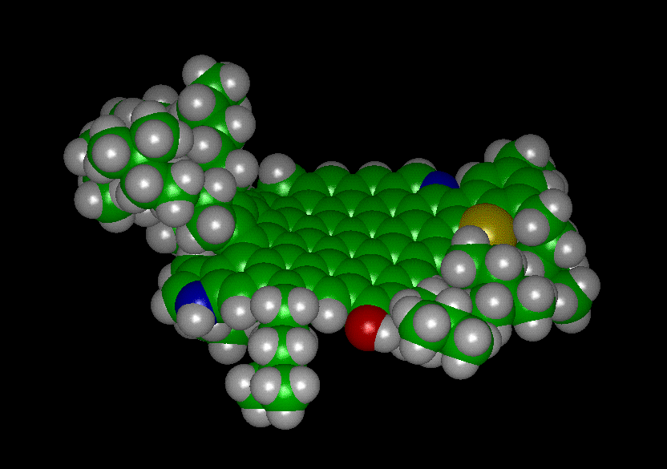

Asphaltene Structures

Slide 12
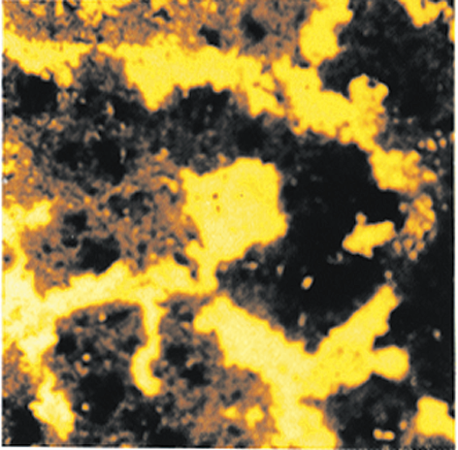
Agglomerated Asphaltenes

Slide 13


Asphaltene Formation & Polymers
Asphaltene contribute to formation of polymers in fuel.
A polymer is simply a large molecule built up by repetitive bonding together of many smaller units called monomers.
Dispersants are needed to prevent sludge dropout.

Slide 14
The Role of Dispersants
The fuel’s natural resign configuration may be changed during secondary refining, making it prone to sludge (polymer) formation.
Asphaltene dispersants and stabilizers are designed to keep asphaltenes apart.

Slide 15
Other Pre-Combustion Marine Fuel Problems
Excessive sludge precipitation from unstable and/or incompatible fuel
Filter blockage
Centrifuge overload from sludge
Water removal from partial and stable emulsions
Cat fines in the fuel

Slide 16
Other Pre-Combustion Marine Fuel Problems
Fuel heater fouling
Fuel injector tip fouling
Poor fuel atomisation
Abrasive wear

Slide 17
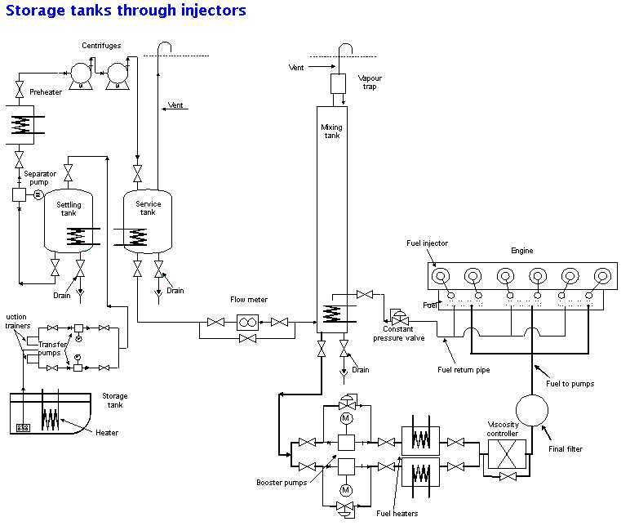
Fuel Sludge & The Marine Fuel Transfer System

Slide 18
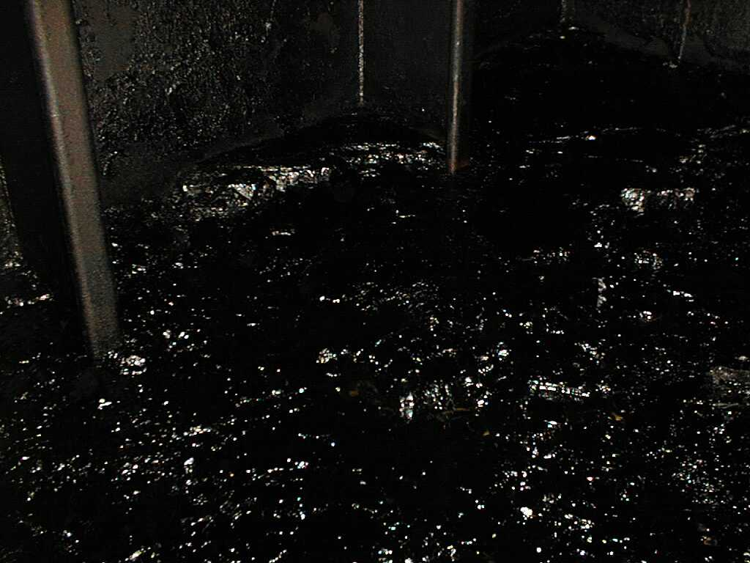
Tank Sludge From Marine Fuel Oil
Unstable fuels (asphaltenes) create tank sludge

Slide 19
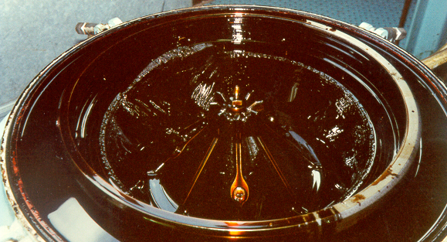
Excessive Sludge Volume in Centrifuges
Sludge deposits in purifier bowl
How much fuel volume is lost to sludge dropout?

Slide 20
Pre-Combustion Fuel Issues In Other Areas
Viscosity Controllers
Fuel Heaters
Hot Fuel Filters
Fuel Pump fouling
Fuel Injector depositing

Slide 21
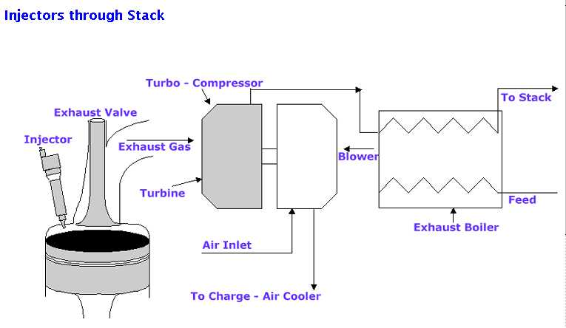
Marine Heavy Diesel Schematic

Slide 22
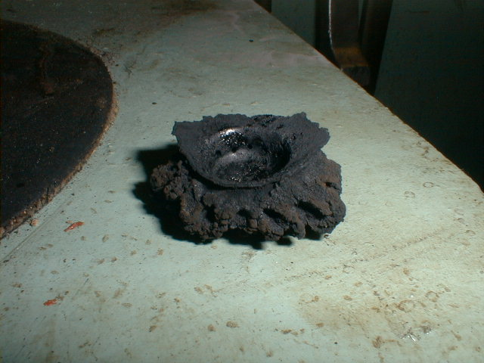
Example: Sludge Contamination In Fuel Injector Problems
Excessive carbonization of injector tips
Results? Inadequate atomization and combustion

Slide 23
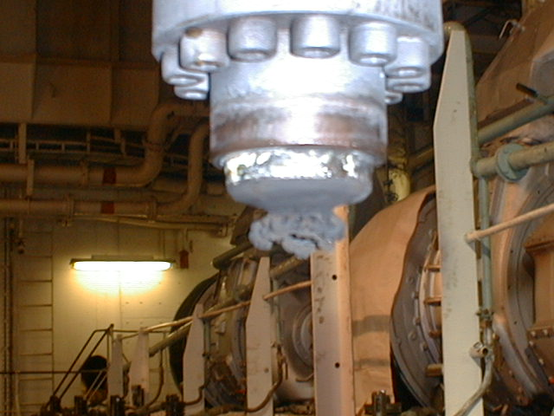
Sludge Contamination In Fuel Injector Problems
Sea-Land Express
Sulzer 9RND90M
30,150 BHP
June 29, 1999
Injector trumpets or cauliflower's, often caused by poor quality fuel or fuel with high asphaltene levels.

Slide 24
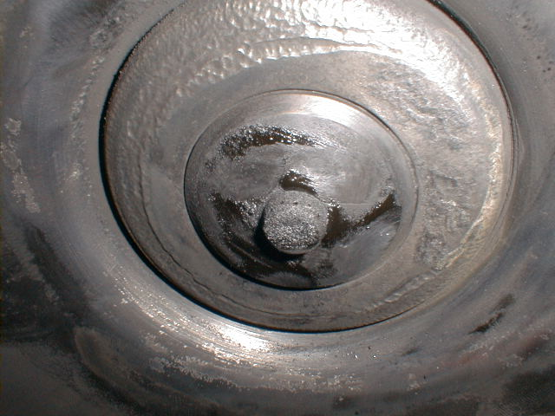
Sludge Contamination In Fuel Injector Problems
Sea-Land Express
Sulzer 9RND90M
30,150 BHP
June 29, 1999
Injector trumpets or cauliflower's, often caused by poor quality fuel or fuel with high asphaltene levels.

Slide 25
Solving Pre-Combustion Problems
Characteristics of a best-practice solution
  Stabilizes and disperses existing asphaltene agglomerations
  Improves the efficiency of centrifuging and filtration
  Reduces fuel slop waste and saves fuel
  Improves the efficiency of centrifuging, by improving the reduction of cat-fines
  Enhances fuel oil atomization and improves combustion

Slide 26
Marine Fuel Issues During Combustion
Now that we know pre-combustion…..
what about problems in the combustion zone itself?

Slide 27
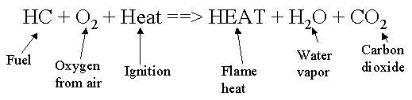
Marine Fuel Oil Combustion Issues: The Basics
Success = Optimal combustion of the fuel to achieve best fuel economy
How to achieve this success?

Slide 28
MATT & Optimal Combustion
MATT
M- Proper Mixture of air and fuel is required.
A- Proper Atomization of liquid fuels is required.
T- Proper Temperature of air, fuel and zone temperature must be maintained to achieve complete combustion.
T- Proper Time must be provided to complete the combustion process before the gases of combustion come in contact with the heating surface.

Slide 29
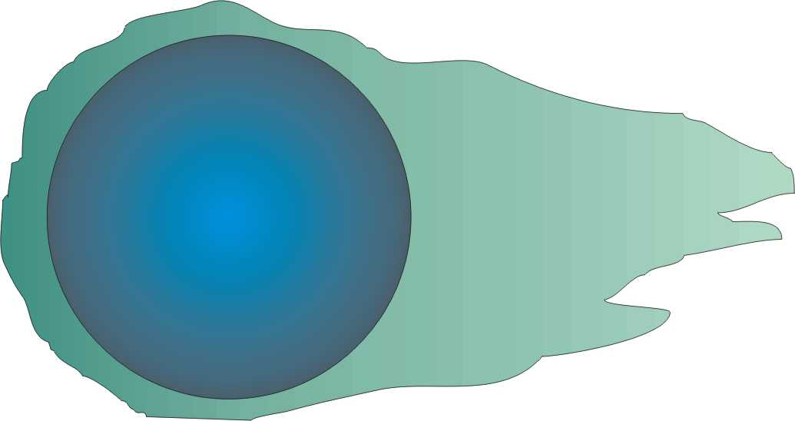
Stages of Combustion #1: Pre-Ignition
The droplet is heated and evaporation of the volatile material begins.
This stage ends with the self-ignition of the vapour surrounding the droplet.

Slide 30
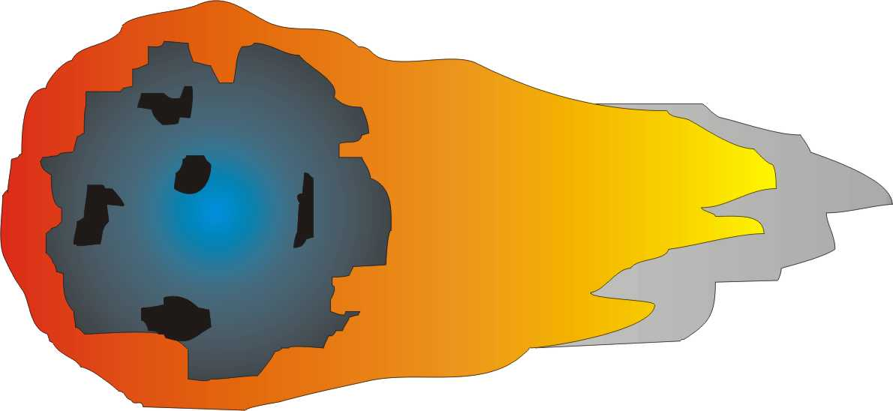
Stages of Combustion #2: Combustion of Volatiles
The volatile constituents of the oil and the cracked products burn in an enveloped flame surrounding the droplet.
The stage ends by the flame dying away as the evolution of flammable material ceases.

Slide 31

Stages of Combustion #3: Coke Combustion
When the flame dies, hot gases (including oxygen) can reach the hot surface of the coke residue.
It glows red and burns at 1400 - 1700 K.
The unburned coke left after combustion is called a cenosphere.

Slide 32
The Combustion Process: A Summary
A delay period between the beginning of injection and the start of ignition (ignition delay)
Rapid combustion of the fuel is accompanied by a rise in pressure
Steady combustion of the reminder of the fuel as it is being injected
An after-burning period during which remaining unburned fuel mixes with oxygen and combustion is complete

Slide 33
Poor Marine Fuel Combustion Is Caused By Or Can Lead To
Poor atomization
Slow burning fuel
Incomplete combustion
Having to increase excess air with subsequent acid production

Slide 34
More Combustion Problems
Piston fouling & depositing
Premature piston ring failure
Accelerated cylinder liner wear
Scavange air port fouling & increased under-piston deposits

Slide 35
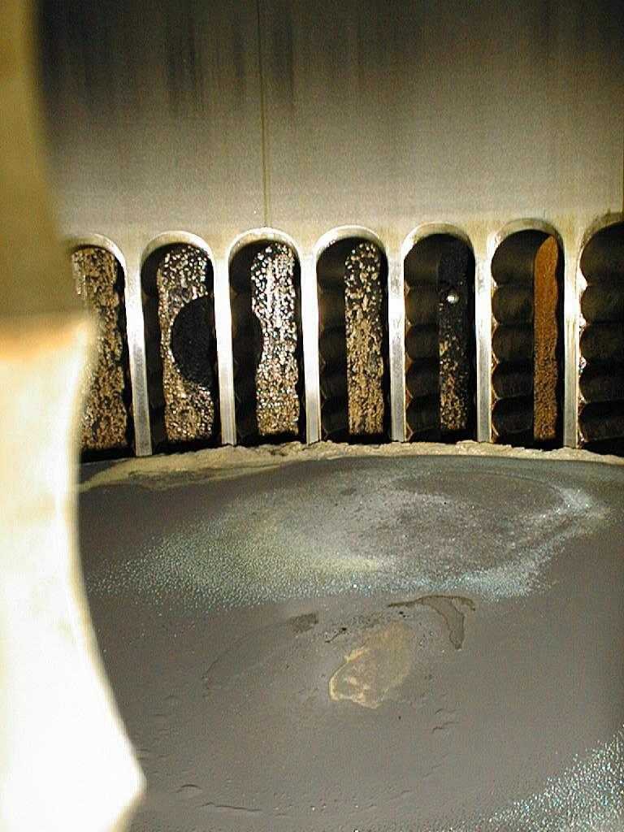
What These Problems Look Like: Combustion Air Excess
Acid droplets condensing on piston crowns

Slide 36
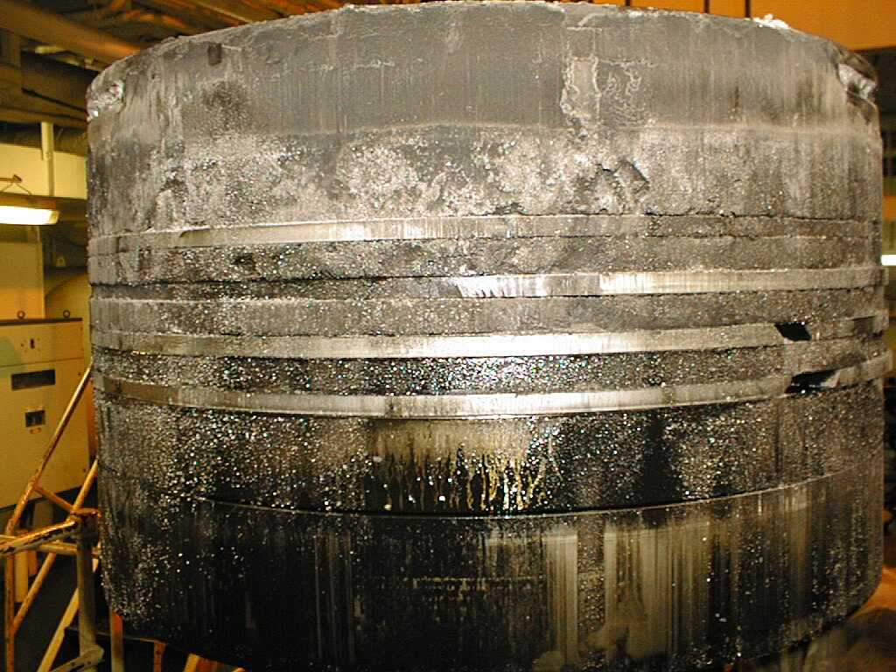
What These Problems Look Like: Piston Fouling

Slide 37
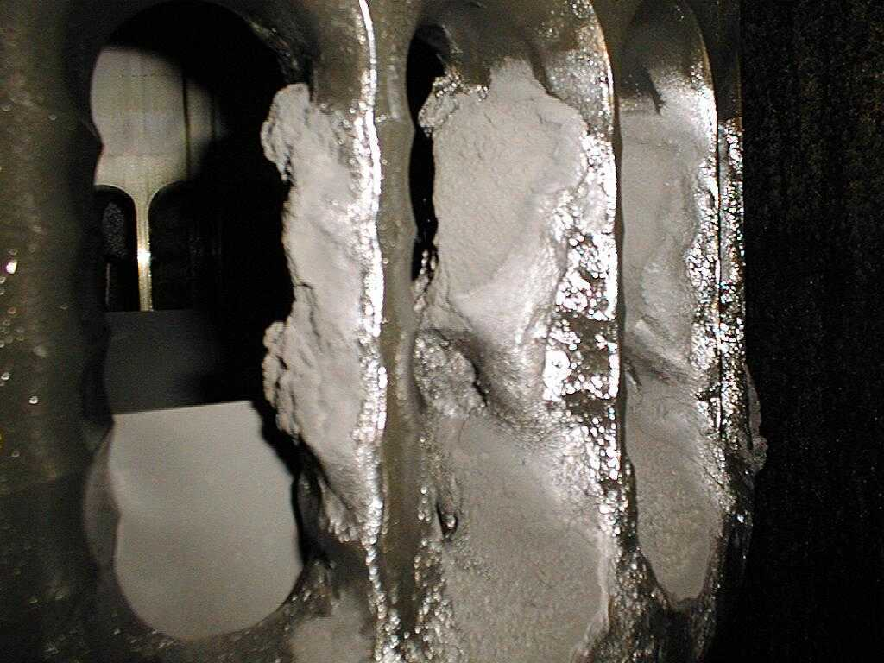
What These Problems Look Like: Scavenge Port Deposits

Slide 38
Combustion Problems: What’s the Ideal Solution?
Characteristics of a best-practice solution
  Provides earlier completion of combustion and therefore longer burn-out time and less soot
  Enhances oxygen transport during coke combustion resulting in less unburned carbon (cenospheres)
  Provides cleaner fuel injectors, pistons and valves free from carbon deposits
Use of metallic catalysts in ATX is a best practice

Slide 39
Solving Unburned Carbon Problems With Catalysts
Unburned carbon presence means sub-optimal fuel usage
The problem of unburned carbon can be addressed by surface catalysts and radical generators.
Research on organometallics in 1950s.

Slide 40
How These Catalysts Work
Surface reactions produce radicals of OH,O etc.
Radicals promote improved combustion by essentially increasing amount of volatiles around the fuel oil droplet
Lowering of activation energies for combustion reactions
Lower ignition temperatures of carbon resulting in faster and more complete combustion

Slide 41
ATX MFA Fuel Treatments With Combustion Catalysts
ATX MFA Fuel Treatments Deliver The Combustion Catalysts Needed To Solve These Problems

Slide 42
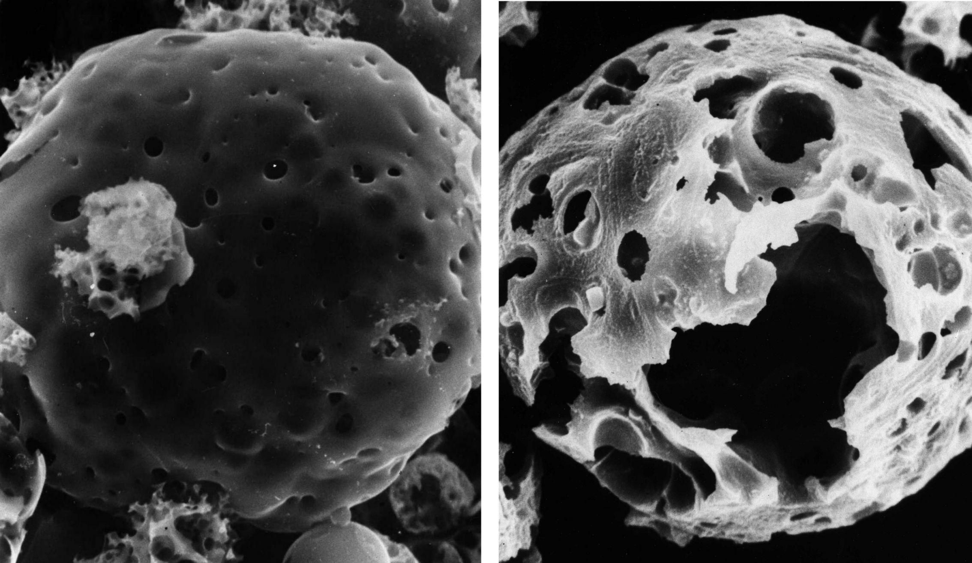
With & Without ATX Combustion Catalysts
Carbon Cenoscopes - Electron microscope (1:1200x)

Slide 43
Unburned Carbon Reductions With ATX & Catalysts Blends
60.7%
Reduction
62.5%
Reduction
66.4%
Reduction
88.2%
Reduction

Slide 44
Post-Combustion Problems with Marine Fuels
Pre-combustion problems
Combustion problems
Post-combustion issues: Hot and Cold Corrosion
Corrosion problems are a major concerns for marine fuel users.

Slide 45
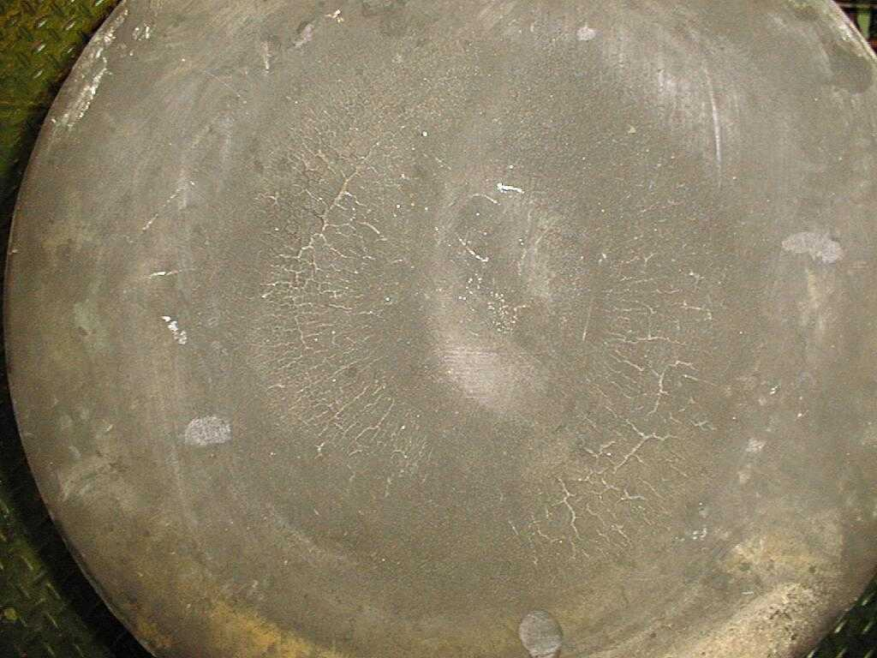
High-Temperature Corrosion: Piston Crown Erosion

Slide 46
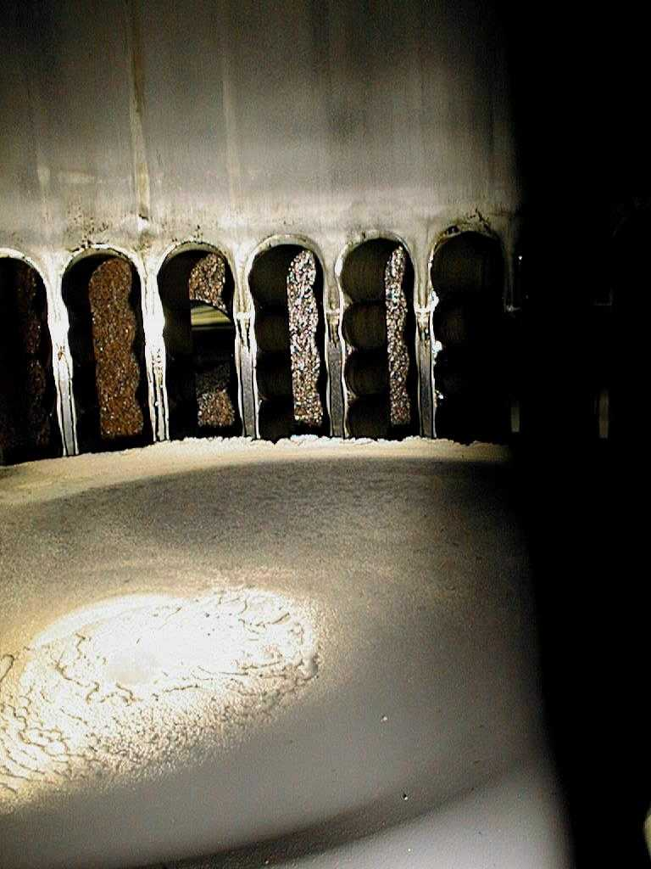
Typical Piston Crown Deposits

Slide 47
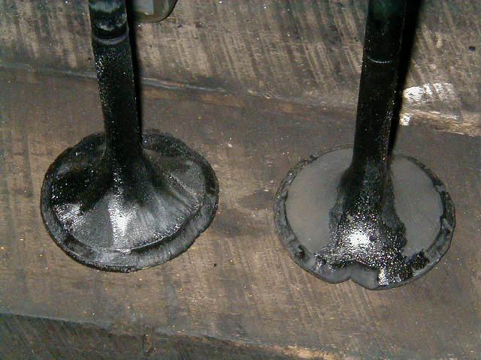
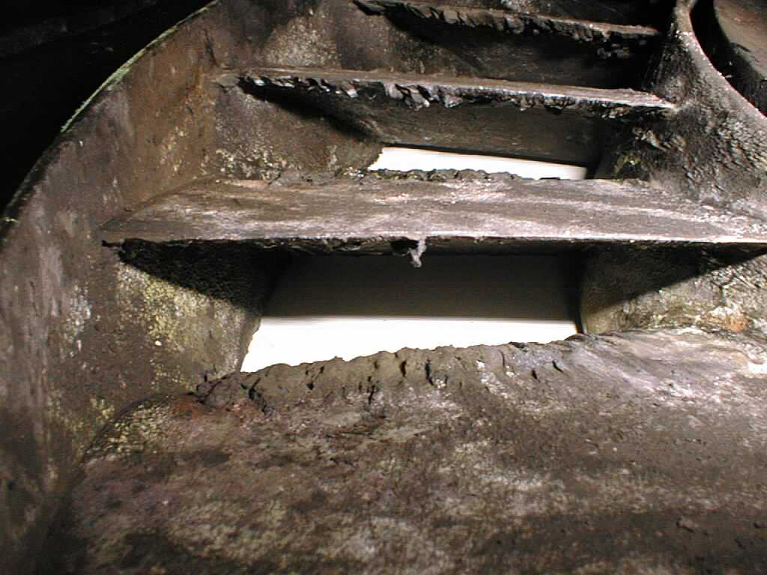
More High-Temp Corrosion and Deposits
Damaged exhaust valves caused by corrosion
Vanadium deposits on nozzle ring

Slide 48
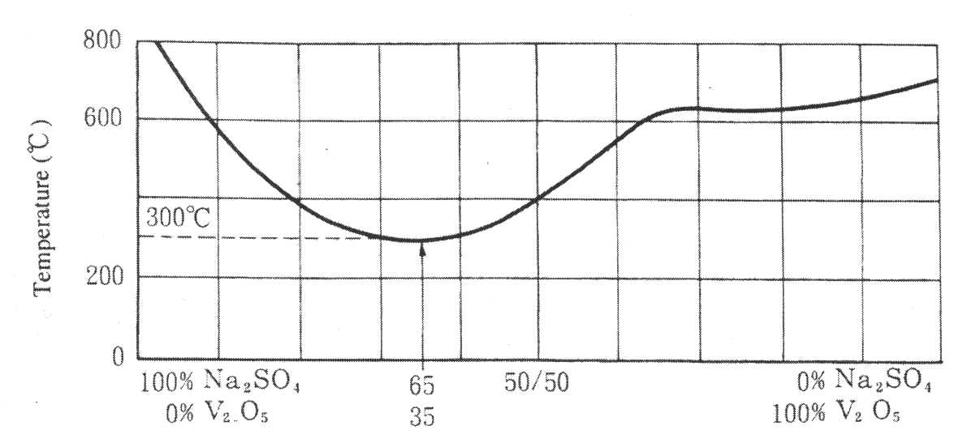
Contributing Factors To High-Temp Corrosion
Vanadium Pentoxide
V₂O₅
690°C
Sodium Metavandate
Na₂O.V₂O₅
630°C
Sodium Pyrovanadate
2 Na₂O.V₂O₅
640°C
Sodium Orthovanadate
3 Na₂.V₂O₅
850°C
Sodium Vanadyl Vanadate
Na₂.V₂O₄.5V₂O₅
625°C
Pentasodium Vanadyl Vanadate
5 Na₂.V₂O₄.11V₂O₅
535°C
Ferric Metavanadate
Fe₂O₃.2V₂O₅
860°C
Ferric Vanadate
Fe₂O₃.2V₂O₅
855°C
Sodium Sulphate
Na₂SO₄
880°C

Slide 49
Deposit Melting Points Depend on Na-V Ratios
Deposits created from Na + V in marine fuels
Deposit melting points depends on Na and V content.
Most low- and high-sulfur fuel oils produce corrosion deposits with low melting points.

Slide 50
How Corrosive Deposits Form
V₂O₅ and Na₂O is formed during the combustion sequence
Ash particles stick to surface, Na₂O acts as binding agent
V₂O₅ + Na₂O react on metal surface
The liquid forms fluxes with magnetite, exposing the underlying metal to rapid oxidation and corrosion damage
Best practices to combat this problem?

Slide 51
Magnesium – The Traditional Solution for HFO Corrosion
Magnesium is highly effective at combating corrosion problems.
Acts as an ash modifier/inhibitor that increases the melting points of ash (Vanadium/Sodium/Nickel) adhering to exhaust valves and other areas
Acts as an acid neutralizer - MgO + SO3 → MgSO4 instead of SO3 + O2 → H2SO4
Determining proper dose-rate is relatively straight-forward

Slide 52
The Right Treatment Amount Depends on Vanadium
Mg
O
O
O
V
V
O
3MgO.V₂O₅
Mg
O
O
O
Mg
O
Mp:675ºC
Mp:2800ºC
Mp:1190ºC
The right amount of Mg raises the melting point of harmful deposits.

Slide 53
Low Temperature Corrosion Is A Substantial Problem
Corrosion resulting from combination of SO3 and water.
  SO₂ + ½ O₂⇔ SO₃ (0.1-8%)
  SO₃ + H₂O ➔ H₂SO₄ (70-170ºC Dew point)
Concentration of sulfuric acid influences dew point.

Slide 54
Preventing Low Temp Corrosion Issues
Operational options for corrosion prevention include
  Excess Oxygen
  Maintain as low as possible
  Temperature
  Maintain above the acid dew point
Both of these options have down sides for combustion efficiency

Slide 55
System Areas Prone To Corrosion Damage
HOT CORROSION:
Exhaust valves
Piston crowns
Turbocharger nozzle ring
Turbocharger blades
COLD CORROSION:
Cylinder liner walls
Exhaust valves
Piston crowns
Exhaust valve casing
Exhaust trunking
Exhaust gas economizers
Funnel casing
How much are corrosion problems costing you?

Slide 56
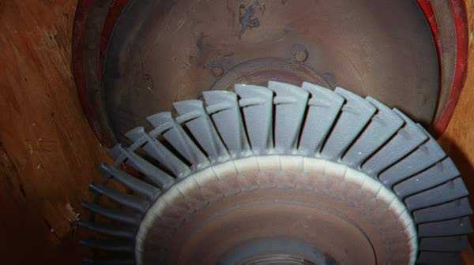
Corrosion in Critical Areas: Turbocharger
Holland America Line w/ Sulzar 12ZAV40S (8,640 bhp)

Slide 57
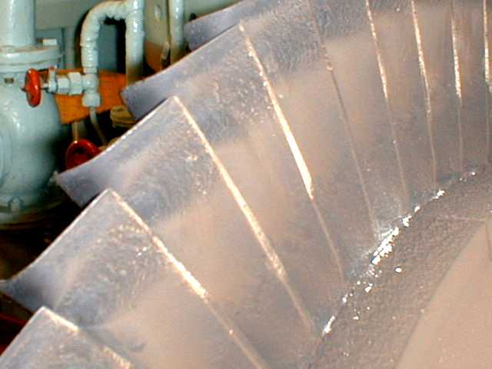
Turbocharger Damage
Sea-Land Independence Sulzer 9RND90M 30,150 BHP Built in 1980 Using treatment

Slide 58
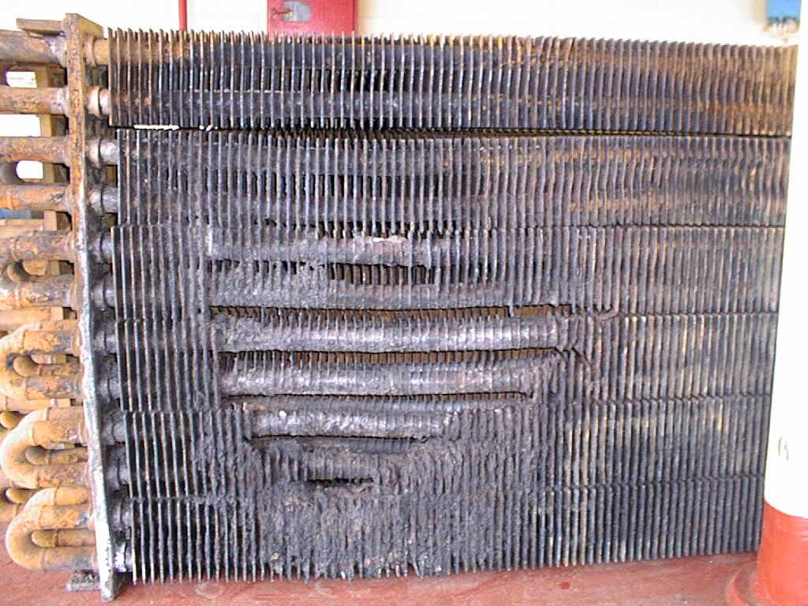
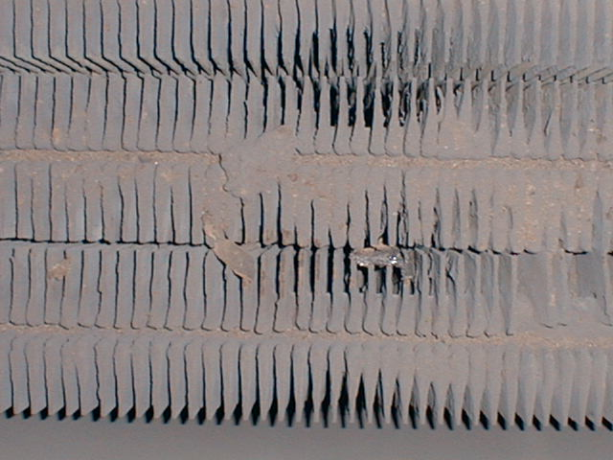
Cold Corrosion & Blockage: Economizer

Slide 59
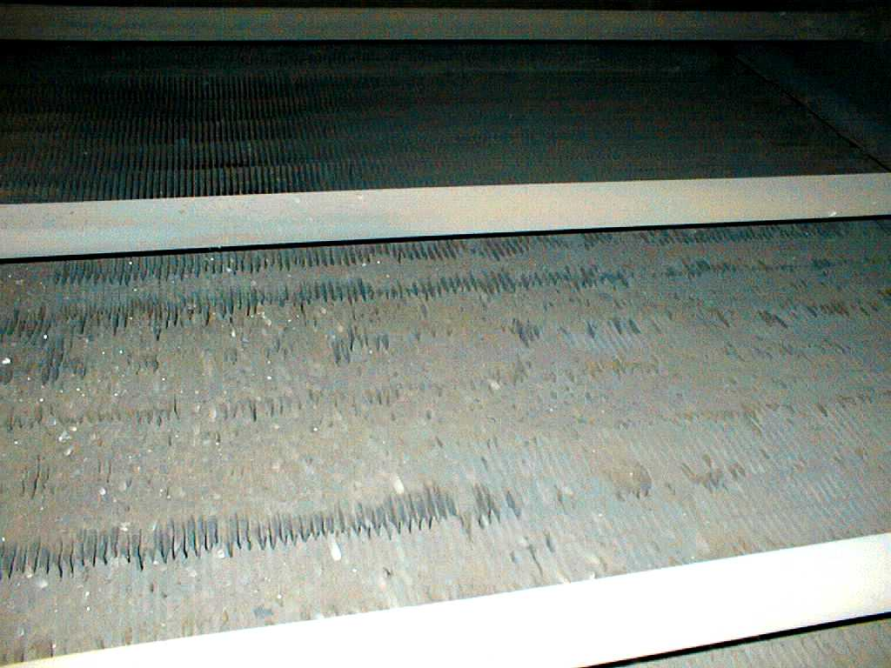
Economizer / Exhaust Gas Boiler
Sea-Land Express Sulzer RND90M 30,150 BHP Sept. 1997 Before treatment

Slide 60
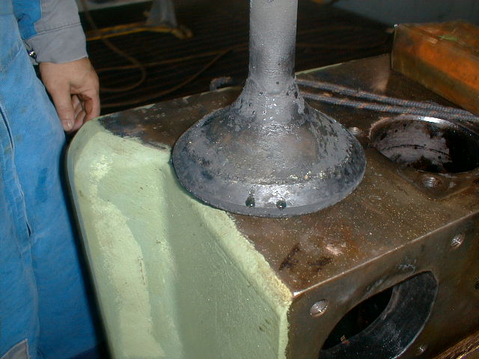
Exhaust Valve Corrosion
Disney Magic Sulzer 16 ZAV40S Built in 1998

Slide 61
Using A Mg Treatment To Neutralize Corrosion
High temp corrosion is caused primarily by V/Na/S compounds.
Adding Mg increases the melting points of sticky ash
Low temp corrosion is minimized due to the neutralizing effect of MgO in treatments like Bell Performance’s ATX MFA line
MgSO₄ (non-corrosive) vs. H₂SO₄ (highly corrosive)

Slide 62
ATX MFA Treatments Deliver To Solve Problems
Deposits of ash and carbon on exhaust valves and turbo-chargers are significantly reduced because the Mg component in ATX.
ATX combustion catalysts reduce unburned carbon.
Economizers will collect less unburned carbon with subsequent reductions in the number of cleanings needed to maintain efficiency.

Slide 63
Treatment Recommendation: ATX Multifunction Fuel Treatments
To address these problems, Bell Performance recommended its ATX family of multifunction fuel treatments (MFAs).
A reduction in the formation of unburned carbon deposits in the engine and less engine wear
Significant improvement in economiser cleanliness
Reduces low and high temperature corrosion
Stabilizes fuel and reduces the formation of sludge
Measurable improvements in post-combustion emissions
Disperses and eliminates water and moisture

Slide 64
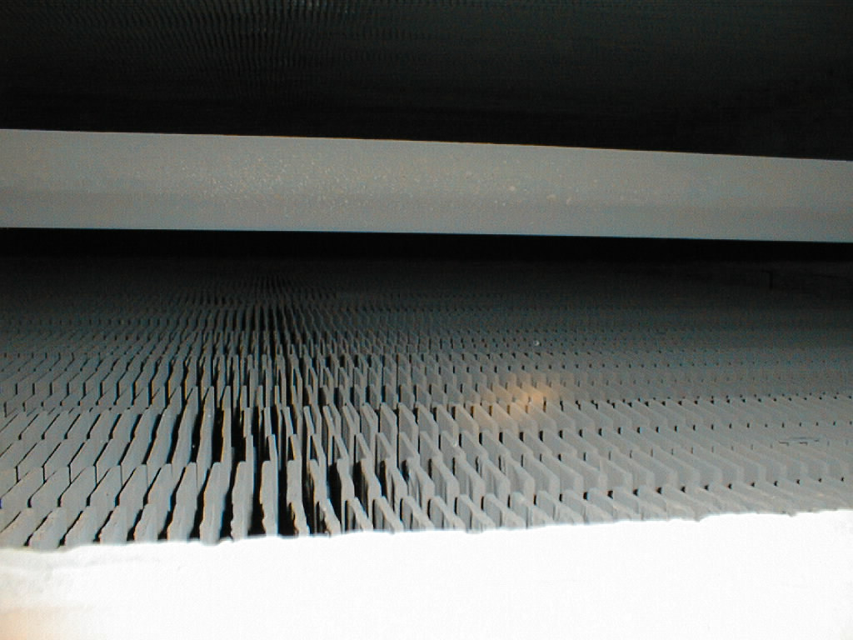
Economizer / Exhaust Gas Boiler
Sea-Land Independence Sulzer RND90M 30,150 BHP Sept. 1997 After treatment

Slide 65
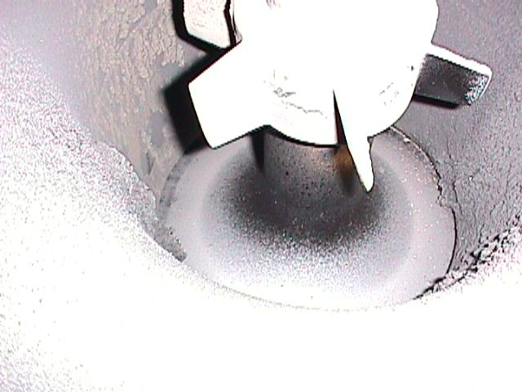
Exhaust Valve Corrosion
Sea-Land Anchorage B&W 7L70MC 20,286 BHP Built in 1987

Slide 66
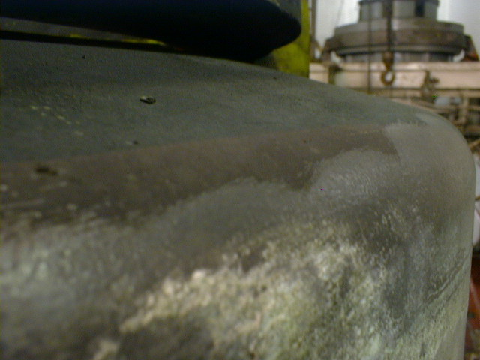
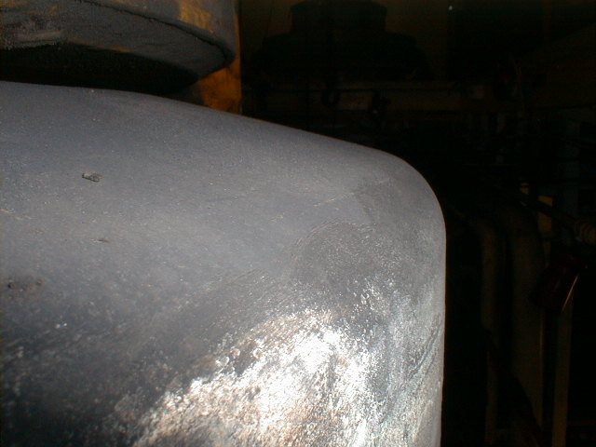
Piston Crown Corrosion
Matson’s Mahi Mahi Sulzer RND90M 43,200 BHP Built in 1983
After 12,000 hours

Slide 67
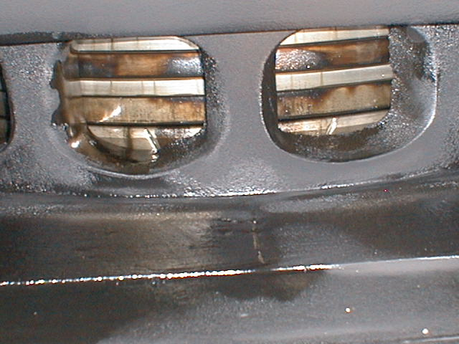
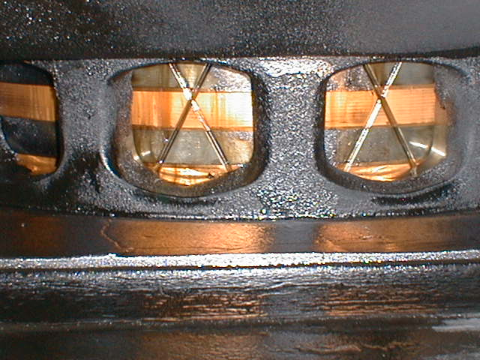
Piston Rings and Wear Rings
Matson’s Mahi Mahi Sulzer RND90M 43,200 BHP Built in 1983 After treatment

Slide 68
Recommended Dosage & Application
Recommended dosage : 1:3,000 – 1:4,000
  Increased dosage for higher vanadium fuels (>250 ppm)
Dose into settling tank, directly into engine or by direct injection into fuel line
Output of injection system is determined by the fuel transfer pump capacity

Slide 69
ATX Use Across Multiple Sectors
Organometallics in ATX are employed by HFO users large and small.
These users all seek the same solutions
Save money by reducing fuel usage while maintaining output
Protecting capital investment through damage control
Recover lost fuel value through sludge dispersal

Slide 70
Considering Value Propositions For Marine Fuel Users
ATX fuel treatments, used in marine fuels, can bring substantial benefits.
Fuel savings – large ships can realize substantial financial gains through improvements approaching as little as 1.0%.
Corrosion and Deposit Control – substantial savings through prevention of damage and reductions in maintenance costs. The extent of savings is dependent upon current expenses of the customer.
Sludge removal – recapture of lost fuel value/reduction of centrifuge waste; both of these can represent added value.

