Slide 1
Lubricity Improvers and Treatment for Diesel Fuel
NEW DIMENSION LOGISTICS – JANUARY 2015

Slide 2
What We Will Cover Here
Lubricity improvers and how they work
Regulations & standards governing their need in fuels
Options from Bell Performance to help customers meet those requirements

Slide 3
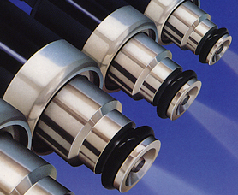
Lubricity & Its Effects On The Engine
The ability of a fluid to minimize friction between surfaces in relative motion and to minimize damage to surfaces in relative motion
Diesel engine fuel injection systems rely on the lubricating properties inherent in the fuel.

Slide 4
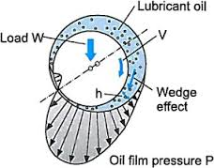
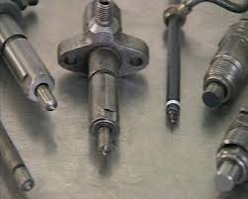
Lubricity Improvers
Lubricity improvers are essential to provide boundary lubrication between metallic parts in critical fuel system components by forming a protective layer on the metal surfaces.
Fuel injectors and fuel pumps rely on fuel lubricity to prevent damage and extend their working lives.

Slide 5
Changing Fuels Create a Market For Lubricity Improvers
Ultra-low sulfur fuels that have undergone extensive hydrotreatment for sulfur removal need assistance to meet the ASTM D6079 requirements of 520 µM wear scar (460µM in Europe)
Extensive hydrotreating to meet ULSD sulfur requirement remove naturally-occuring polar molecules that used to contribute to lubricity protection
Used in low viscosity fuels used to meet low temperature handling specifications
Used in low viscosity fuels used to reduce emissions

Slide 6
Early Landmarks in Lubricity Use
60’s & 70’s: Lack of fuel lubricity contributes to a number of gas turbine equipment failures.
For military operators the addition of corrosion inhibitor additives has been the solution of choice.
1990 Fuel desulphurization in Scandinavia causes vehicle failures
Early 90’s, US Lubricity improvers were included in diesel performance packages (e.g. Hess)

Slide 7
Early 90’s Scandinavian Experience
Fuel Desulphurization to <500 ppm caused vehicle failure
Dimer Acids implemented – pump wear alleviated
Problem – High treat rates cause deposits, >200 ppm
Cause – Lubricant interactions
Solution – Non-acid technologies, Esters, Amides

Slide 8
MIL Approved Dimer Acid Lubricity Agents
MIL Approved
Good Performance
Pipeline approved
Good low-temperature operability
Downstream Lube Interactions Evident at High Treat Rates, > 200 ppm
Notes:
Lube interactions mean contact with lubricant cause polymerization compounds to form and drop out

Slide 9
Amides and “Low Acid” Amides
Caustic Interactions
Water Interactions
Lube Interaction Problems in United States and EU
USA, BP
EU, Preem @ 155 pm vol/vol
Inconsistent Performance
Does not meet 40CFR80.521 - 15 ppm S cap

Slide 10
Non-Synthetic Esters
Fully resistant to Lube oil interactions
Good performance
Marginal Low Temperature Solubility in Low Aromatic Fuels
Only Partially Synthetic
Questionable whether meets 15 ppm S Cap

Slide 11
Early to Mid 90’s
As more fuels were desulphurized to make low sulfur diesel, lubricity improver use expanded
Esters dominate high treat fuels
Problem – Costs
Cause - Synthetic products (esters)
Solution – Mono-acids
Notes:
A new problem emerged – the high cost of synthetic esters

Slide 12
Mono-Acid Lubricity Solutions
Less chance of lube-oil interactions compared with dimer acid technologies
Some mono-acids had poor low temperature operability – forming cold weather precipitates in fuel
This was true in the beginning, but the market adjusted with monoacid versions that were not subject to this problem
Adds minimal amount of sulfur to ULSD fuels

Slide 13
Synthetic Esters
Synthetic esters exhibit good performance with favorable characteristics
No Interactions
Good Low Temperature Operability
Good fuel solubility
Good Performance
Fully Synthetic
Meets 40CFR80.521 15 ppm S cap
However, you pay for what you get.

Slide 14
Late 90’s - Now
Many in the market are moving away from synthetics and back to monoacids and low-acid amides
The field interactions haven’t materialized
Fewer lube oil interactions
Less expensive and work just as well

Slide 15
If monoacids work just as well, who would buy synthetic?
Synthetic ester technology was developed by Infineum – a joint venture between Exxon and Texaco.
Synthetic esters work reasonably well but are more expensive than monoacids.
Exxon & Texaco require use of synthetic lubricity by their captive audience to preserve their market.

Slide 16
How Lubricity Improvers Work
Notes:
Contain molecules with ends with affinities for different things. Bond to the metal surfaces and create an boundary lubrication film.

Slide 17
EMA Guidelines
Some groups historically had not included Lubricity in the definition of premium diesel because of problems associated with accurate measurement of this property
The accepted measures of lubricity are:
ASTM D6078 SLBOCLE
Scuffing Load Ball-on-Cylinder Lubricity Evaluator
Recommended ≥ 3100 gram load
Downside: Poor reproducibility
ASTM D6079 HFRR
High Frequency Reciprocating Rig
Requirements 520 µm wear scar @ 60°C
Good reproducibility but wasn’t always a good indicator of field performance

Slide 18
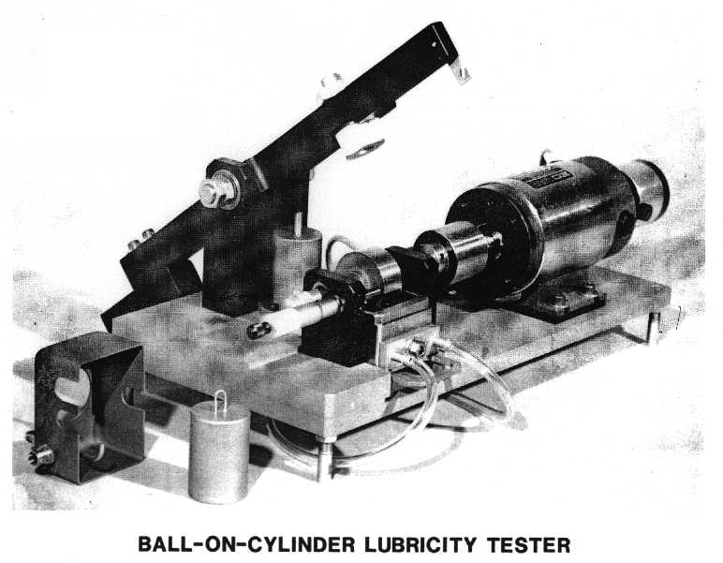

Slide 19
Other Groups Weigh In
CARB promotes a basic standard since August 2004
Target ≤ 520 µm wear scar @ 60°C
Intent was to reduce to ≤ 450 µm over time
ASTM agrees on a ≤ 520 µm wear scar diameter via HFRR D6079
Diesel fuel must meet this standard to legally be defined as diesel fuel
Notes:
Why does CARB care about lubricity?

Slide 20
Lubricity Treatment Chemistry Options

Slide 21
Solutions for lubricity issues from Bell Performance
Bell Performance offers several solutions to solve lubricity concerns for both small and large diesel fuel users.
Lube Pro – aftermarket lubricity treatment for fleet and small volume fuel storage professionals
Lube Pro RB-EC and CC – our “refinery-blend” bulk lubricity treatments, with synthetic and monoacid chemistries.

Slide 22
Lube Pro RB11-EC Series
Proprietary fully synthetic
Ester-based chemistry
Specially developed for use in ULSD applications
[≤15 ppm Sulfur]
Used as stand alone additive because it will not interact with other additives or contaminants in fuel
Pipeline approvals
Also provide conductivity improver

Slide 23
Lube Pro RB11-CC
Originally developed for use in low sulfur diesel fuels, but highly effective in ULSD fuels
Monoacid Tall Oil Fatty Acid chemistry
Also contains Conductivity Additive to Meet ASTM Requirements of 25 ρS/M

