Slide 1
Fuels Overview: Heavy Fuel Oil
NEW DIMENSION LOGISTICS - JANUARY 2015

Slide 2
What We Will Cover
Petroleum refining: distillate vs. residual
Heavy fuel oil characteristics
Problems review
Areas of use for heavy fuel oil

Slide 3
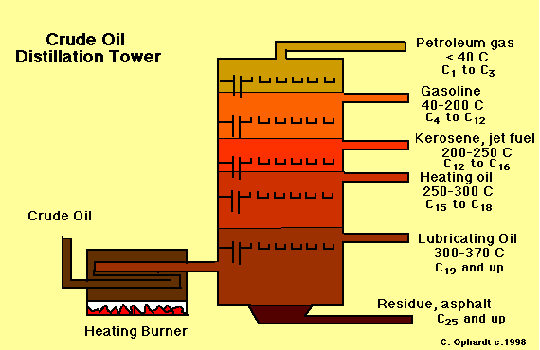
Petroleum Refining
Distillate fuels refined from crude
Natural gas
Gasoline
Light diesel (#1, #2, #4)
Residual fuels: the stuff left over
#6 Heavy Fuel Oil (HFO) – “Bunker C”
Asphalt and Tar
Notes:
Contrast distllate vs. residual fuels

Slide 4
Fuel Characteristics: Distillate vs Residual
The properties of fuels change as their weight increases
Residual = heavy
Distillate = light
Physical properties like these can influence a fuel’s characteristics in use.
Consider the property of energy content

Slide 5
Distillate vs Residual Fuels
Molecule size influences weight and density
Larger fuel molecules = heavier = more carbon content
Gasoline: 7-9 carbons
#2 Diesel: 11-18 carbons
Heavy Fuel Oil: 20-27
More carbon content = greater energy value

Slide 6
Energy Content Relative to Size
Hence why gasoline has less energy than diesel fuel
Ethanol has less energy than gasoline
Biodiesel has less energy than diesel fuel
Energy content isn’t the only thing affected by physical properties of fuel…..

Slide 7
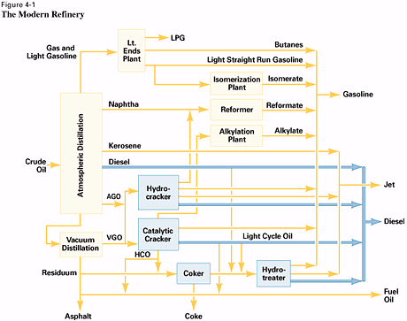
Refining & Fuel Stability
Cracking processes for greater yields of gasoline and diesel.
Resultant less-stable molecules and greater stability problems.
Not a problem for HFO.

Slide 8
Comparing HFO To Gas & Diesel
Heavier and higher density
Higher sulfur content
Greater inorganic content
These properties give HFO some positive qualities.

Slide 9
Heavy Fuel Oil – The Good
Higher energy value (due to higher weight)
More long-term stability (due to residual nature)
No microbial issues (from high sulfur content)
Inexpensive price

Slide 10
Heavy Fuel Oil Becomes Ideal For
These properties of heavy fuel oil
make it an ideal fuel for
many kinds of industry

Slide 11
Marine Shipping

Slide 12
Power Generation

Slide 13
Light & Heavy Industry

Slide 14
Every Positive Has A Down Side
Typical problems with heavy fuel oil include:
Deposit buildup from high metal content
Corrosion from sulfur
Sludge dropout (from heavy content)
Bell Performance offers ATX fuel treatment solution for improved heavy fuel oil performance and fewer HFO problems.

