Slide 1
Fuel Stability – Diesel & Fuel Oil
NEW DIMENSION LOGISTICS – JANUARY 2015

Slide 2
What We Will Cover Today – Stability for Vehicle Diesel and Fuel Oil
Customer problems in the field related to fuel storage stability
Refinery Processes/Fuel Components
Stability Modes, Characteristics
Predicting Stability
Additives to Improve Stability
Evaluating Additive Performance
Recommendations for Testing
Situation Recommendations

Slide 3
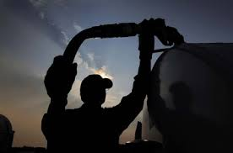
Why Groups Are Concerned About Fuel Stability
What is the problem?
Microbes, water, uncertain fuel stability in stored fuels
Uncertainty of the viability of stored fuels needed during an emergency
Essential emergency systems rely on stored fuel - will they function properly?
The need for guaranteed fuel quality at all times
What can they do about these problems?
Do nothing about them and hope for the best
Try to fix it themselves

Slide 4
The Costs of Inaction Are Potentially Huge
The costs of inaction or “not addressing the problem” are always greatest. The size of these costs depends on the customer.
Shutdowns and disruptions
Monetary costs associated with lost productivity caused by addressing vehicle and system malfunctions and damages
Mental costs associated with “putting out fires” and damage control measures
Impaired emergency response scenarios
Based on past precedents (like Hurricane Sandy), up to half of generators can be expected not to work during any future major storm event
Impaired credibility
Ones’ professional acumen comes into question by supervising bodies or officials when these things happen
Don’t want to be on the heads will roll list because equipment failed on your watch
We seek to ensure that they have the right answers.

Slide 5
Best Practices to Solve Stored Fuel Issues
The right fuel treatments are the most viable solutions.
Biocide needed to kill active microbes in fuel
Water-absorbing treatments to remove accumulated free water
For regular use fuel, multi-function treatments that combine stability ingredients with detergents and cetane improver
Anti-oxidant stability treatments for emergency fuel
Sometimes, chemical treatment paired with mechanical remediation is the best solution.

Slide 6
Fuel Stability Treatment
Fuel antioxidants are essential pieces of the puzzle for protecting stored fuel quality.
Antioxidants protect fuel quality by interrupting chain reactions that would threaten the chemical stability of the petroleum fuel.

Slide 7
Fuel Stability Treatment
Without such protection, chemical precursors in the fuel react with stable molecule to form large unstable molecules that eventually lead to darkened fuel.
Why are fuels today more susceptible to instability than before?

Slide 8
Today’s Fuel More Affected By Instability
Removal of sulfur to create ULSD also leaving fuels more susceptible to microbial attack and breakdown.
More extensive cracking methods at the refinery level.

Slide 9
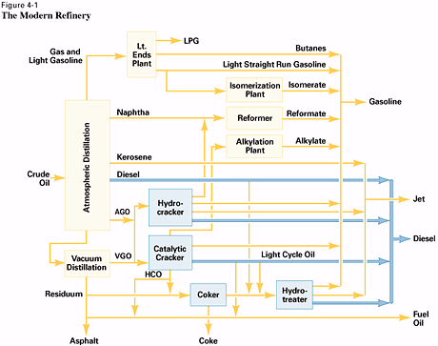
The Simplified Refinery

Slide 10
Definitions & Areas of the Refinery
Coking
Severe thermal cracking
Hydrotreating
Removes many contaminants from many streams i.e. sulfur & metals

Slide 11
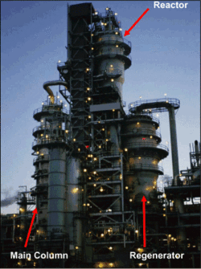
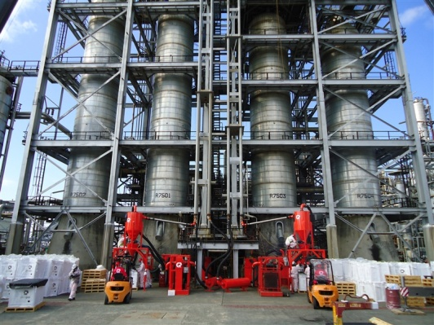
Definitions & Areas of the Refinery
Cat-Cracker
Straight run heavy oils are subjected to heat/pressure/catalyst to increase conversion of heavier oils into gasoline
Hydrocracker
Cat-cracking in presence of hydrogen and catalyst yields light gas oils. (Makes great jet and diesel fuel)

Slide 12
Components in Cracked Refinery Diesel Fuels
Diesel fuels may contains fractions of some of these, which can contribute to fuel instability:
Kerosene – Normally stable
Straight Run Diesel (Virgin Diesel) – Stable (Hydrotreated for LSD)
Light Cycle Oil - Variable, good to poor (Hydrotreated for LSD)
Hydrocracker Diesel – Very good
Coker Distillate - MUST BE HYDROGEN TREATED
Tendency to form sediments during storage - reduced by hydrogen treating

Slide 13
Diesel Storage Stability & Sediment Formation
Typically not a problem for low sulfur fuels (LSD) in the absence of dissolved copper
Refers to formation of sediment and dark color or stratification
Color is cosmetic, and not significant for dyed fuels if sediment content is less than a given floor

Slide 14
Diesel Storage Stability & Sediment Formation cont.
Sediment content over 10 – 20 mg/L may give problems
If fuel is used quickly, this is not a problem
Hence why non-ethanol gasoline rarely has stability problems
Problem situations possible with diesel fuel
Seasonal use
Standby power
Recirculation through copper
Military storage
Diesel users planning long-term storage should incorporate biocide usage (but that’s another show)

Slide 15
Fuel Storage Stability & Peroxide Formation
Prior to Low Sulfur Diesel, peroxides were not viewed a problem
Many low sulfur fuels are not susceptible. However, potential for peroxide formation is more important for ULSD
Sediment formation and Peroxide buildup do not occur in the same fuels – one or other
If peroxides are present in concentrations exceeding 8 ppm, peroxides can rapidly degrade elastomers, esp. Buna-N
Peroxide formation is easily prevented by 5-15 ppm of a stabilizer.

Slide 16
Testing for Fuel Storage Stability
Stability tests may be predictive or measure present stability.
Accelerated stability tests are the most reliable predictive
Only way to predict additive effectiveness
Only accelerated tests are currently cited in specifications
Present stability tests include
ASTM D5304 Overpressure Test
ASTM D2274 Stability Test

Slide 17
Thermal Stability and Cetane Improver
Thermal stability of diesel assessed by ASTM D6468 or F21.
Cetane improver 2-EN will affect thermal stability of some fuels; DTBP has only a minor effect
First noticed by Chevron in some heavy truck fleets
Several stability treatment options are able to counter these effects in most fuels, at very low concentrations

Slide 18
Modes of Stabilizer Addition to Diesel Fuel
Stabilizers function best if used before cracked components exposed to oxygen
Stabilizers free of any side properties; most cost-effective for use at refinery level
Dispersants and DMD function at any point prior to formation of sediment
More universally effective than stabilizer
Anti-peroxidal treatments should be added before oxygen exposure

Slide 19
Stabilizer Options from Bell Performance
Dee-Zol Life: Non-bulk treatment options for storage tanks
1:2000 treat ratio
Dee-Zol Life RB: Bulk treatment for large-scale fuel stability protection
1:5000 treat ratio
Both options contain the industry’s best combination package of stability ingredients, anti-peroxidals and dispersant.

Slide 20
“Late” Addition of Dee-Zol Life
Dee-Zol Life Late Addition to Dyed Terminal Fuels F-21 150°C, 180 minutes
Fuel Sample | FOA-35A conc., mg/L | Base Fuel Pad, % Reflectance | Treated Fuel Pad, % Reflectance
A | 29 | 43 | 79
B | 29 | 57 | 91
C | 29 | 64 | 91
D | 29 | 65 | 91
E | 29 | 64 | 91
F | 29 | 43 | 83

Slide 21
Review – What Did We Learn?
Both large and small customers have equal concerns about the stability of the fuels they use and/or produce.
Effective stability treatments combine a package of chain-reaction neutralizers and dispersants to keep fuel from stratifying.

Slide 22
Go Forth & Stabilize!

