Slide 1
Ethanol Defense – Gasoline Multifunction Fuel Treatment
NEW DIMENSION LOGISTICS – JANUARY 2015

Slide 2

What We’ll Learn Today
Problems with ethanol
What Ethanol Defense does
How it works
Benefits for the consumer

Slide 3
Gasoline Is Not What It Used To Be
Increased use of cracked stock result in less-stable gasoline
  Life of gasoline used to be one year or more, now a lot less
Introduction of ethanol further shorten life of gasoline

Slide 4
Why Add Ethanol To Gasoline?
Gasoline needs adequate octane rating to function properly in an engine
Removal of TEL in late 70s
MTBE and oxygen were viable replacements for octane supplementation

Slide 5
Why Add Ethanol to Gasoline?
Clean Air Act of 1986 mandates creation of boutique fuels for air quality
Addition of oxygenates to gasoline help satisfy requirements
Oxygenates reduce harmful emissions to improve air quality
Phase out of MTBE left ethyl alcohol as most viable replacement
  It’s not all the EPA’s fault
Notes:
People blame the EPA because they are the most visible face. But the EPA merely enforces the rules laid down by Congress.
EPA, through the Renewable Fuels Standard, projected the amount of ethanol used by the country in the future. But changes in driving and more fuel efficient cars have made projections fall short, forcing the EPA to consider reducing the minimum ethanol requirement in on-road fuel.

Slide 6
Positives & Negatives of Ethanol
Renewable fuel (POS)
Reduces emissions to help air quality (POS)
Contains less energy, so it drops mileage (NEG)
Dissolves polymer components in older vehicles and small equipment (NEG)
Susceptible to phase separation
Confusion about E10 vs E15 and who uses what
Notes:
Ethanol is made from corn in the United states, but countries like Brazil make it from sugar cane.
If E85 drops mileage by 25%, E10 or E15 can drop mileage by 4-5%
Only certain late-model vehicles are legally approved for E15. Not supposed to use it in small equipment or boats.

Slide 7
Why Can’t You Store Ethanol Gasoline
The Phase Separation problem makes it very difficult to store ethanol blends for longer periods of time.
Absorption of water above the blend’s threshold causes separation of ethanol+water.
Phase separation causes loss of octane in gasoline, due to removal of ethanol plus dissolved organic compounds.
Notes:
The ethanol carries out compounds in the gasoline that normally would contribute to the octane value of the fuel.

Slide 8

Who’s Most Concerned About What?
Consumers – Better mileage, making their lawn equipment last
Municipalities – Concern about damage to small equipment, fuel storage
Fleets – rare, as most fleets are diesel
Consumer marine – Water absorption, damage, can’t run E15
Notes:
E15 isn’t approved for marine use

Slide 9
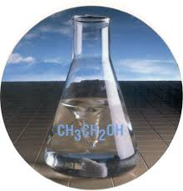
Ethanol Defense & Mix-I-Go
First formulated in 2010 as a response to developing consumer concern about ethanol fuels.
Ethanol Defense is formulated to address all of the main concerns that different vertical groups have about using ethanol blends.

Slide 10
What Ethanol Defense Does For The User
Combustion improver
Detergency for fuel injectors and combustion chambers
Commercial-grade water control and stability
Protection for rubber and polymer parts from ethanol damage
Concentrated formula (1:1000)

Slide 11
Combustion Improver
Better gas mileage and fuel economy to help restore lost mileage effects of ethanol blends.
Mileage improvement is also a reason of engine cleaning.

Slide 12
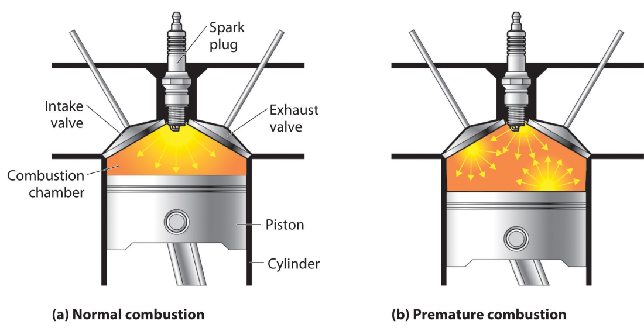
Detergency & Restored Octane
Fuel injector detergency is the biggest factor in improving mileage chemically.
Detergency to clean dissolved polymers absorbed by ethanol
Helps restore proper octane rating
Notes:
Fuel injector cleaning can add 2-3% to mileage by itself, according to research done by the SAE
Gasoline has been required to contain detergent since 1996. But it’s been shown to not be enough.
Does not contain octane improver by itself
Many customers can run on higher octane fuel, though the company position is to follow the manufacturer’s recommendation for grade of gasoline to use

Slide 13
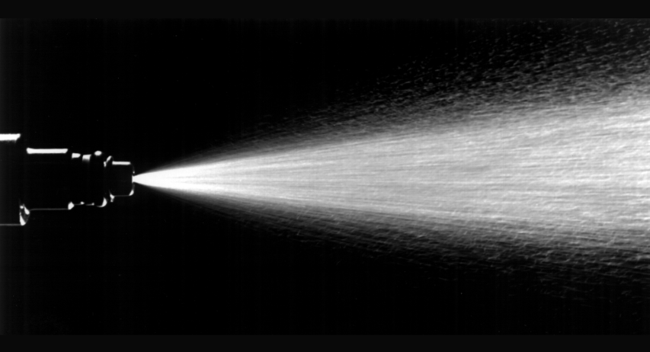
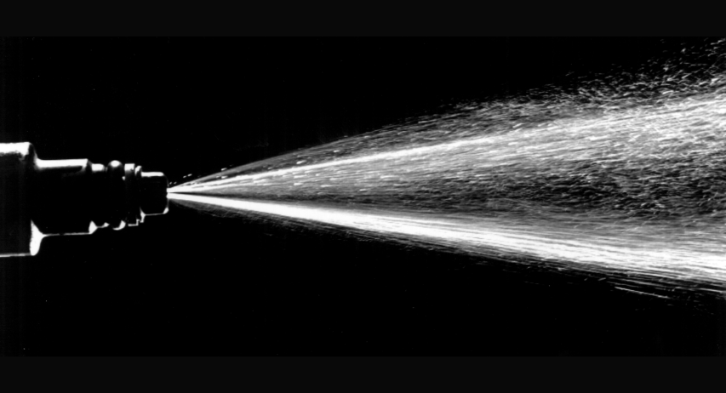
Removal of Deposits Improves Fuel Injector Spray & Mileage
Clean Injector Spray
Fouled Injector Spray
Notes:
Fuel cannot burn optimaly without proper atomization

Slide 14
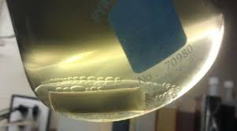
Water Control, Absorption, and Stabilization
Solves the critical ethanol problem of water absorption
Prolongs phase separation for improved storage
Contains dispersants and antioxidants
Improves storage life of ethanol blends

Slide 15
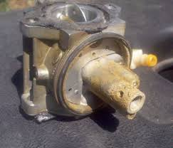
Protects against ethanol corrosiveness and solvency
Fuel soluble lubricant protects rubber & plastic from attack
Protects small equipment from damage
Water controller helps blunt corrosiveness
Notes:
Ethanol is corrosive, in part, because of the water it attracts

Slide 16
Opportunities & Markets
Municipalities & companies with gas-powered fleets
Small equipment protection for private and public sector
Police fleets

Slide 17
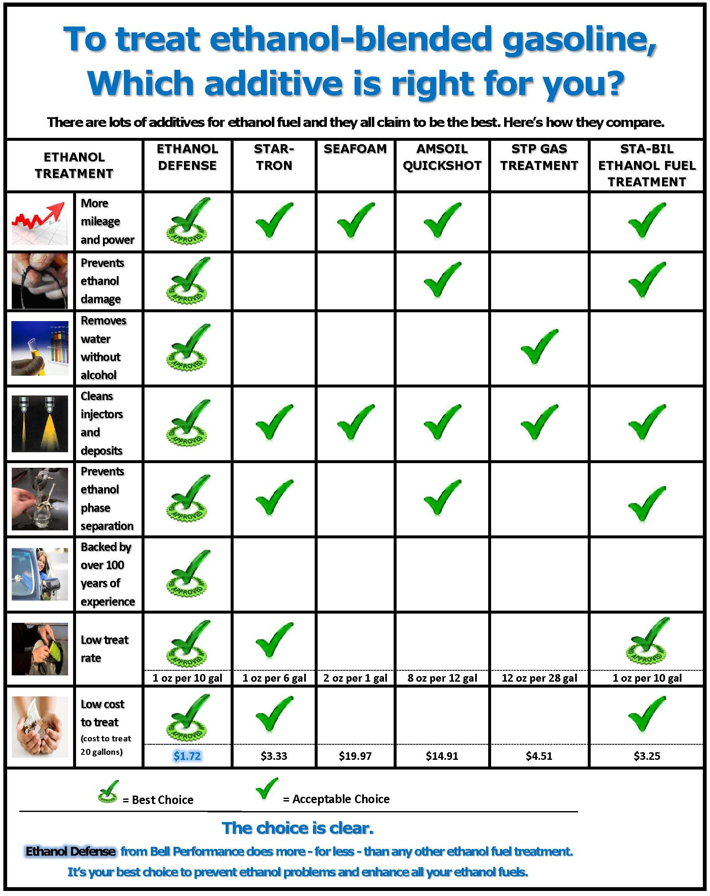
Competition Comparisons
Also available on bellperforms.com
Notes:
Seafoam is most alcohol
STP is mostly solvent

Slide 18


