Slide 1
Diesel Fuel Treatments
NEW DIMENSION LOGISTICS – JANUARY 2015

Slide 2
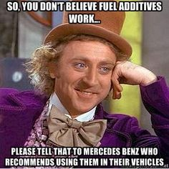
What We’ll Cover Today
Problems and concerns for diesel users
Markets for diesel additives
Bell Performance multifunction diesel solutions

Slide 3
Issues Facing Diesel Users
Mileage
Emissions (

Slide 4
Recent History of Diesel Changes
Increased cracking of distillate fuels like #2 diesel
Removal of sulfur from diesel for environmental benefits
Lubricity problems
Cold flow
Susceptibility to microbes
DPF and DEF systems
Biodiesel

Slide 5
Problems and Concerns for Diesel Users
Deposits in diesel engines
No detergent requirements
Diesel injector deposits & mileage
Excessive emissions
Incomplete combustion
DPF service intervals
Water in stored diesel
Diesel injectors don’t like water
Notes:
Diesel engines are simpler in design than spark-ignition engines and last longer
But performance can definitely be improved by things like removing deposits

Slide 6
Problems & Concerns
Microbes & Stability
Lubricity
Not so much a problem with biodiesel mixing
Cetane
Inadequate cetane rating related to a host of problems
The goal is to reduce operational costs & extend equipment life.
Notes:
Threw lubricity in there to mix it up
Cetane rating = emissions, poor starting, noisy running, lack of perceived power
Ask James if I missed anythiing

Slide 7
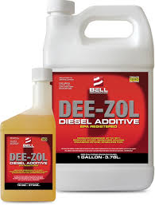
Dee-Zol Multifunction Fuel Treatment
Combustion improver
Detergency
Cetane Improver
Lubricity Improver
Stabilizer & dispersant
Water control (emulsification)
Cold flow (in Dee-Zol Plus)
Concentrated formula 1:1280

Slide 8
Combustion Improver
Organic combustion improver
Prevent pre-oxidation reactions in combustion chamber

Slide 9
Detergency
Modern fuel injection technologies are designed to facilitate compliance with ever more stringent emission targets
Greatly increased pressures (2000 Bar !!!) are required to generate adequate fuel flow through reduced dimension labyrinth.
Prevents formation of, and removes existing, deposits (coking) caused by fuel decomposition
Results in optimal fuel spray pattern being maintained (as demonstrated in the Cummins L-10 IDT and numerous other engine depositing tests).
Disperses particulate into submicron packet's
Notes:
Engine technology is changing, becoming more advanced and creating the need for better treatment technologies.

Slide 10
Detergency Benefits
Reduced wear in the upper cylinder
Reduce / prevent ring deposits
Better fuel economy (up to 3.5 %)
Helps maintain fuel spray pattern
Restored horse power / Torque/combustion noise
Helps reduce emissions and black smoke
Reduced maintenance of injector system and extended vehicle life
Cleaner fuel system

Slide 11
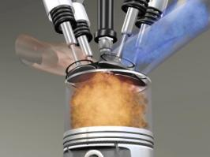
Cetane Improver
Adds up to 2 points of additional cetane rating
Lower emissions
Smoother running engine with more power

Slide 12
Lubricity Improver
Fuel-soluble lubricant to improve diesel fuel lubricity
Not so important with practice of biodiesel blending
Notes:
Adding as little as 2-5% biodiesel will solve lubricity problems for ULSD

Slide 13
Stabilizer & dispersant
Antioxidant to prevent oxidative chain-reaction initiation
Dispersants to keep sediment precursors aparts
Anti-peroxidals to combat degredative peroxide formation
Improve and extend the storage life of diesel life

Slide 14
Water Control
Picks up free water and draws it into the fuel
Necessary to protect injectors
Help reduce microbial growth (but does not kill it)

Slide 15
A little bit about treat rate
Concentrated treat rate of 1:1280
Treat rates determine whether an additive can do what it claims to do
Can an additive do ten different things at a 1:10,000 treat rate?
Notes:
You may not need high amounts of certain things, but that only goes so far.
Detergents may only need 100 ppm, more if you want a one-tank clean.
100 ppm = 1-10,000
Cetane improvers typically need 500-1000ppm to work.
Therefore, you could not have effective cleaning and cetane improvement both together at 1:10,000

Slide 16
Opportunities and Markets in the Diesel Sector
Fleets – private and public sector
Buses
Construction
Light marine
Regular use diesel generators

Slide 17
DFS Plus
Commercial-grade water absorber, formulated for the fuel storage market.
Absorbs water and locks it into phase with the fuel.
Works in both gasoline (ethanol) and diesel.

Slide 18
Market Potentials
Any place adversely affected by water buildup in stored fuel
Diesel generators
Fuel distributors
Fleets
Marine environments
Pair with Bellicide and Dee-Zol Life
Notes:
Ask for input from Dan Bordui and James Dunst

Slide 19
Registration of Fuel Additives
How do I know it’s safe?
EPA registration requirement for fuel additives
“Substantially chemically similar”
Things you are and are not allowed to put into fuel

