Slide 1
Cold Flow Handling of Diesel Fuels
NEW DIMENSION LOGISTICS – JANUARY 2015

Slide 2
Items To Cover Today
Chemistry of diesel and cold flow
Creation of ULSD and how it impacted diesel fuel properties
Differences between summer ULSD and early winter ULSD
Impacts of changes on Ultra Low Kerosene

Slide 3
The basis for the need for cold flow improvers
Wax crystals precipitate out of diesel fuel as temperatures become cold.
These wax crystals plug fuel filters and lines, thereby shutting down equipment.
Cold flow additives like Cold Flow Improver (CFI) lower the operational temperatures of diesel.
Notes:
Brief overview of the basis for what we’re talking about

Slide 4
Glossary of Terms
Cloud Point – temperature at which fuel becomes cloudy when wax first precipitates out
Cold filter plug point – temperature at which wax may be expected to plug fuel filters and interrupt engine operation
Pour Point – temperature at which fuel gels enough so as to not be pourable

Slide 5
Diesel Fuel Chemistry
Diesel Fuel is comprised of aromatic, olefinic and paraffinic hydrocarbon compounds.
Paraffins
C_{n}H_{2n+2}
Naphthenes
Aromatics
Olefins
n-Decane
Butylcyclohexane
Butylbenzene
Heptene
iso-Decane
Decalin
Naphthalene
Notes:
A mix of different kinds of molecules

Slide 6
Removal of Sulfur To Meet ULSD Standards
Dropping of max. sulfur levels in on-road diesel fuels from 5,000 ppm to 500 ppm in 1992(for environmental reasons).
2006 – further reduction in sulfur to 15 ppm, creating Ultra Low Sulfur Diesel (ULSD).
Sulfur removed at the refinery level.

Slide 7
How can they get the sulfur level down?
Hydrotreating
Distillation cut management
Removal of heavier components where S is more difficult to remove
Import of high quality feedstocks
Crude oil sourcing
Lower Sulfur crudes provide Lower S products
Use of low Sulfur components for blending
Alternative Fuels
The necessary desulfurization of these fuels alter essential properties like paraffin wax content.
Notes:
Alternative fuels like biodiesel which naturally is low sulfur.

Slide 8
Paraffins
Notes:
Paraffins are the waxes that cause cold problems.
They get chemically altered so they come out of solution easier in cold weather.

Slide 9
As diesel fuel cools
Straight-chain paraffin waxes in the diesel fuel come out of solution.

Slide 10
Progression of Crystal Formation As Temperature Drops
TEMPERATURE
Nuclei formation
10ºF
0ºF
-10ºF
-20ºF
Visible crystals form
Crystals grow and begin
to adhere to each other
Formation of Large crystals in the fuel that stick together. Liquid is trapped in honeycomb pockets.
Notes:
Independent crystallization dominates the onset of solids formation.
Crystallization nucleation is pure component driven phenomena Therefore cloud point largely follows freezing point depression theory as applied by independent crystallization of pure components.
This generates nucleation sites for similar compounds that may attach to the surface of forming solids
Independent crystallization creates cloud points and has single component driving forces. Solid solutions result in pour points and are driven by the total concentration of homologous species in solution. A different approach is required to manage both systems.
Even & Odd n-paraffins have a different enthalpy of fusion. The net heat of crystallization is different. Even number n-paraffins form crystals at higher temperatures.
Spread between carbon numbers cause a difference in precipitation. Non-linear mixing rules are inadequate. Ratio effects this difference between formation of solid solution vs. pure component crystals.

Slide 11
Wax Crystal Formation in an Untreated No. 2 Diesel Fuel
120 microns
Notes:
Important to note that cloud/CFPP/pour properties can vary even from batch to batch.
That’s because paraffin content is a natural property and you cannot control exactly how it is changed by refining processes.

Slide 12
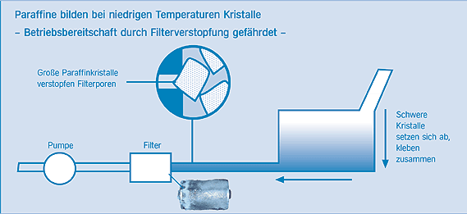
Caused by wax crystal formation that will plug filters and clog lines during cold temps. Icing of fuel filters followed by waxing, Icing of water separators
Causation of cold weather operational problems
n-Paraffins form crystals at lower temperatures – Filter plugging causes operability problems
Large paraffin crystals
can block filter pores
Heavy, large crystals sediment and agglomerate
Pump
Filter

Slide 13
Desulfurization Impact On Wax Levels In Fuel
Changes in the processing of middle distillates to make ULSD resulted in chemical changes of base fuels and things like wax content.
The result? ULSD fuels didn’t respond as well to cold flow treatments.

Slide 14
Relative Increase in Precipitated Wax
Removal of sulfur caused two phenomenon seen here:
Higher wax content from ULSD
Earlier more rapid precipitation
Notes:
Graph shows how more wax comes out at colder temperatures as more sulfur was removed.

Slide 15
Impact on the fuel’s wax distribution
Taking the sulfur out of diesel altered the distribution of wax in the diesel.
The result? Diesel fuels that are harder to treat effectively for cold flow protection.
Analysis of wax distribution in these fuels tell us some things.
Notes:
We won’t go into a lot of detail here. All you need to know is that looking at wax distributions for fuels can tell industry professions some hints about how it’s going to perform in the cold.
IF I HAVE TO GIVE AN EXAMPLE….
Normal distributions allow for an even precipitation of waxes, making them easiest to treat.
Narrow distributions result in a rapid precipitation of waxes and are very difficult to treat.
Heavy n-paraffins precipitate out at higher temperatures creating a competitive nucleation effect. These fuels tend to have a high final BP.

Slide 16
Paraffin Ratio / Wax Distribution in Diesel Fuels
Normal distributions allow for an even precipitation of waxes, making them easiest to treat.
Narrow distributions result in a rapid precipitation of waxes and are very difficult to treat.
Heavy n-paraffins precipitate out at higher temperatures creating a competitive nucleation effect. These fuels tend to have a high final BP.

Slide 17
Paths to Achieve Desired Performance in Winter Conditions
Cold Flow Improver additives can significantly improve low temperature operability limits & economics when:
Properly formulated, adjusted and added to meet regional requirements
Used to maximize performance with kerosene blends

Slide 18
Factors with Ultra Low Sulfur Kerosene
Chemical changes have also impacted ultra low sulfur kerosene (ULSK)
ULSK blends have higher cloud points than in the past..
ULSK were expected to be in shorter supply during the changeover, but have stabilized.
Notes:
Kerosene is used to lower cloud point of fuel blends in extremely cold environments.
Used to be -50 or -55. Now closer to -35 or -40 cloud points.

Slide 19
Kerosene/#1 Diesel Blending Downsides
Only Dilutes Wax Content
Does Not Alter The Way The Wax Grows
Still forms large Crystals at lower temperatures
Large Quantities Must Be Used
Horsepower Loss
Fuel Consumption Increase
Less Lubricity
Higher Cost per Gallon - Lost Revenue

Slide 20
Middle Distillate Flow Improvers (Cold Flow Improvers)
Gain an increase in operability by changing the way a wax crystal grows
Different Crystal Shape
Creating smaller crystals
Avoiding the large crystals and subsequent agglomerations
Prevents an impenetrable film from building up on the filter
This allows the engine sufficient time to warm up and melt the wax

Slide 21
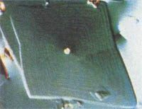
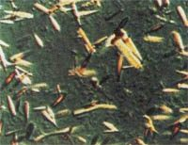
Middle Distllation Flow Improvers – How They Work
Form and size of n-paraffin crystals were influenced by adding CFIs
Crystallisation depends on type and amount of n-paraffins as well as on the middle distillate oil matrix, e.g. aromatics, naphthenics

Slide 22
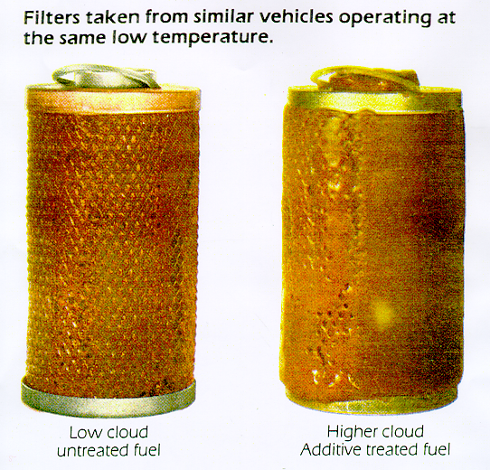
Wax Crystal Formation 101
Treated with Treated with
MDFI Typical Anti-Gel/PPD

Slide 23
Theory of Action - Low Temperature Operability Additives
Wax Anti Settling Additives (WASA)
Chemistries that keep wax modified crystals evenly dispersed for extended periods of time throughout the fuel relative to non dispersed systems.
The end result is an even distribution , by weight, of n-paraffins regardless of the depth of the sampling.

Slide 24
Wax Dispersant Technology
Operability increases by dispersing crystals.
Wax dispersants are used in combination with typical CFI’s.
Wax dispersants improve performance by keeping wax crystals dispersed for long periods of time when fuels are stored below the cloud point.

Slide 25
Typical Cold Flow Responses for Ultra Low Sulfur Fuels
Q: If you treat diesel fuels with Cold Flow Improver, what temperature drop benefit should you expect?
A: It’s variable, depending on the fuel composition.

Slide 28
What are the Keys to Better Cold Performance for Diesel Fuel?
#1 – Have the correct concentration of
Cold Flow Improver in the fuel

Slide 29
CFPP Volume vs. Performance

Slide 30
Fuel Response Curve (The Cliff Effect) – Too Much Is Better?
Notes:
Discussion on how amount of CFPP needed at higher temperatures goes up exponentially.

Slide 31
What are the Keys to CFI Performance in Fuel?
#2 – Have the correct base of
Cold flow constituents in your formulation
Notes:
This is not something you need to worry about, but you need to know that we’re on top of this.

Slide 32
CFI: Basic Chemistry
Variables:
Vinyl acetate content
Molecular weight (M_{w}; M_{n})
Polymer distribution
Solvent
Active polymer content
Ethylene-Vinyl acetate copolymer (EVA)
Notes:
This is the basic molecule.

Slide 33
Keys to CFI Performance
Having the correct synergists for the fuel blend
Various chemistries enable better CFI performance
Certain resins work well with heavy end waxes
Poly-methacrylates,
Alkyl-phenols
Comb polymers work well with narrow boiling range fuels
Notes:
Run through this quickly.

Slide 34
n-PARAFFIN DISTRIBUTION
Normal
Narrow
Hi-FBP
Heavy end
HE

Slide 35
Fuel Response to Synergists – The Right Blend

Slide 36
Regional CFI Performance Data

Slide 37
What are the Keys to CFI Performance in Fuel?
#3 – Have to prevent
Fuel Icing Problems

Slide 38
Deicer’s / Water Dispersants in Cold Flow Improvers
Water Icing Prevention
Dual stage deicer water dispersant system
Demulsifier / Dehazer system

Slide 39
Recommendations for CFI customers to control water
Good housekeeping practices are required on a consistent basis
Drop out excess entrained water
Generally requires a demulsifier
Use deicers consistently
High molecular weight Glycol Ethers
Maintained in sufficient quantity
Freeze point at or below CFPP levels
Avoid light alcohols .

Slide 40
What is “Wind Chill” and Does it Effect Operability ?
Wind chill has no effect on operability.
High winds can remove heat much faster from a fuel tank than no wind at all. Sufficient warm up time is required.
The rate of temperature change has a significant impact on:
size and shape of wax crystal formation.
condensation and solubility of water within the fuel.
Wide swings and rapid drops in temperature can lead to icing problems.

Slide 41
Smaller Filter Sizes Resulting In Higher Gelling Temperatures
Diesel engine manufacturers is using “smaller” diesel fuel filter specs.
This spells bad news for cold flow protection, but also good news for us.

Slide 42
Fuel Filter Area vs. Micron Sizes: Smaller Filter Sizes Than Before
25 μ size
491 μ²
78.5 μ²
19.6 μ ²
3.1 μ ²
5 μ size
19.6 μ²
4%
10 μ size
78.5 μ²
16%
2 μ size
3.14 μ²
0.64%

Slide 43
Smaller Filters Mean Higher Gelling Temperatures
Conventional recommendations expect CFPP temperatures of 8-10 degrees below fuel cloud point.
Smaller filter (i.e. 5 micron vs. 10 micron) mean CFPP temperatures now can be a full 5-8 degrees higher than before.
This means it’s even more important to treat diesel fuel with cold weather treatment.

Slide 44
Coordinating Treatment: Quick Thaw
What to use if the fuel has already gelled?
Need something to get back on the road as quickly as possible.
Cold flow improvers only prevent the problem, they don’t fix a gelling problem afterwards.

Slide 45
Quick Thaw – fixes gelled fuel problems
The only Bell formulation that contains alcohol.
Formulated as an emergency “fixer” solution.
Thaws gelled fuel and fuel systems.

Slide 46
How to use Quick Thaw
Clear out the fuel filter, fill with Quick Thaw.
Add Quick Thaw to the fuel tank.
Allow fuel to circulate.
This creates two thaw points in the fuel system, and the Quick Thaw will diffuse outward, thawing fuel on contact.
Thaw a normal-sized gelled fuel system in about 45 minutes.

Slide 47
Market Opportunities for Cold Flow/Quick Thaw
Not Florida…..
Fleet and businesses in cold weather climate who rely on engines to get the job done
Long haul truckers
Emergency generators
Customers with a strong financial stake in avoiding fuel gelling problems.

Slide 48
Slide Title

Slide 49
Slide Title

