Slide 1
Biocide Factors & Use
NEW DIMENSION LOGISTICS – JANUARY 2015

Slide 2

What We Will Cover Today
ULSD fuel changes and the need for biocides
Other biocide applications
Sources of microbial contamination
Problems they cause
Biocide options and chemistries
Treatment applications

Slide 3
Microorganisms in ULSD – Anticipated Problems
2006 move to ultra low sulfur diesel (ULSD) rightly sparked concern among industry experts on how the new fuels would behave in the field.
“Natural stabilizers, lubricity agents, conductivity improvers and biological growth inhibitors will be greatly reduced or absent due to processing.”
  Excerpt from an Octel-Starreon presentation to Phillips Petroleum 5/04/2001
Notes:
Comment about how ULSD is going to change things

Slide 4
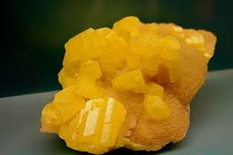
Removal of Sulfur from Fuel
Sulfur impact on microbes
High sulfur diesel fuel contained high amounts of sulfur - up to 5,000 ppm. This decreased to 500 ppm in the 1990s, and then to 15 ppm in 2006-07.
Sulfur and many sulfur compounds are antagonistic to microbial growth
  Less biocide was required in those high sulfur systems
Notes:
Sulfur inhibits microbial growth

Slide 5
How Removal of Sulfur Changed Fuel Properties
Reducing sulfur levels (through hydrotreating) removed naturally occurring microbial inhibitors in the fuel
Sulfur and sulfurous compounds
Certain phenolic compounds that were also natural microbial inhibitors
Result? Increased biocide levels would be required to provide comparable performance/protection to before.

Slide 6
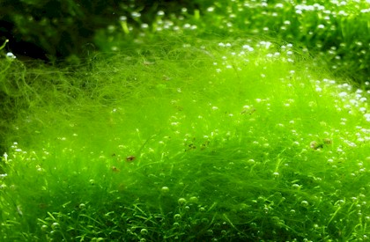
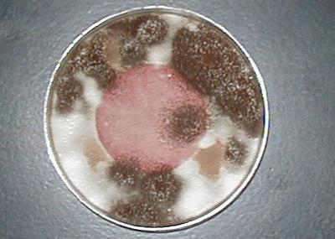
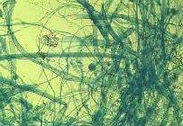
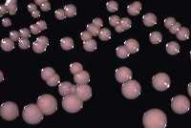
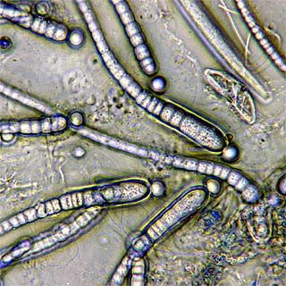
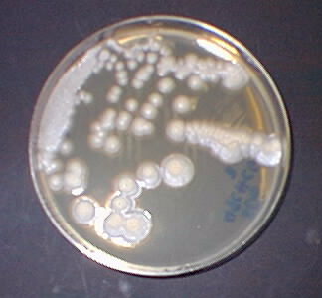
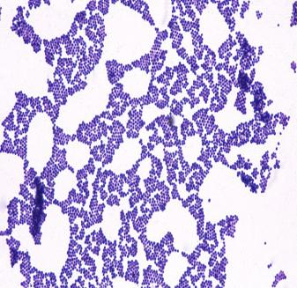
Types of Microbes Found In Stored Fuels
Algae – Not a fuel issue
  Photo synthetic; requires light
Fungi
  Mold (filamentous)
  Yeast (single-celled)
Bacteria
  Single cell organisms
  Extremely small (1 - 10 microns)
  Rapid growth (20 - 30 min generation time)
  1 cell can replicate into > 2 million cells in only 7 hrs
All of these will use hydrocarbons as a food source
Algae
Mold
Yeast
Bacteria
Notes:
Algae is the common name for all of these, but we know algae cannot grow in fuel.

Slide 7
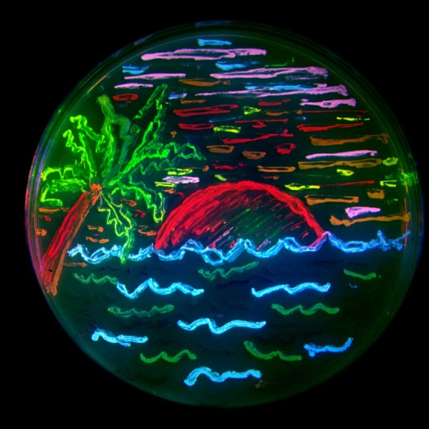
Microorganisms: Universally Present and Easy To Please
Present in the air we breath
Will enter storage tanks through variety of ingress avenues:
  Vents
  Water encroachment,
  Fuel delivery, etc.
Need water to live
Bacteria, Molds, Yeasts grow and multiply as conditions allow
Notes:
Microbes are everywhere.
Microbes grow wherever water meets fuel. Most people recognize the need to remove bottom water, but even in regularly drained tanks, microbes thrive in tank-wall slime.

Slide 8
Common Sources of Microbial Contamination in Storage
When faced with a contaminated tank, it is almost impossible to pinpoint, for sure, where the contamination originated from.
Vents allow air, water & dust to enter during tank ‘breathing
Ingress from Condensation
Cross contamination between systems
Manifolds
Ingress from fuel delivery

Slide 9
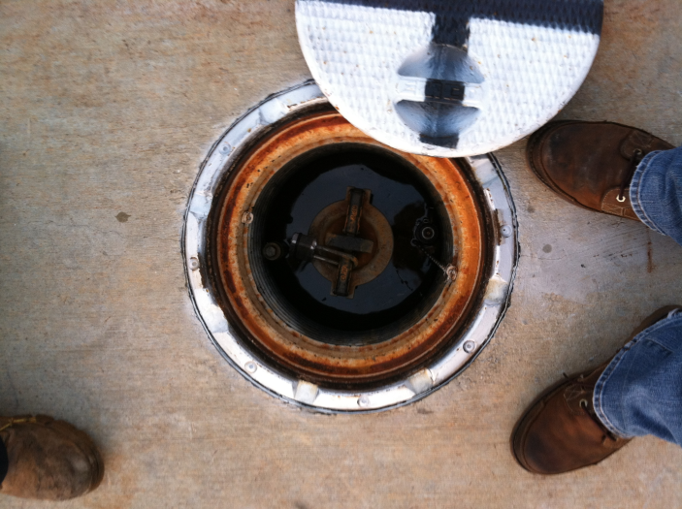
Common Sources of Microbial Contamination cont.
Leakage through fill cap and spill bucket
Unsealed sounding ports and manways
Floating roof leaks
Ballast/Seepage water
Transfer piping: fixed & portable
Leakage into underground tanks
Notes:
Photo of a spill bucket with the lid off.
So many possible sources, hard to know where it came from.
When an end user has a microbe problem, they blame the fuel supplier (KEY SELLING POINT)

Slide 10
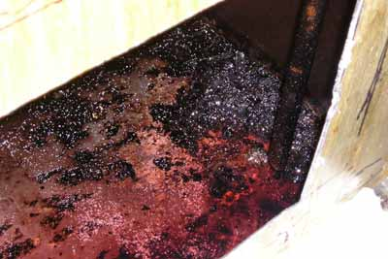
Problems Causes Common To All Microbes
The lifecycle of microbial infestations leads to universal problems for the user:
Consume fuel
Make sludge and debris
Promote corrosion
Clog filters and burner nozzles
Generate acids and surfactants that destroy fuel quality
Notes:
Picture of a corroded tank floor.

Slide 11
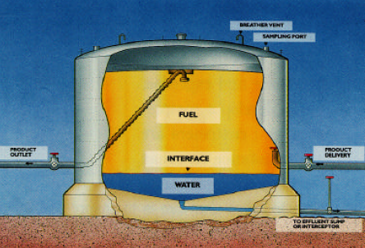
Storage Tanks Are Common Microbial Breeding Grounds
Notes:
Hydrocarbon fuels such as diesel fuel, kerosene, and heating oil are often stored in contact with water.
It is not uncommon for a diesel fuel tank to accumulate as much as 1% water (based on the volume of fuel) as a result of condensation during long-term storage.
At the water / hydrocarbon interface, conditions are favorable for the growth of microorganisms which often contaminate fuels.

Slide 12
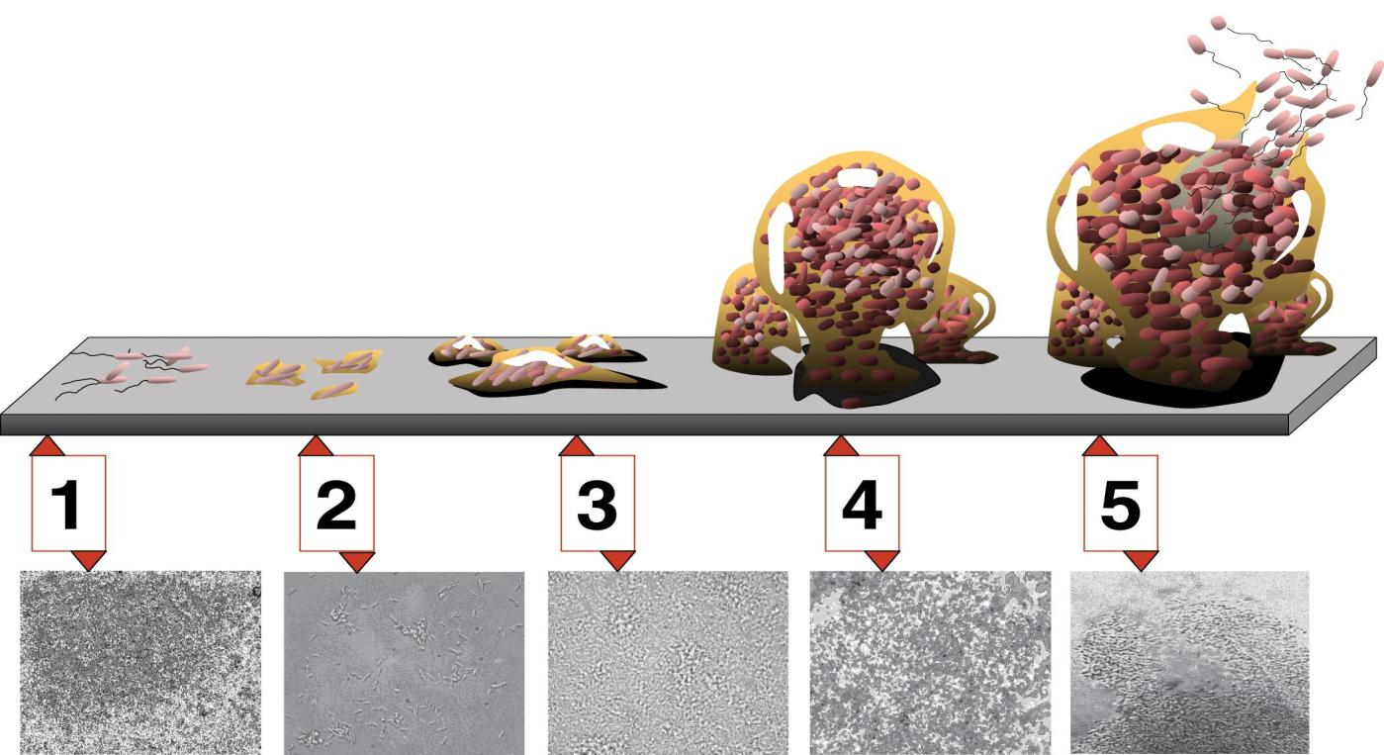
The Common Microbial Growth Cycle
Stage 5, dispersion (days to months)
Stage 1, initial attachment
(seconds)
Stage 2, irreversible attachment
(seconds to minutes)
Stage 4, maturation II
(hours to days)
Stage 3, maturation I
(hours to days)
Notes:
There are 5 basic stages of biofilm development.
Stage 1, initial attachment
Stage 2, irreversible attachment
Stage 3, maturation I
Stage 4, maturation II
Stage 5, dispersion.

Slide 13
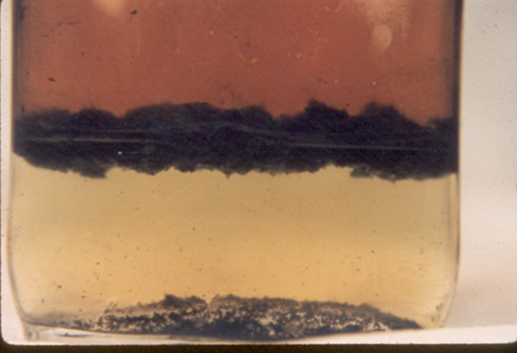
Essentials Needed for Microbial Contamination
Microbes cannot grow appreciably in diesel fuel alone.
Water is necessary to sustain microbial life and growth
Microbes, in general, can live at the fuel water interface
Water bottoms (the big cause)
Any place a droplet of water is present (less of a problem)
Diesel Fuel
Bio-mass
Water
Notes:
Although the microbes need water to grow they need very little. In practice there is often sufficient water in the bottom of large storage tanks and even in the fuel tanks of road vehicles such as trucks and buses for some microbial growth to occur.
The microbes tend to be most active at the interface between the water and fuel and also on internal tank and system surfaces. When the tank contents are disturbed, for example when the tank is refilled, the microbes become suspended in the bulk fuel where they cause fouling and may be passed on down the distribution chain to contaminate facilities downstream. Costs for decontaminating facilities are high.

Slide 14
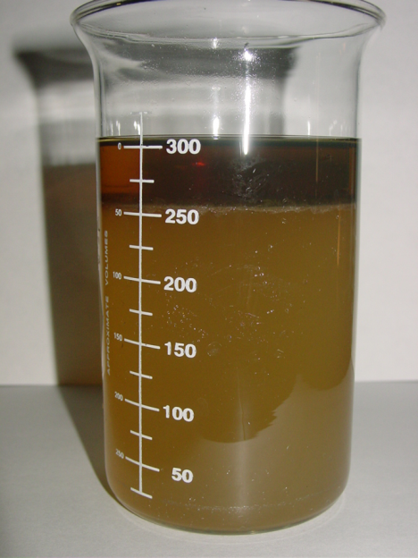
Types of Microbial Contamination: Planktonic
#1 - Planktonic = Free “swimming” microbes
Live in the water bottom
Feed off the hydrocarbon upper phase as it slowly “leaches” into the water
#2 - Living at the fuel-water interface
Notes:
Single-celled organisms generally exhibit three distinct modes of behavior.
The first is the familiar free floating, or planktonic, form in which single cells float or swim independently in some liquid medium.
Microbial surfactants can stimulate the suspension of water in fuel causing it to become hazy and causing failure of fuel water separators.
Second is existance and multiplication at the fuel-water interface.

Slide 15
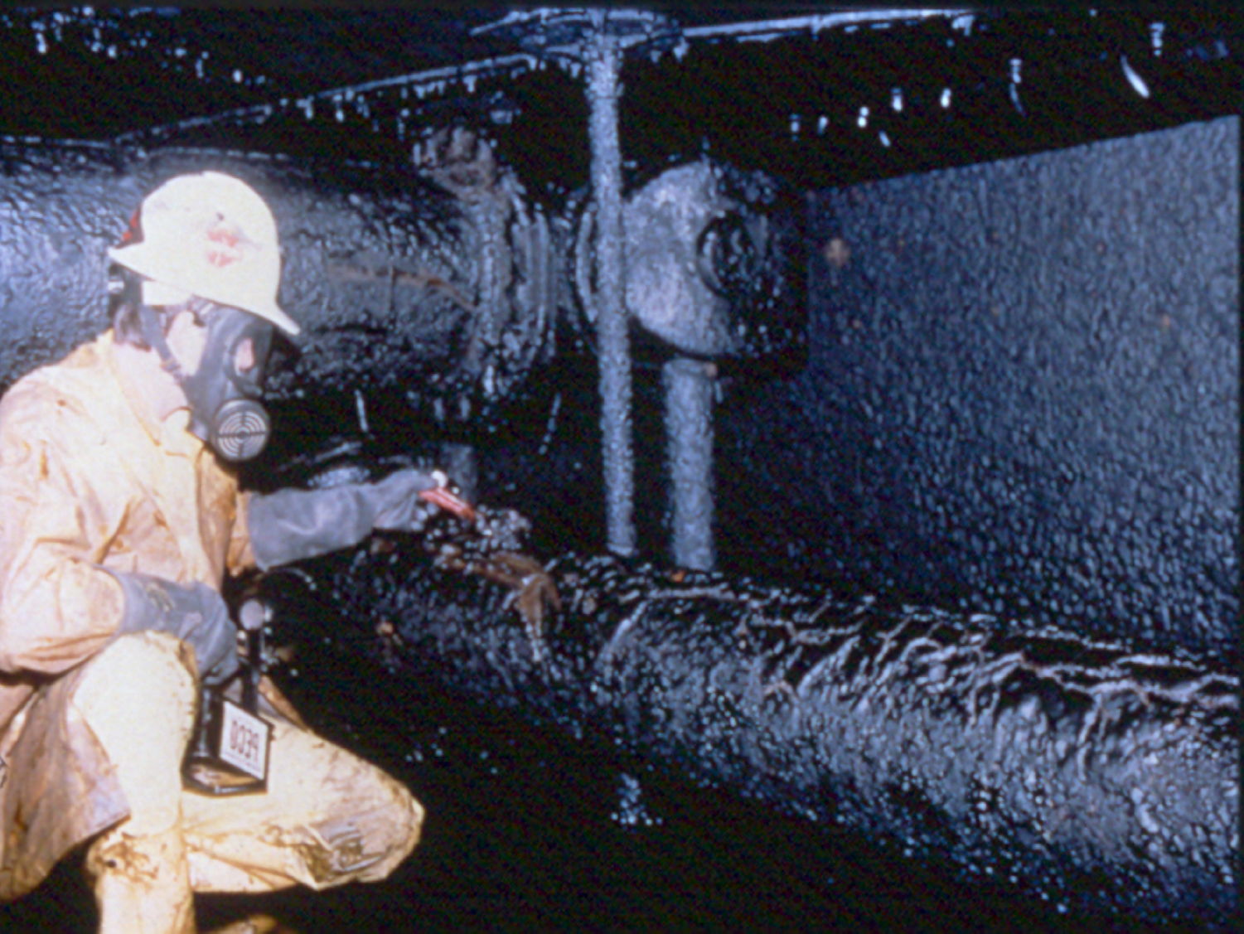
Microbial Contamination: Sessile Microbes & Biomass
#3 - “Sessile” microbes = live on surfaces, not in fuel
Microbes produce biomass through their lifecycles – one of the signs
Can live in biomass attached to sides of fuel tanks, floating roofs, booms
Notes:
The second (sessile) is an attached state in which cells are closely packed and firmly attached to each other and usually form a solid surface. A change in behavior is triggered by many factors, including quorum sensing, as well as other mechanisms that vary between species.

Slide 16
Microbial Contamination Product: Biomass
Biomass blooms: lipopolysaccharides
Offer microbes protection & a breeding area
Can be difficult to remove, even manually
Biocides only penetrate the outer layer, increasing chances of reinfection.
Notes:
A biofilm is a complex aggregation of microorganisms marked by the excretion of a protective and adhesive matrix. Biofilms are also often characterized by surface attachment, structural hetergeneity, genetic diversity, complex community interactions, and an extra-cellular matrix of polymeric substances.
Biomass or biofilm is important in a system because it can shield microbes from things like biocide action.
Many times, a system will become reinfected when new fuel is added because biofilm gets disturbed elsewhere in the distribution system after biocide had been applied and used up.

Slide 17

Microbial-Induced Storage Tank Problem
Biomass build-up in tanks and on filters
Notes:
Microbes can contaminate a wide range of petroleum fuels from heavy residual fuel oils to gasolines and cause very costly operational problems for suppliers, distributors and also end-users such as airlines, ship and small boat operators, haulage companies, bus and train operators and power generators.
Pseudo monads and sulfate-reducing bacteria have been isolated from contaminated fuels, but the greatest sources of problems are fungi, Yarrowia, Cephalosporium, Penicillium and, in particular, Hormoconis resinae and Aspergillus fumigatus.
When these organisms are allowed to grow unchecked, they produce long filaments, large mats, or globules which can cling to the surfaces of tank walls, pumps, delivery lines, and vital engine parts.

Slide 18
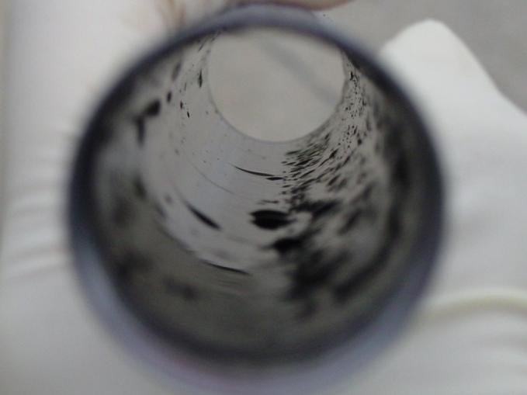
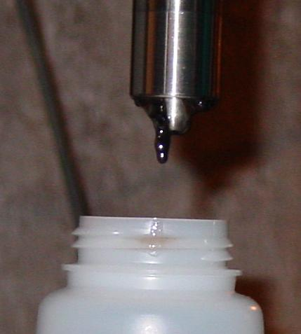
Microbial-Induced Diesel Fuel Problems: Biomass in Tank & Engine
Biomass build up
Biomass deposited on the inside of sampling thief after collection of tank bottom sample.
Sludge and water bottoms

Slide 19
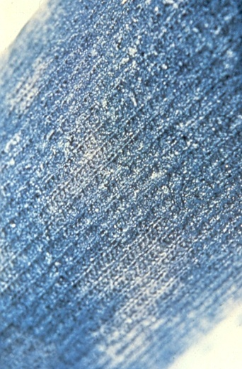
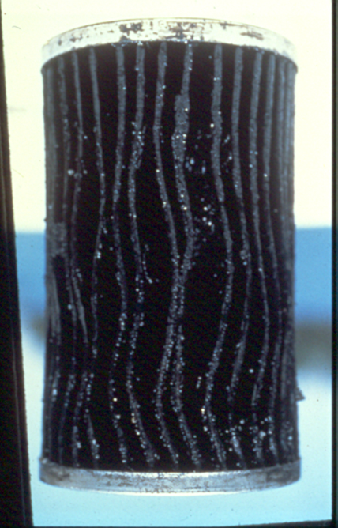
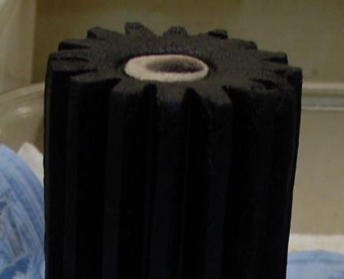
Problems Caused by Microbial Presence: Filter Blocking
Biomass build up
Fuel filter blocking
Fuel line blockage
Furnace Filter
Sock Filter
GM light duty truck
Heavy Duty
Diesel Truck Filter
Notes:
Fouling by slimes produced by bacteria, yeasts and/or molds can cause severe filter plugging, blocking of fuel lines and injectors. This can consequently cause excessive wear and failure of engines and system components. Fuel fouled by microbial slimes can fail particulate specifications.

Slide 20
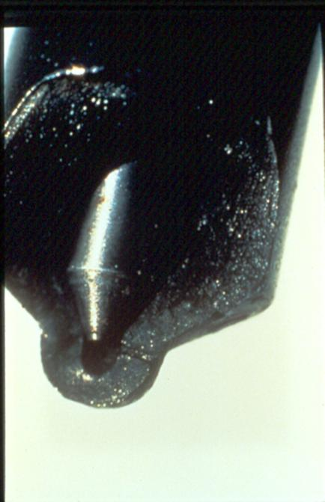
Problems Caused by Microbial Presence: Fuel Injector Fouling
Fuel deposits and biomass resulting from microbial activity can foul fuel injectors

Slide 21
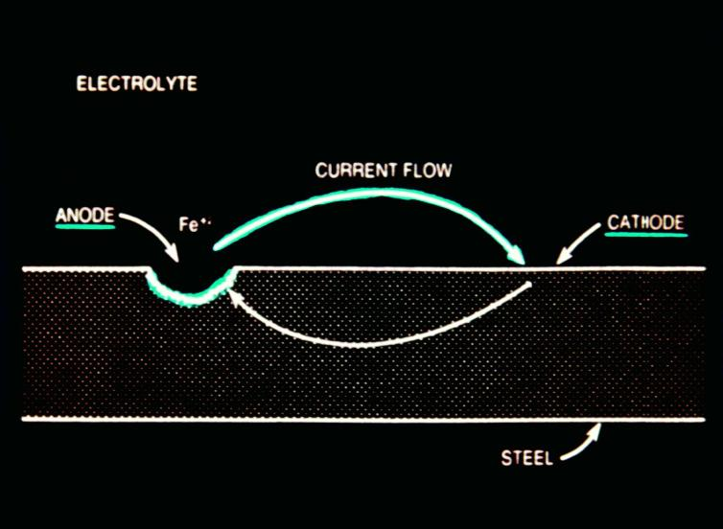
Problems Caused by Microbial Presence: Corrosion
Corrosion resulting from acidic products of microbial respiration and reproduction.
Expensive problem for storage tank, metal fuel distribution parts, and stand-by systems exposed to fuel for longer periods of time.
Acidic components also destroy fuel stability.
Notes:
Microbial growth in fuel tanks and fuel systems can result in rapid and severe corrosion. For example occasional problems occur in aircraft wing tanks due to the growth of molds and also yeasts and bacteria which produce organic acids and also stimulate corrosion by creating oxygen gradients which enhance electrochemical corrosion cells.
Microbes can sometimes induce the corrosion of steel and non-ferrous metals or they can accelerate normal electro-chemical corrosion processes. There are a number of mechanisms involved, which may operate at the same time or in succession. The mechanisms may be direct or indirect.
Examples of direct mechanisms are:
Corrosion by weak organic acids produced by many aerobic microbes
Corrosion by strong acids (sulphuric or nitric) produced by a few aerobic microbes
Corrosion by hydrogen sulphide produced by anaerobic Sulphate Reducing Bacteria (SRB)
Examples of indirect mechanisms are:
Oxygen gradient corrosion associated with oxygen depletion beneath microbial growth
Microbial destruction of chemical corrosion inhibitors
Microbial attack on protective paints and coatings
Corrosion of aluminum alloys in aircraft fuel tanks is promoted by local aggression from microbial produced organic acids and by the oxygen gradients which become established at aggregations of microbial growth.

Slide 22
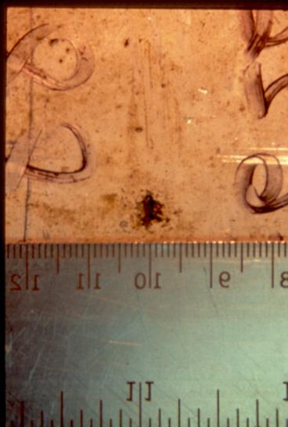
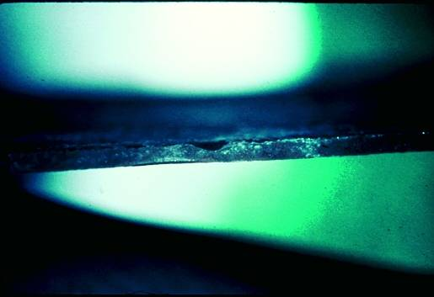
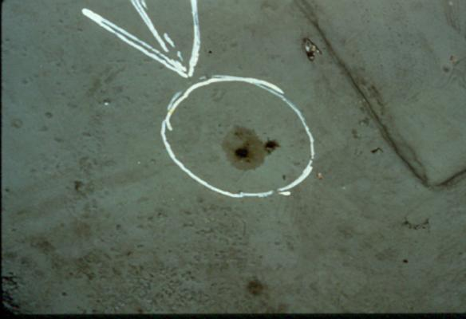
Problems Caused by Microbial Presence: Corrosion
Examples of corrosion resulting from acidic products of microbial respiration and reproduction.
Aluminum Saddle Tank
Notes:
In steel tanks, growth of Sulphate Reducing Bacteria (SRB) in water and sludge in the bottoms of tanks can cause pitting corrosion.
Microbially Influenced Corrosion of steel, largely caused by SRB, can be found in ships’ hull plate beneath bilge water, ballast water and oil cargoes and in tank bottom plate of fuel and crude oil storage tanks. Corrosion pits are formed which often have terraced edges and have a silvery grey colour when first exposed. Non-ferrous metals are stained black by SRB.

Slide 23
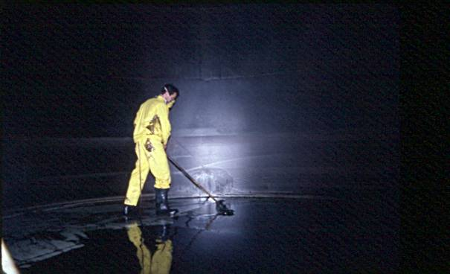
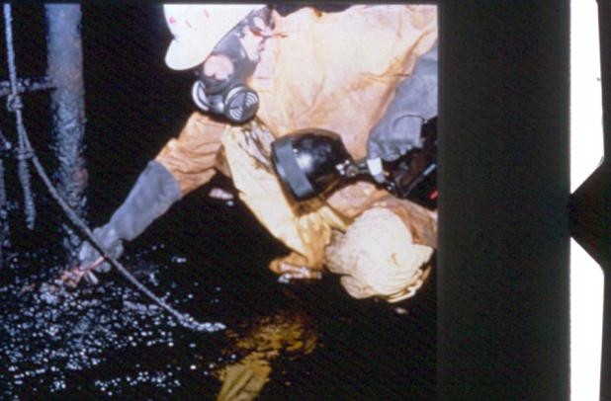
How To Fix The Problem?
Physical removal of biomass (and sessile microbes)
Remove the water bottoms (and monitor future development)
Treatment with Biocide
Remember that a clean tank does not mean a sterile tank
Fuel polishing & tank cleaning, without a biocide, will not solve the problem.
Notes:
Unlike in the past, removing the water is no longer a guarantee microbe problems won’t develop (because there’s always a time when something will be missed. It is true that if you could keep water 100% out of fuel, you would never get a microbe problem).
Biocide is the only thing that will kill a living microbe organism.

Slide 24
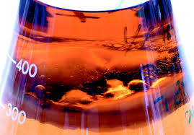
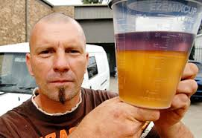
What Are The Signs of Microbial Contamination?
Visual inspection of fuel showing discoloration or presence of biomass, or sulfurous smell
Water phase in tank sample strongly correlates with microbial presence
Notes:
The value of the human touch – looking, smelling, observing

Slide 25
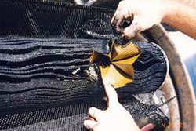
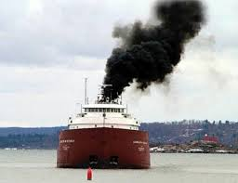
What Are The Signs of Fuel Microbial Contamination?
Increase in filter change frequency (vehicle or tank)
Change in engine performance to indicates poor fuel combustion
  Emissions, smoothness
Notes:
Change in engine performance probably means the engine is trying to burn some of the microbe products that don’t really burn well.
Or it means the microbes are breaking down the fuel quality.

Slide 26
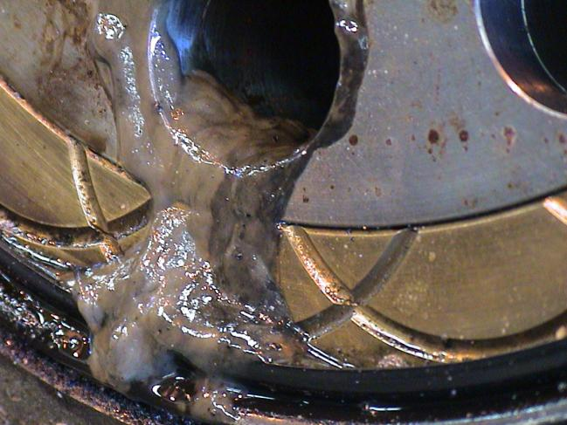
Industrial Biocide Treatment Areas
Oil and gas, forestry, mining sectors
Drilling fluids
Lubricating oil and hydraulic fluids
Any place were microbial activity and byproducts can damage equipment.
Notes:
We have spent most time up to this point talking just about fuel and microbes.
Biocides are widely used across oil and gas, forestry and other industrial sectors beyond just fuel applications.
Anywhere where microbial activity, biofilms and corrosion can interfere with industrial processes and damage equipment.
Microbial contamination in hydraulics, or lube oil systems can cause malfunction in the operation of the machinery due to blocked functions of vital parts in the installation.
Biofilm and slime from bacteria can block filters, nozzles and form sticky surfaces on machinery parts.
Biofilm is a typical cause for leakage trough rotary seals, and is forming glue between the seal and the surface of the shaft.
If the machinery is operated intermittent, the glue between the rotary parts will tear off the sealing lips of the seal during start up.
The first picture there is the oil distribution box of a hydraulic thruster unit. Note the excessive biofilm and slime. That should not be there.

Slide 27
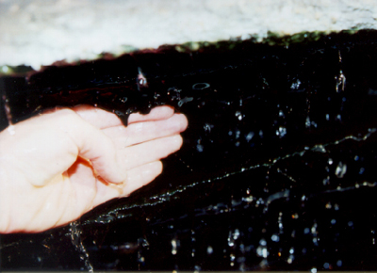
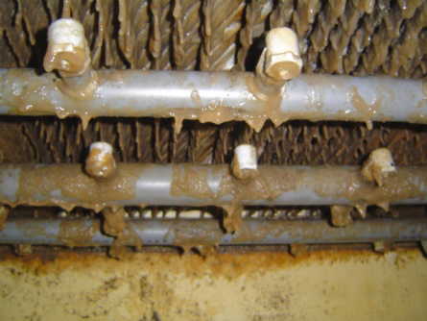
Industrial Biocide Treatment Areas cont.
Cooling towers and cooling water recirculation systems are prime breeding grounds.
Slime production and corrosion.
Reductions in cooling efficiency from algal/microbial growth.
Rot and damage to surfaces.
Notes:
Problems
Microbiological contamination and growth will increase the corrosion activity and deposit formations (biofilms) in the system.
Biofilms are excellent insulators. Their presence will significantly increase the energy consumption.
Increased risk of transmission of infectious diseases, e.g. Legionnaires’ disease.
Causes
Microbiological contamination is introduced to the recirculating system through the make-up water and airflow over the tower. Conditions in the system, a warm, moist environment, are conducive for microbiological proliferation.
Certain bacteria produce slime as part of their metabolism. The slime acts as “glue” by binding other contaminant particles together and adhering to the system’s surface.
Corrosion cells can be extremely active under biofilms. This is known as under-deposit corrosion.
By-products of bacteria and algae metabolism can increase the corrosiveness of the system water.
Algae growing on the distribution decks and fill can result in uneven distribution of the water and poor cooling efficiency. Algae can plug the distribution nozzles which will have to be cleaned.
Cooling water tower surfaces need to be proteted from microbial rot damage.
The best defense against biofouling is the continuous feed of microbiocides. Microbiocides are chemicals that inhibit the growth or reproduction of microorganisms eventually resulting in death.

Slide 28
Bellicide™ Features (The Good Stuff)
Industry leading efficacy on bacteria and fungi
Through its thiocyanate chemistry
Effective in both fuel & water phases
Partitions effectively into water phase to kill microbes
Highly effective in both B100 and all range of Bxx bio-blends
Leaves no corrosive deposits
Notes:
Important to partition into water phase so the planktonic microbes can be killed.
Important to be effective in biodiesel because of biodiesel’s affinity for microbial growth

Slide 29
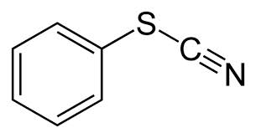
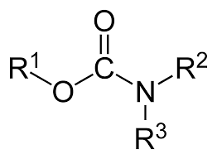
How Bellicide compares to other chemistries
Most true biocides fall into 4 or 5 main chemistry groups. Some chemistries are better than others.
Thiocyanate(Bellicide) – Very effective and tolerant of most environments of use. Does impart some sulfur. Works in both oil and water phase.
Carbamate (Pri-ocide/Aquatreat) – Very effective. But contains a lot more sulfur.
Notes:
Most biocide product names fall into one of these 4-5 chemistries because they are simply relabels.
Bellicide adds 1-2 ppm of sulfur to ULSD.

Slide 30
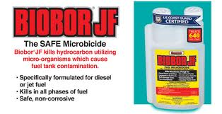
How Bellicide compares to other chemistries
Dioxyborinane (Biobor JF) – The “industry standard” in that it is the most well known (because it was the first to be approved for use in jet fuel).
Reacts with water, resulting in reduced effectiveness
Notes:
Biobor first introduced by US Borax in 1963.
They have a lot of OEM recommendations because they’ve been very successful at leveraging their jet fuel approval.

Slide 31
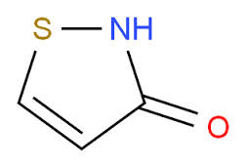
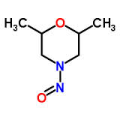
How Bellicide compares to other chemistries
Isothiazone (Kathon) – Imparts small amount of sulfur. Works well in water phase. Takes longer to kill and does no last as long as Bellicide chemistry.
Nitromorpholine (Dow Fuel Saver) – Biggest downside is they lose effectiveness in higher acid environments, such as when acetobacter is present.

Slide 32
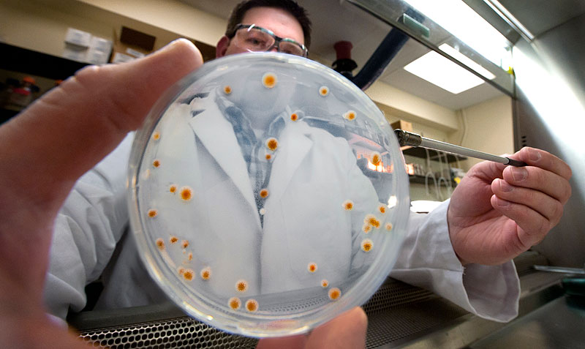
Biocide Kill Study Comparison
Laboratory kill studies conducted to determine relative effectiveness of biocide chemistries on different microbial strains at varying treat rates.
Pseudomonas aeruginosa (P. aeruginosa)
Hormoconis resinae (H. resinae).
Selected because they are common contaminants in the field, they grow well in large numbers, and they grow well both in water and at the fuel-water interphase.
Notes:
Attributes of Biocide Efficacy: Kill Studies Background
Because the purpose of a biocide is to kill microbes, the data relating to how fast and how completely it kills microbes is going to be the primary determiner of biocide value. Thus, the three remaining data points in the infographic comparison – Contact Time / Effectiveness After
1 Week / Effectiveness After 4 Weeks – are derived from the results of comparative kill studies conducted at independent testing laboratories.
Pertinent details on the comparative kill studies are listed here:
Bellicide was tested in the laboratory to demonstrate its effectiveness against three other leading fuel oil microbicides.
Multiple treat rates were used during the studies (100 ppm, 200 ppm, 300 ppm) to determine each biocide’s level of effectiveness at killing different strains of microbes relative to treat rate.
The test method used is contained in the SIM publication #2, “Proposed Procedures for the Screening of Microbial Inhibitors in Hydrocarbon/Water Systems.”
The microorganisms used in the study include the bacterium Pseudomonas aeruginosa (abbreviated as P. aeruginosa or Ps. aeruginosa) and the fungus Hormoconis resinae (formerly known as Cladosporium resinae, abbreviated as H. resinae). These microbe strains were selected because they are common contaminants in the field, they grow well in large numbers, and they grow well both in water and at the fuel-water interphase.
The data is expressed in terms of percent kill (at 1 week and 4 weeks) of the total microbe count relative to the count in identical untreated fuel oil samples. For perspective, the average microbial count (between the two microbe strains) at 1 week in untreated fuel was about 6.4 x 10⁶ per ml of fuel, and the average count at 4 weeks in untreated fuel was 6.0 x 10⁵ per ml of fuel.

Slide 33
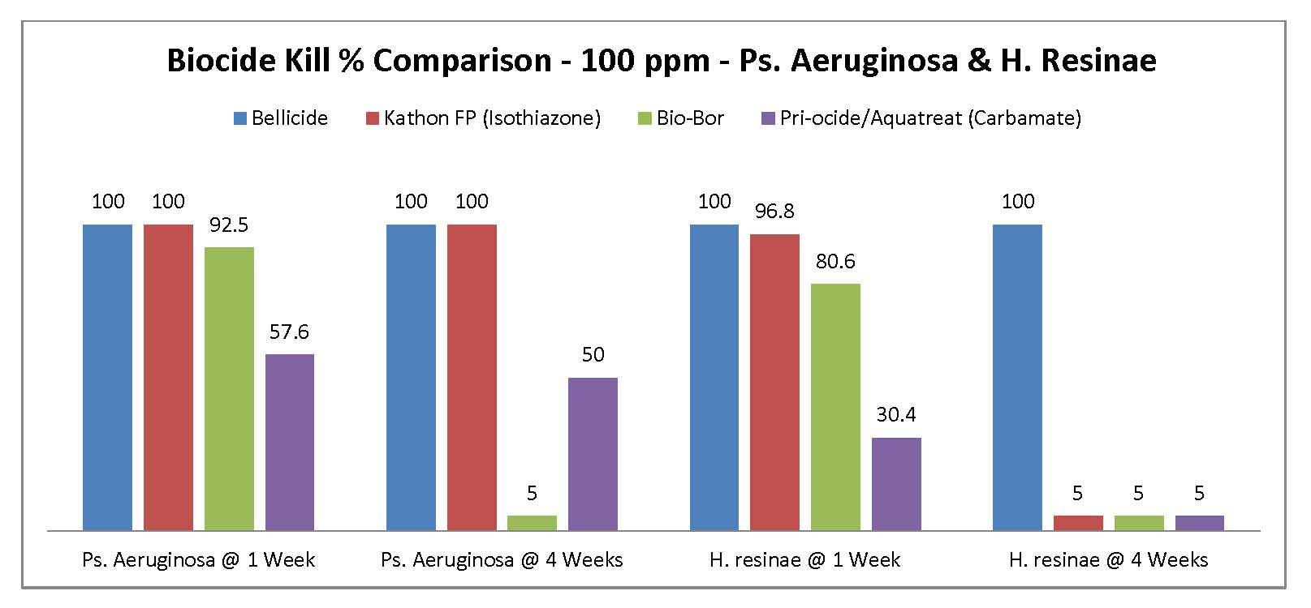
Biocide Kill Study Comparison – 100 ppm (1:10,000)
Bellicide only one to maintain 100% kill rate over both 1 and 4 weeks.
Kathon killed 100% of Pseudomonas but lost effectiveness on H. resinae within 4 weeks.
Biobor and Carbamate(s) were less effective over 1 and 4 weeks.
Notes:
These results show the kill effectiveness of these biocides at the lowest treat rate – 100 ppm, which is equivalent to a 1:10000 or 1 oz: 80 gallons volumetric treat rate. From these results, we can see the following:
Bellicide was the only chemistry to maintain 100% kill rate for both microbes over 1 and 4 weeks.
Kathon killed 100% of Pseudomonas but lost effectiveness on H. resinae within 4 weeks.
Biobor JF killed over 80% of both microbes during the first week but was ineffective on both after 4 weeks.
Pri-ocide/Aquatreat only killed 50% of Pseudomonas over 4 weeks and was largely ineffective on H. resinae.

Slide 34
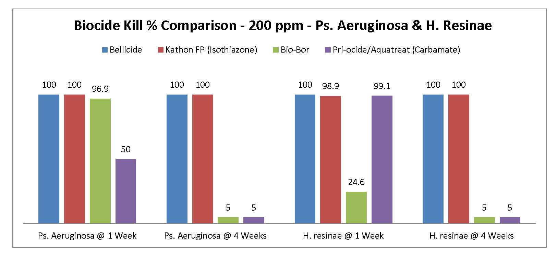
Biocide Kill Study Comparison – 200 ppm (1:5,000)
Bellicide still maintains 100% kill rate over both 1 and 4 weeks.
Kathon achieves 100% kill rate on both microbes at this higher treat rate.
No substantive change in Biobor effectiveness.
Carbamate(s) now kill 100% of one microbe for 1 week, but ineffective after 4 weeks.
Notes:
These results show what happened after the treat rate was doubled to 200 ppm – equivalent to 1:5000 or 1 oz: 40 gallons volumetric.
Bellicide was 100% effective on both microbes through 4 weeks.
Kathon maintained its 100% effectiveness on Pseudomonas and was able to achieve 100% effectiveness on H. resinae after 4 weeks. It was ineffective here at only 100 ppm.
Biobor and carbamates still don’t maintain effectiveness over 4 weeks,
The effectiveness of Biobor JF actually dropped with the higher treat rate – there was no significant improvement on Pseudomonas – it was still in effective after 4 weeks.
The carbamates achieve 100% kill of H.resinae in the first week, but still remained ineffective after 4 weeks.

Slide 35
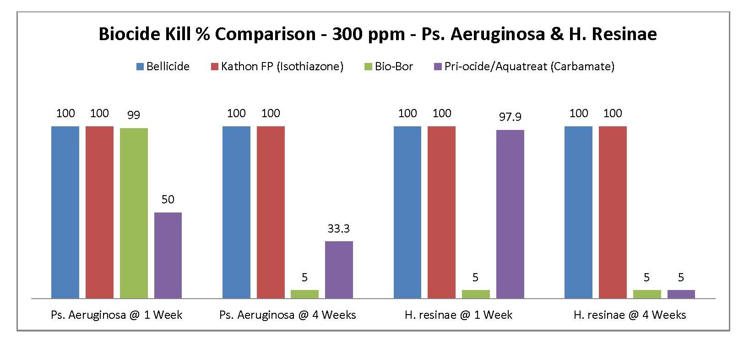
Biocide Kill Study Comparison – 300 ppm (1:3,333)
Bellicide and Kathon have 100% kill rate over both 1 and 4 weeks.
Biobor effectiveness is unchanged by higher treat rate (no benefit after 4 weeks)
Carbamate(s) have no change in effectiveness over 4 weeks.
Notes:
These results show effectiveness at the highest treat rate, 300 ppm, equivalent to 1:3333 or 1 oz: 23 gallons.
Bellicide and Kathon FP 1.5 still remain 100% effective through 1 week and 4 weeks. This is to be expected at the highest treat rate.
The highest treat rate had no beneficial effect on Biobor JF’s ability to maintain kill rate through 4 weeks. It was still ineffective in this time frame.
The highest treat rate had no meaningful effect on the ability of the carbamates (Pri-ocide/Aquatreat) to kill microbes for 4 weeks.

Slide 36
Kill Study Conclusions
Bellicide was the most effective biocide across 1 and 4 weeks. Bellicide was also the only one to maintain full kill at lowest treat rate.
Kathon showed better-than-average effectiveness, though it needed an increase in treat rate to 200 ppm to achieve 100% kill over 4 weeks
Aquatreat DNM-30, Pri-ocide, and Biobor JF were all only sporadically effective at lower treat rates and could not maintain effectiveness for as long as 4 weeks.
Notes:
Bellicide was the most effective biocide at both killing microbes in the first week and (more importantly) maintaining a full kill for up to 4 weeks, both at the lowest treat rate (100 ppm).
Kathon also showed better-than-average effectiveness, though it appears an increase in treat rate to 200 ppm was needed to ensure complete 4 week effectiveness.
Aquatreat DNM-30, Pri-ocide, and Biobor JF were all only sporadically effective at lower treat rates and did not demonstrate satisfactory effectiveness for as long a time period as Bellicide and Kathon FP 1.5.
- The Biobor results are surprising, given its name recognition in the marketplace.

Slide 37
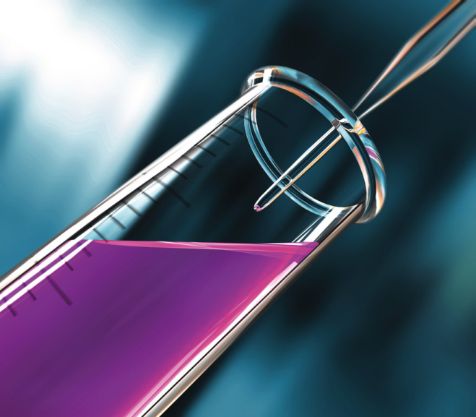
More Good Stuff About Bellicide
Burns similarly to fuel
(>106,000 BTU/gal)
Good temperature stability
Will not ignite at temps. <174ºF / 79ºC
Imparts low amount of sulfur relative to typical biocides
Low VOC content: 6.25 w%
Performs well in the typical thick emulsions that exist in slop/waste water tanks
Notes:
BELLICIDE antimicrobial agent is an excellent preservative for the prevention of microbial growth in hydrocarbons. Studies have shown that at recommended levels it is:
Effective for shock dosing against bacteria, mold, and yeasts found in contaminated fuels soluble in fuels, hydrocarbons and water at typical use levels active even in the presence of large quantities of water
When tested at levels of up to 1000 ppm in No.2 diesel fuel, no deleterious effects on engine performance or emissions were noted. Engine rpms, power output, and torque remained unchanged, and no increase in the amount of exhaust pollutants emitted was observed.
The following benefits are obtained when using BELLICIDE:
Effective in both fuel and water
Leaves no corrosive deposits
Burns similar to fuel (>106,000 BTU/gal)
Will not ignite at temperatures below 174°F/79°C
Reduces engine maintenance costs
Helps to prevent fuel system failures
Solubility in Water@ 20°C 1.1 g/100 mL - @ 50°C 1.4 g/1 00 mL

Slide 38

BELLICIDE™ Handling and Cautions
Not registered for use in jet fuel
Adds small amount of sulfur to fuel
< 4 ppm at shock dosage
Use proper person protective equipment (see MSDS for guidelines)

Slide 39
Treatment Recommendations
Treat rate by volume for stored diesel fuels
New tanks: 200 ppm
Shock dose: 200 ppm when fuel is fouled
Maintenance dose: 100 ppm when new fuel is added
Treat rate by volume Slop/Waste Water Tanks
New tanks: 200 ppm
Shock dose: 200 ppm when waste water is fouled
Maintenance dose: 100 ppm when new waste stream is added to the tank

Slide 40
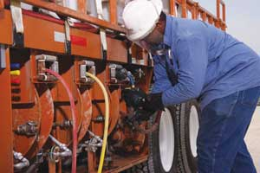
Applying Bellicide To Fuels & Liquids
Add enough biocide to treat maximum anticipated volume of fuel
Wait up to 8 hours after biocide application and circulation before using fuel (if feasible)
To allow for settling of dead microbes
User may need to change filters to remove dead microbes
Notes:
Protection of

Slide 41
Additional Application Guidelines
Bellicide performance is enhanced when continually injected in delivery lines, but can be splash blended if provided sufficient time to homogenize through normal thermal convective processes.
Essential to ensure proper contact and residency time in the fuel
Spray applications to protect industrial surfaces.
Recommend microbial monitoring with ATP microbial testing
Notes:
Proper contact and residency time is most important.
Biocides can’t kill microbes if they don’t come into contact with them.
Protection of industrial surfaces can be done through spray applications with appropriate PPE.

Slide 42
Regulatory Rules for Biocides
Biocides must be registered with the EPA Office of Pesticides
Must contain EPA Registration and Fulfillment Number(s) on label
Product name must be registered with national EPA & with each individual state DOE.
Products that make claims to kill (or imply to kill) microbes must be registered as a biocide because the EPA considers those to be “biocide claims”.
Products that claim to “prevent microbial growth” through the absorption of water are not biocides and should not claim to act as such (but many do).

Slide 43
Who’s Going To Use Bellcide
Anyone who stores fuel
Fleets & business
Municipalities
Marine
Fuel distributors (blame the fuel supplier)
Emergency generation systems
In addition to fuels, also suitable for use in:
Drilling fluids
Cooling towers
Refined middle oils in storage
Notes:
Bellicide has a very wide range of possible markets to target.
Fuel distributors should be a large market. They know that people blame them for problems.
Use in emergency generation system to ensure they run as needed when they are needed.

Slide 44

What Have We Covered Today?
Bellicide is highly effective for treating fuel and other liquids at treat rates of 100-200 ppm.
Industry-leading kill rates and efficacy period
Effective in diesel & bio-diesel
Imparts a minimum amount of sulfur (to protect ULSD fuels)
Proper mixing and metered application highly recommended

