Slide 1
Powergen & Manufacturing:
ATX Heavy Fuel Oil Treatment Solutions
NEW DIMENSION LOGISTICS - JANUARY 2015

Slide 2

What We Want To Learn Today
Discussion of Inherent Problems Associated with Heavy Fuel Oil Use In PowerGen and Manufacturing
Slagging & Deposit Problems
Low & High-Temp Corrosion
Unburned Carbon Particulates

Slide 3
What We Want To Learn Today cont.
Discussion of Inherent Problems Associated with Heavy Fuel Oil Use In PowerGen and Manufacturing
Opacity & Emissions
Petroleum Sludging
The Role of Fuel Treatments In Solving These Problems, Including ATX from Bell Performance.

Slide 4
Facilities Utilizing Heavy Fuel Oil
Fuel oil use declining compared to previous years
The economics of natural gas vs. fuel oil
Market remains sizeable, especially internationally
Market users include
Power generation facilities
Industrial facilities – light, medium, heavy
Refineries

Slide 5
What do they use it for?
Fuel for producing heat and steam to generate power and/or industrial output.

Slide 6
Problems Encountered at Fuel Oil-Fired Facilities
Boiler tube depositing
Flame impingement in areas like hydrogen reformer
High and low temperature corrosion
Loss of operational efficiency
Excessive SO₃ / NO_{x} formation in flue gases
Shutdowns with loss of production availability
Sludge dropout with loss of heating value
All contributing to reductions in operational efficiency and non-peak operating conditions.

Slide 7
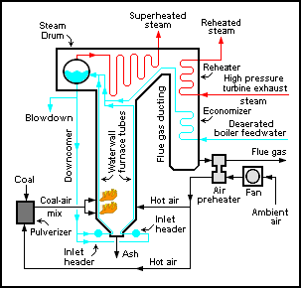
Typical Power Generation System Schematic

Slide 8
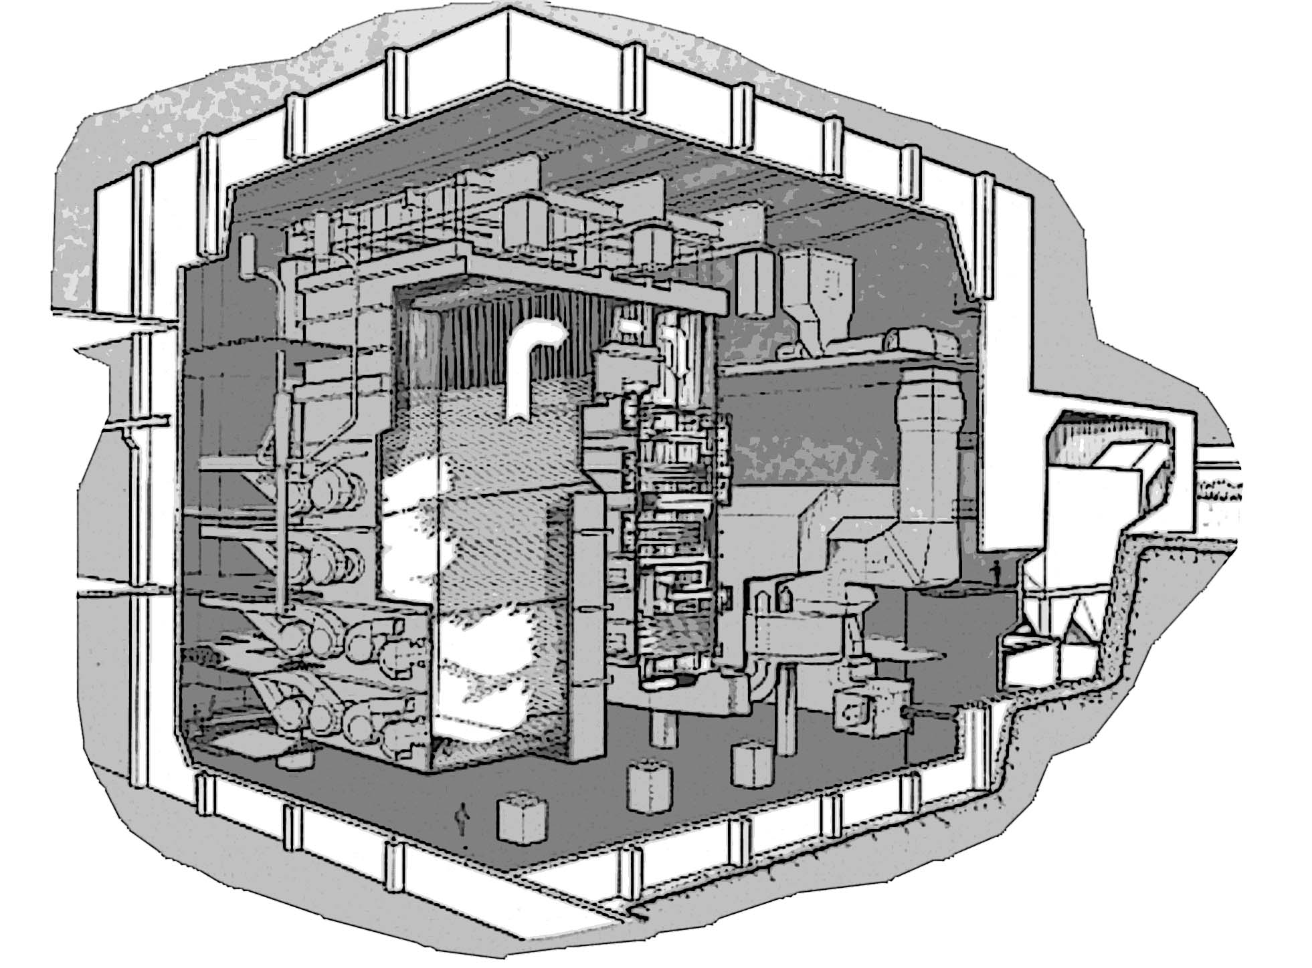
How Fuel Behaves In A Typical Boiler Unit
Transport, Reaction & Formation
Deposit Formation & Corrosion
Ash forming constituents are released during combustion.
Results of fuel combustion

Slide 9
Heavy Fuel Problems
Fuel Problem:
Slagging & Deposit Issues

Slide 10
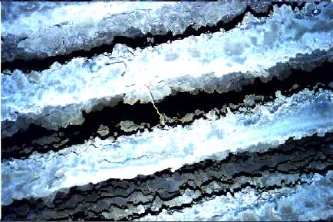
Slagging Problems in HFO Systems
Problem - Fly ash particles that hit the tube contain unburned carbon and inorganic compounds like salts/oxides of Na, V, Ni, Al, Si, S etc., resulting in build-up of slag formations.
Particles of inorganic ash and unburned carbon

Slide 11
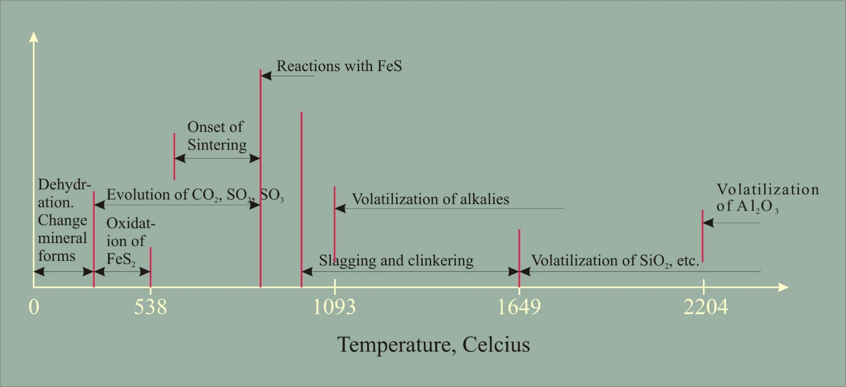
Effect of heating on mineral content in fuel

Slide 12
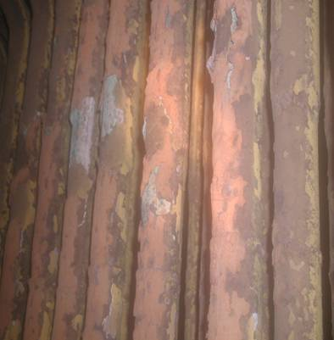
Slagging Deposit Problems
Slagging on tubes (V and Na) lowers heat transfer and might cause temperature shift
High temperature corrosion caused by Vanadium and Sodium salts/oxides
Catalyzes formation of SO2 to SO3
Maintenance cost (replacement of tubes, cleaning etc)
Loss of production because of shut down for cleaning and lower boiler efficiency

Slide 13
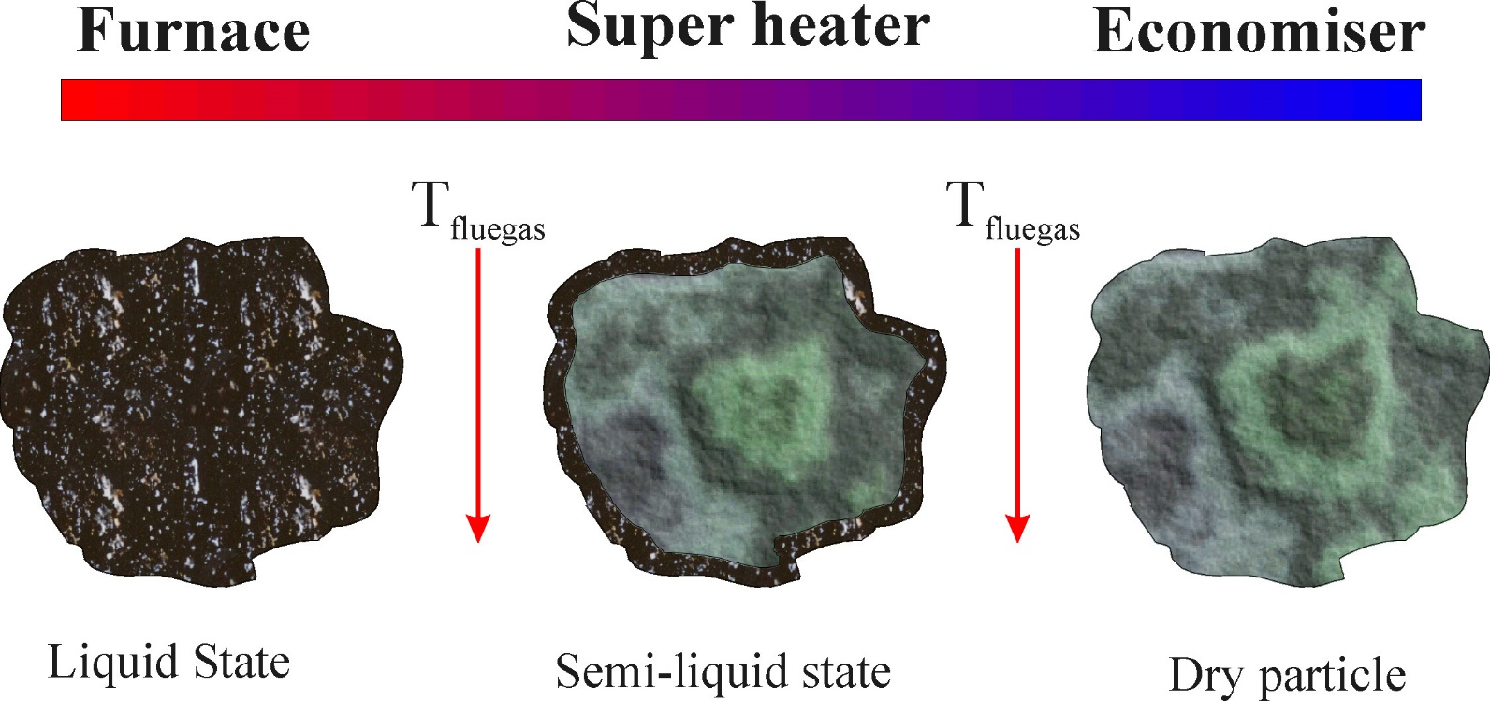
Formation of Solids In Different Areas

Slide 14
Rate of change of heat flux with accumulation of slag
F.G. Ely and L.B. Schueler, Furn. Perf. Suppl. to Trans., ASME, 66 (1944) 23.

Slide 15
Deposit Formation Sequence
The formation sequence of deposits is as follows:
V₂O₅ and Na₂O is formed
Ash particles stick to surface, Na₂O acts as binding agent
V₂O₅ + Na₂O react on metal surface
The liquid formed fluxes the magnetite, exposing the underlying metal to rapid oxidation

Slide 16
Deposit Formation
Coarse ash
Growth of hard deposit
Fine particles forming
hard alkali-rich deposits
Corrosion
zones
Early stage of fouling
Late stage of fouling

Slide 17
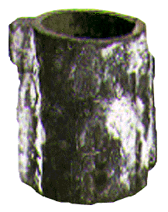
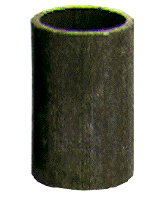
Deposit Example
Before Treatment
After Treatment

Slide 18
Deposits from Different Particle Sizes

Slide 19
Different Formation Methods for Deposits
Molecular diffusion
      Tiny particles move with velocities close to gas molecules
Brownian motion
      Larger particles in motion by collision with gas molecules
Thermophoresis
      The difference in temperature pushes towards the cold side
Turbulent diffusion
      Large particles are propelled through the laminar sub layer onto the tubes
Inertial impaction
      The largest particles penetrate the boundary layer and onto the tubes

Slide 20
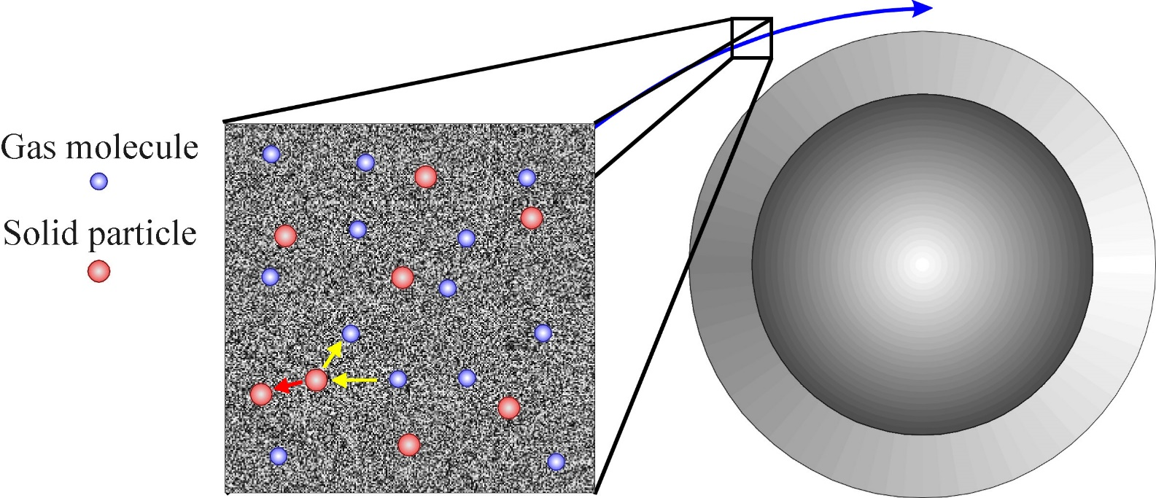
Molecular diffusion
Particle size: < 0,1 μm

Slide 21
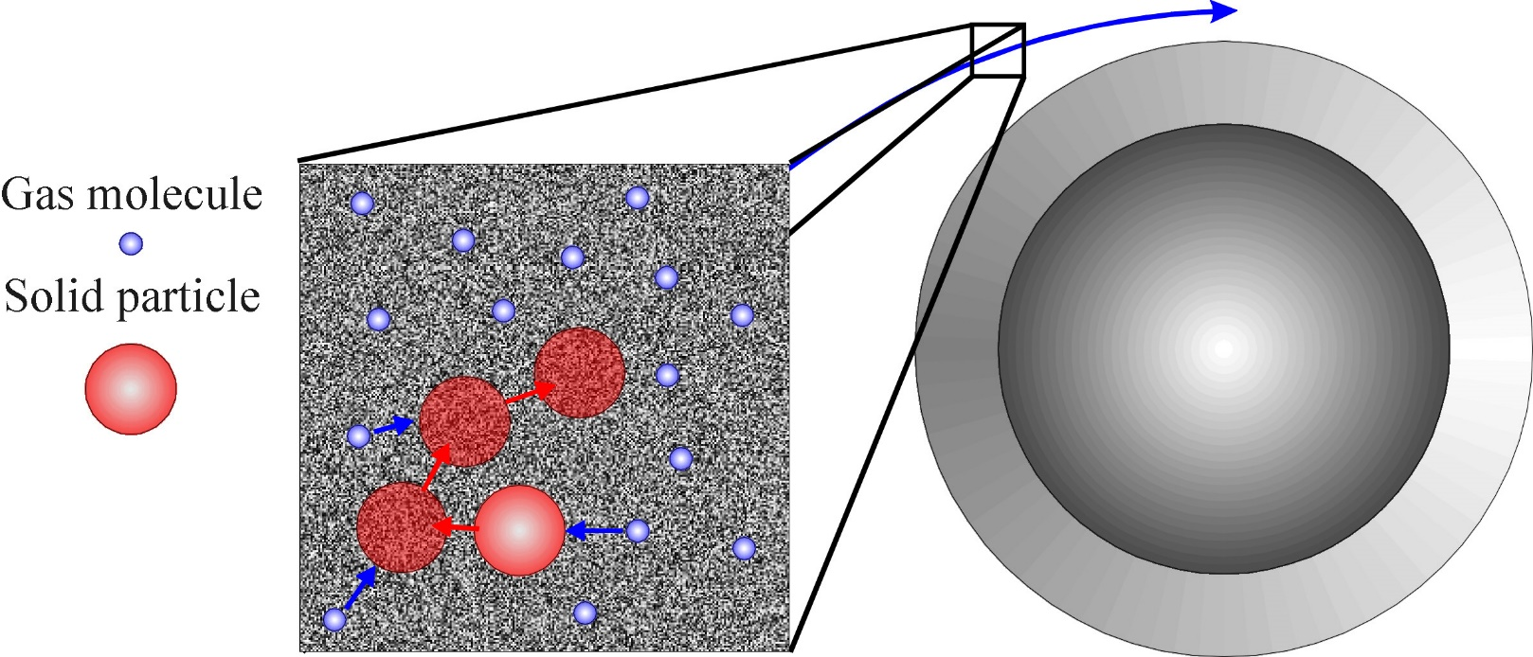
Brownian Motion
Particle size: 0,1 - 1 μm
(“Random walk”; “Drunken sailor”)

Slide 22
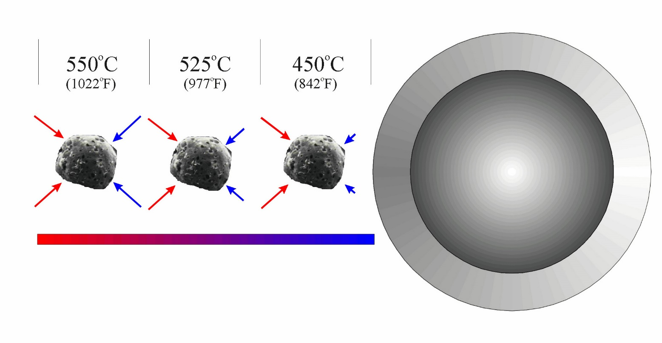
Thermophoresis
Concentration

Slide 23
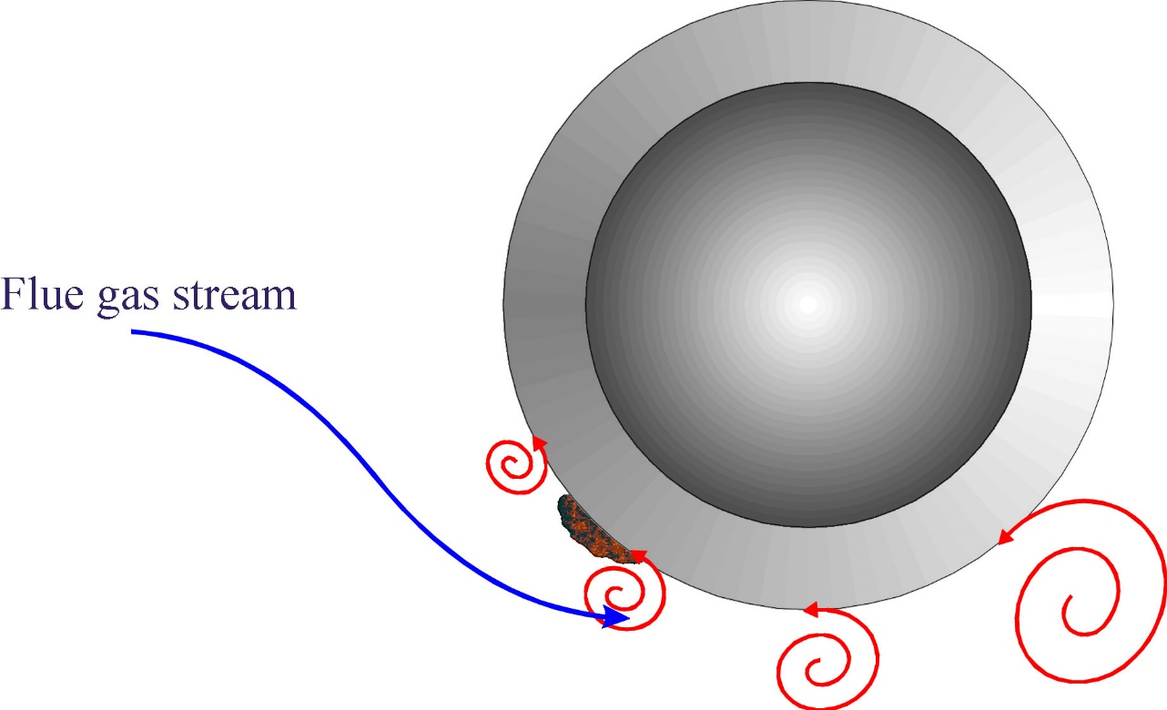
Turbulent diffusion
Particle size: 1 - 10 μm

Slide 24
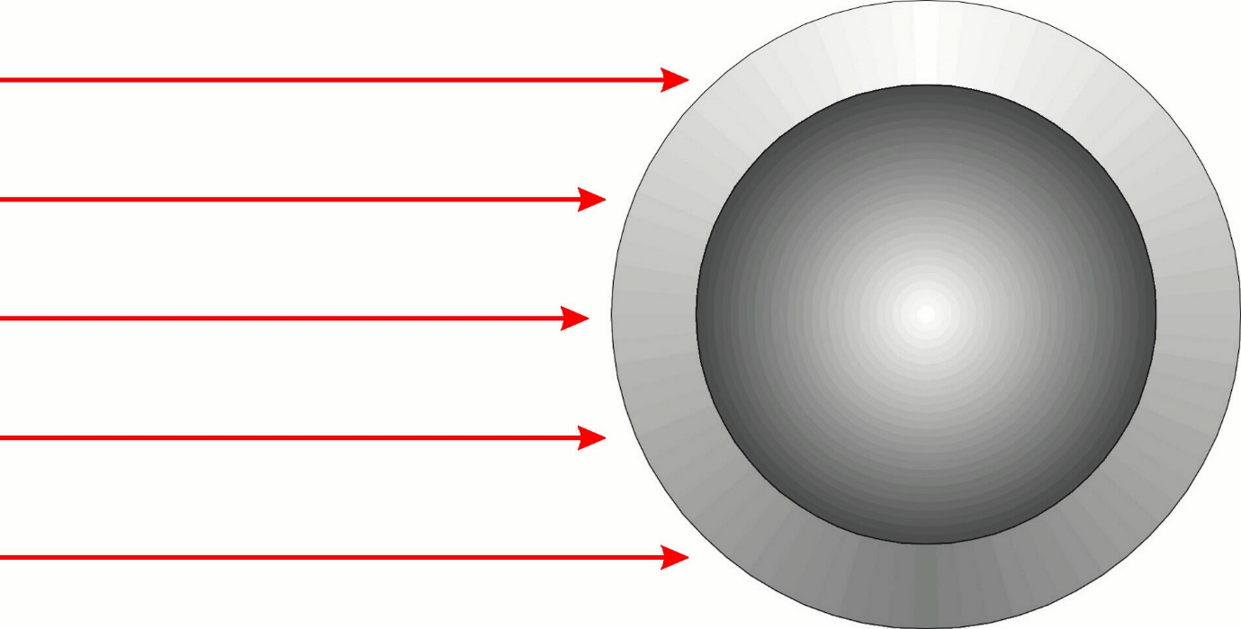
Inertial impactation
Particle size: >20 μm to 300 μm

Slide 25
Transport of ash particles to a surface
Impaction
Big particles
(> 0.5 - 5 mm)
Diffusion
Small particles
(< 0.5 - 5 mm)
Hedley et al., Samms et al. 1966

Slide 26
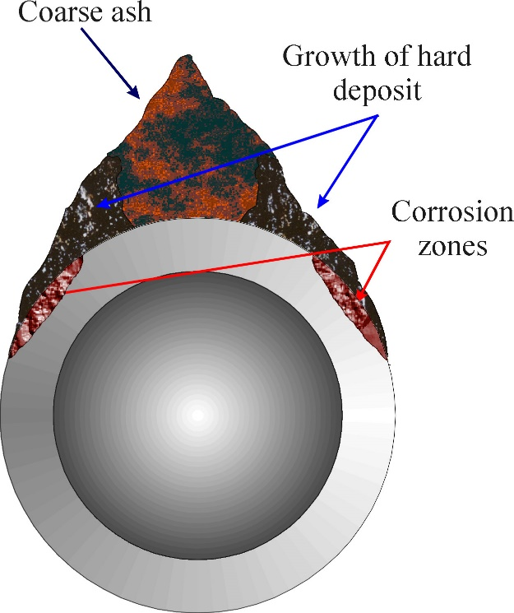
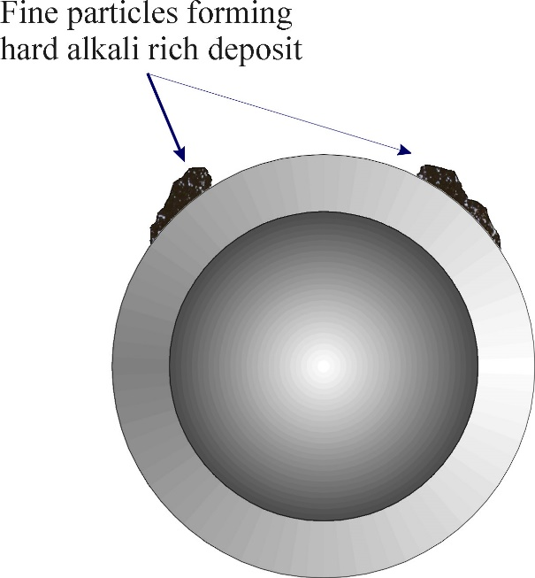
Deposit Build-Up

Slide 27
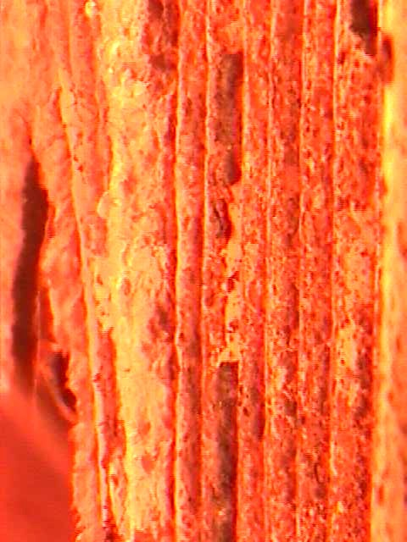

Formation of Deposits
Water Wall Deposits
Superheater Deposits

Slide 28
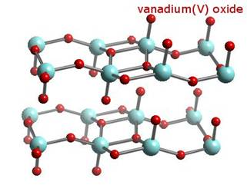
The Problem of Low-Temperature Slag Deposits
Mix of Vanadium and Sodium oxides/salts have low melting temperatures, especially if the ratio is in the range 1:1 - 4:1.
These low temperature melting compounds are sticky, building up deposits on furnace walls, Super-Heater and Re-Heater tubes.
Deposit Examples:
V2O5 mp = 675ºC
5Na2.V2O4.11V2O5 (7:1) mp = 535ºC
NaVO3/Na2O.3V2O5 (4:1) mp = 480ºC
3MgO.V2O5 mp = 1190ºC

Slide 29
Vanadium and Oxygen Influence Slagging Incidence
The V₂O₅ is the vanadium oxide that causes most problems. The formation of V₂O₅ is dependent on the oxygen excess in the boiler.

Slide 31
Sintering & Deposit Formation with Heavy Fuel Oil
The process whereby powders and small particles agglomerate and grow together to form a continuous solid phase.
Sintering can be divided into three different stages:
  Initial; Particles begin to adhere and grow together
  Intermediate; Grain growth continues
  Final; Begins when body achieved 90-95% theoretical density. The final stage involves removal of remaining pores, leading to a denser material.

Slide 32
Factors Affecting Sintering
Chemical composition of the ash
The time-temperature history during combustion
Turbulence within the boiler
The time during which the ash particles are in contact on a heat transfer area

Slide 33
Alkali Effect on Sintering
Alkali is expressed as percentage of Na2O in coal

Slide 34
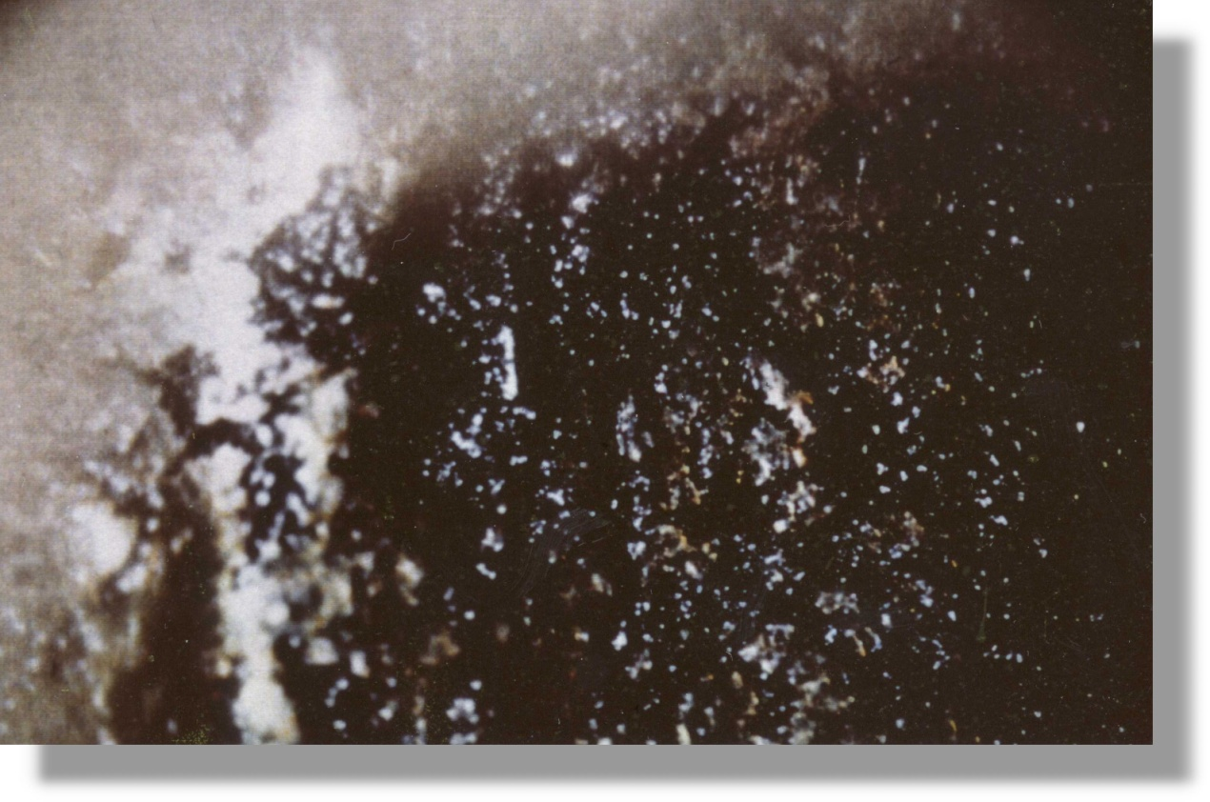
Types of Deposits – Melted Sticky Ash
Melted ash at 600ºC, sticks to surface

Slide 35
The Cost of Slagging Deposits for Facilities & Refineries
How much do slagging problems cost yearly?
Slagging problems start with the fuel.

Slide 36
Heavy Fuel Problems
Fuel Oil Problem:
Low- and High-Temperature Corrosion

Slide 37
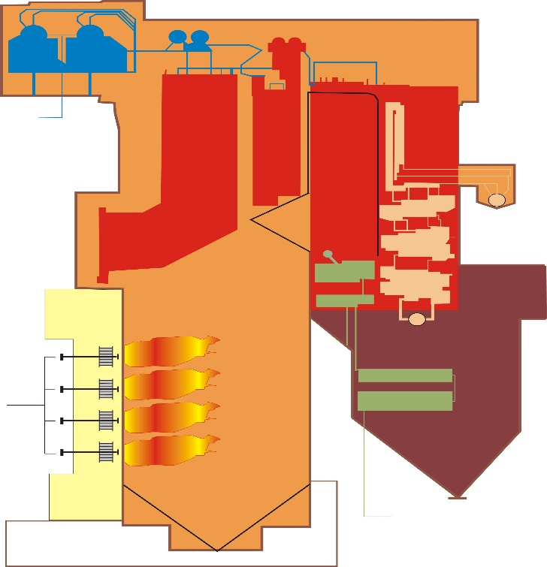
Corrosion-Related Processes in the Boiler
Deposit buildup &
Corrosion
Deposit buildup &
Corrosion
Combustion reactions
Transport
Opacity
Fly ash
Fuel & Air
Atomization/mixing
Ash forming
compounds is
released
Bottom Slag/ash
formation
Notes:
There are several processes going on the boiler while transforming the incoming fuel energy into steam. Some of the most common processes is shortly described.

Slide 38
External Corrosion and Formation of Deposits
Three major factors involved in corrosion and the formation of deposits:
  The temperature of the metal and the gas stream
  The composition of the substances in contact with the metal surfaces and the nature of those surfaces.
  Aerodynamic considerations involving gas and particle velocity and the size of deposited particles.

Slide 39
Causes of Cold End Corrosion
The sulfur contained in the fuel will convert to sulfur dioxide
About 2-5% of the sulfur dioxide will convert to sulfur dioxide to the trioxide in the presence of appropriate catalysts, additional oxygen and temperatures of 500-600 deg C
Iron and/or vanadium oxide can act as catalysts

Slide 40
Formation of SO₂
The sulphur in the fuel is present in both elemental form and/or organically bound.
Once the sulphur enters the combustion process,it is very reactive with oxidizing species, and the conversion into oxidized sulphur species is fast.
The predominant product will be sulphur dioxide, SO₂.

Slide 41
Formation of SO₃
SO₃ will be formed by oxidation of the SO₂ present and is of more interest.
A fraction (1-5%) of the SO₂ formed is oxidized to SO₃
  Direct reaction with atomic oxygen
  SO₂ + O ⇔ SO₃ (equilibrium)
  Catalytic oxidation
  SO₂ + ½ O₂ + Catalyst ➔ SO₃
  Catalyst= Iron oxide, Vanadium pentoxide or Nickel (or other metal surface)

Slide 42
What Influences SO₃-concentration?
The amount of SO₃ formed is dependent on:
  The sulphur content in the fuel and fuel composition
  The combustion process
  The temperature and pressure conditions and also the cooling of the flue gases
  The presence of catalytic compounds and soot.

Slide 43
Catalytic oxidation of SO₂ to SO₃ by various materials

Slide 44
SO3 and Sulfuric Acid Condensation
This SO3 condenses with water vapor at temperatures below the acid dew point, approximately 150 deg C, to form sulfuric acid
SO₃ + H₂O ➔ H₂SO₄
Acid corrosion then takes place on the iron surfaces (principally in the air pre-heater or stack)

Slide 45
Acid dew point
Acid dew point is the temperature where the acid condensates.
Varies with the water vapor concentration in the flue gas.
The higher the water vapor, the higher the acid dew point.
It is favorable to have as low acid dew point as possible to avoid condensation of acid in the flue gas system.
Notes:
The amount of moisture produced is dependent on many factors. Sources include moisture content of the fuel, fuel combustion, leaks in boiler tubes, and steam from soot blowing.
The combined burning of sulphur- and vanadium-containing fuel oil with natural gas is worse than use of oil alone because of the high water vapor content that results from burning natural gas.

Slide 46
Sulfur Content & Dew Point Temperature
Sulfur content in the fuel is a critical factor for formation of SO₃.
Dew point temperature is only slightly influenced at fuel sulfur concentrations above 0.5 %.
The exact temperature on the y-axis dependent on the boiler conditions as well as S-content.
* The NALCO Guide to Boiler Failure Analysis, R. Port and H. Herro, 1991
Notes:
The amount of sulfur trioxide produced increases with increases in the level of excess air, gas residence time, gas temperature, amount of catalyst present, and sulphur level in the fuel.

Slide 47
Low temperature corrosion
Condensed acid causes problems with corrosion.
The presence of a liquid phase on the tubes & surfaces increases the corrosion rate.
The corrosion process is caused by the formation of iron sulfates. The acid formed reacts with the iron in the tubes causing corrosion attacks.
H₂SO₄ + Fe ➔ FeSO₄ + H₂
Notes:
Cold-end corrosion will occur wherever the temperature of metal drops below the sulphuric acid dew point of the flue gas. Most problems caused by cold-end corrosion occur in relatively low temperature boiler components such as the economizer, air pre-heater, induced-draft fan, flue gas-scrubbers and in the stack. Corrosion may occur wherever metal temperatures are less than the sulphuric acid dew point. Below this dew point. Sulphuric acid forms on metal surfaces and corrodes the metal with the following reaction : H2SO4 + Fe ➔ FeSO4 + H2
Cold-end corrosion frequently produces general, smooth, featureless metal loss. Rough, rust colored surfaces also may be observed.
In this section we can also include dew-point corrosion which can occur anywhere in the boiler during idle periods. As the boiler cools, the temperature of its external surface may drop below the dew point, allowing moisture to form on tube surfaces. The moisture in combination with the sulpurus deposits will form a low-pH electrolyte which is capable of generating ver fast corrosion rates (12.7 mm/y). This type of corrosion generallyoccurs in areeas where the metal is covered with the low pH ash.

Slide 48
Corrosion peaks (Temperature-Dependency)
200
Corrosion rate peaks usually 20-50°C below the acid dew point – the point at which the amount and the concentration of the condensate have here reached the most favorable mixture for corrosion to occur.
At lower temperatures, the water vapor condensates, which means that a larger amount of weak but very corrosive acid is produced. Besides the acid the condensate also contains solved SO₂ and CO₂ gases, which are very aggressive.
150
Corrosion starts
Corrosion peak
Surface temperature (ºC)
100
Low corrosion rate
Very high corrosion rate
50
SO
2
are solved in water
forming sulphurous acid
HighO2 excess
Low O2 excess
0
0
Relative corrosion mm/year

Slide 49
Prevention of cold end corrosion – Four Ways
Change the fuel (to lower S content)
  Normally costly if at all possible
Reduce excess oxygen (through use of combustion improver(s) to reduce excess oxygen)
Minimize moisture in flue gas

Slide 50
Prevention of cold end corrosion – Four Ways
Reduce available catalytic surface by coating with MgO
  Caution: what are the side effects?
Neutralise the SO3 with a Mg-based additive
  MgO reacts with the SO3 to form MgSO4 salts

Slide 51
Categorization of Corrosion
Above 1000ºF (540ºC)
  ”High temperature” corrosion’
  Furnace wall tubes, super heaters, re-heaters and economizers.
Below 1000ºF
  ”Low temperature” corrosion
  Air heaters, economizers and in the stack.

Slide 52
High Temperature Corrosion – Just As Problematic
Low-temperate vanadium-based deposits on metal surfaces in fuel-oil combustion zones.
Highly corrosive to metal surfaces in their liquid state.
Hard and glassy when cool – difficult to remove

Slide 53
Hot Corrosion Mechanism
Flue gas
+
e⁻
+
e⁻
Liquid interface between tube
and deposit
Direction
Notes:
The interface between the tube and deposit is a melt. Electrons are feed by the material to the interface where corrosion is accelerated by impurities in the deposit. The chrome-iron oxide layer is destroyed by impurities such as Vanadium oxide. The impurities lowers the melting point of the Cr-Fe layer and causes accelerated corrosion by pitting. This is a dangerous corrosion that weakens the material and can lead to tube explosion.

Slide 54
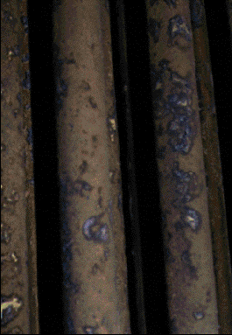

Corrosion Example
Before Treatment
After Treatment

Slide 55
High Temperature Corrosion – Just As Problematic
The Solution to High Temperature Corrosion
Modify (increase) melting points of slag deposits to change their corrosiveness and consistency

Slide 56
The Cost of Corrosion for Facilities & Refineries
How much do hot and cold corrosion problems cost yearly?

Slide 57
Other Fuel Problems
Fuel Oil Problem:
Sub-optimal Combustion &
Reduction of
Unburned Carbon Particulates

Slide 58
Optimal Combustion Leads To A Host of Benefits
Improved combustion
Reduces soot and stack solids by catalysed combustion
Improved efficiency by reduction of the excess air
Improved efficiency by better burnout of the unburned carbon.
Less conversion of SO₂ to SO₃ by lower excess air
Less NOx as a secondary effect of lower excess air.

Slide 59



Combustion Stages
The droplet is heated and evaporation of the volatile material begins. This stage ends with the self -ignition of the vapour surrounding the droplet
Pre-ignition stage
The volatile constituents of the oil and the cracked products burn in an enveloped flame surrounding the droplet. The stage ends by the flame dying away as the evolution of flammable material ceases.
Volatiles combustion stage
When the flame dies hot gases including oxygen can reach the hot surface of the coke residue. It glows red and burns at 1400 - 1700 K. The unburned coke left after combustion is called a cenosphere.
Coke combustion stage

Slide 60
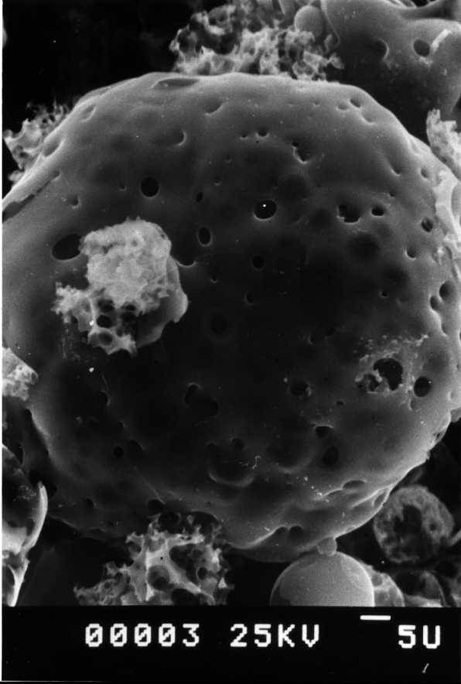
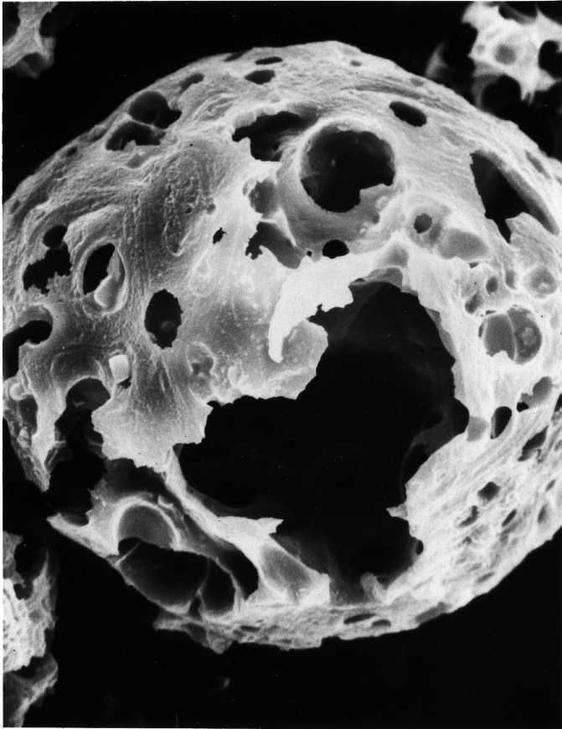
Incomplete vs Complete Combustion

Slide 61
Droplet Size vs. Combustion Time

Slide 63
Indications of carbon particulates
Unburned carbon presence means sub-optimal fuel usage
Many causes within a given plant setting

Slide 64
Unburned carbon particulates
The problem of unburned carbon can be addressed by surface catalysts and radical generators.
Research on organometallics in 1950s.
Surface reactions produce radicals of OH,O etc.

Slide 65
Unburned carbon particulates - Solutions
Radicals promote improved combustion by essentially increasing amount of volatiles around the fuel oil droplet
Lowering of activation energies for combustion reactions
Lower ignition temperatures of carbon resulting in faster and more complete combustion

Slide 66
Operational Decisions Intersecting With Fuel Problems
Fuel Problem:
Having To Use Air Flow Adjustments To Control Opacity & Emissions

Slide 67
Using Air Flow To Promote Complete Combustion
Increasing and lowering air flow is a double-edged sword for combustion management.
You can increase the excess oxygen levels (through air volume) to drive combustion to completion and lower soot.

Slide 68
Not Always A Simple Choice
Adjusting air flow in this manner has consequences.
Downside(s) to doing this
Can increase the tendency for SO3 formation
Cold-end corrosion and acid plumes
Decreases fuel economy by heating excess air
What about decreasing air flow to prevent these?

Slide 69
Moving Air Flow In The Other Direction
Decreasing the air intake
Can lead to soot formation and increased particulate emissions
Can decrease fuel economy due to incomplete combustion

Slide 70
Moving Air Flow In The Other Direction
Decreasing the air intake can IMPROVE system efficiency
Not heating excess air
Decrease the tendency for SO3 formation
Decrease cold-end corrosion and acid plumes

Slide 71
SO3 Formation & Excess Air
Source: External Corrosion and Deposits, William. T Reid, s 180

Slide 72
Dewpoint vs. Excess Air
Source: External Corrosion and Deposits, William. T Reid, s 180

Slide 73
Flue Gas Reductions
For many HFO-burning plants, emissions are an unwanted problem.
Emissions plume opacity can be caused by SO3 and the resulting acid condensation onto particulate emissions
SO3 plumes are usually blue-white and very persistent
Solution: Treat the SO3 on the fuel side.

Slide 74
NOx Flue Gas Reductions
NOx is temperature dependent and difficult to remediate.
NOx is created from fuel and air nitrogen
Lowering of NOx relative to output is the solution

Slide 75
The Need to Solve Sludge Problems
Sludging Problems
In HFO and Petroleum

Slide 76
Petroleum Sludge Is Not A Small Problem
All crude & HFO fuels have inherent sludge (and water) content.
Sludge dropout in storage tanks and delivery systems equals paid fuel calorific value not delivering for the customer.
How much does this cost the user?
These problems have fuel-borne solutions.

Slide 77
Solving Fuel Problems in HFO & Petroleum-Burning Facilities
The Role of
Multi-Functional Fuel Treatments
To Address Problems

Slide 78
Bell Performance Oil-Soluble Mg Solutions
ATX-950, 1004, 1018/1020 Multifunctionals
Oil-soluble Mg
Multiple organometallic combustion catalysts
Sludge-dispersing surfactants
One family of formulations to address multiple needs of crude/HFO users.

Slide 79
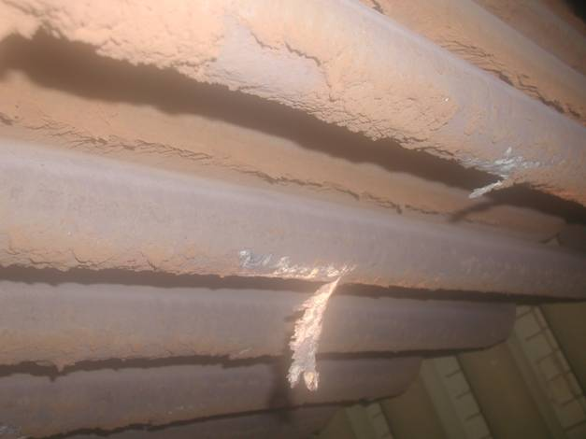
Solutions to these problems with the ATX Line: Multifunctionals
ATX Multifunctionals will solve fuel problems associated with
Deposits & flame impingement
Heat transfer
High temperature corrosion
Opacity
Maintenance
Low temperature corrosion
Sludge & water dispersement

Slide 80
Solutions to these problems with ATX
High-quality Mg delivered in an oil-soluble base approved for use with gas turbines (“turbine-grade”).
Over-based Mg Formulations
Remediates High-Temperature Corrosion
Remediates Molten Deposit Formation
Reacts with SO3 to reduce
Low-Temperature Corrosion
Reduces H2SO4 Emissions and Stack Opacity
Surfactant packages for sludge dispersal

Slide 81
Solving Problems – Combustion Improver Treatment
Organometallic combustion improvers give operator better flexibility & options
Achieving same heat & combustion levels with less air and/or less fuel
Same or better production output while minimizing the problems of trade-off
  Lowering cold end corrosion by reducing air supply without sacrificing combustion efficiency

Slide 82
Flue Gas Dewpoint: ATX vs. Slurries
Dew point = 112ºC

Slide 83
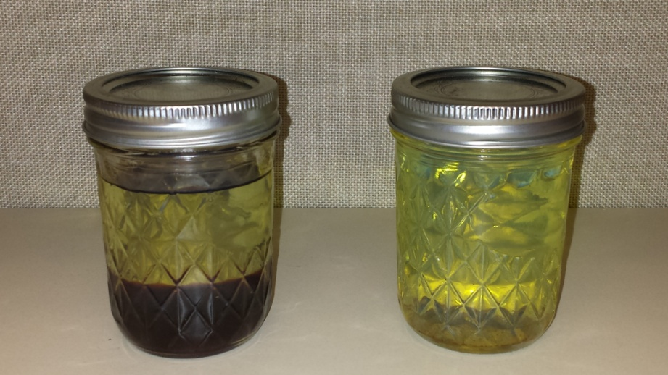
Solutions to HFO Sludge Problems – Stabilizers and Dispersants
Petroleum users with substantial sludging problems benefit from stabilizing dispersant packages in ATX.
Disperse and dissolve sludge
Homogenize fuel oil dropout
Recover lost fuel heating value
Clean delivery systems
Deliver corrosion protection

Slide 84
Solving Problems In Boiler & Refinery Applications – Magnesium
Mg additives are well known in the industry to help slagging problems.
Reduce boiler depositing and high temperature corrosion
React with Vanadium compounds in the fuel to increase the eutectic melting point of deposits
Improve efficiency and maintain a clean boiler/furnace system

Slide 85
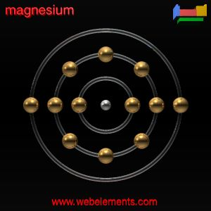
Magnesium, Mg
Identified as an element in 1755 by J. Black, Edinburgh
Mg is the 8th most abundant element
MgO is the 2nd most common compound in the earth’s crust
Mg is an element in chlorophyll and is therefore necessary for all green foliage

Slide 86
What kind of problems can be solved with Magnesium based additives
Cleaning up deposits from tubes and walls
High temperature corrosion (Vanadium and Sodium)
Low temperature corrosion in Economizers
Low temperature corrosion in APH (CAR)
Reduce Acid Dew Temperature
Opacity problem (related to SO3)
Conservation of boiler during shut down

Slide 87
How Mg in ATX Treatments Solve Slagging Problems
Slagging Deposit Solution – Injection of an Mg-based additive will increase the melting temperature of the deposits and make them more brittle and friable.
The “dry” moult will break up from the surface and fall off.
Existing Deposits – Combining with existing low-temp liquid deposits allows them to be removed over time.

Slide 88
Mg
V2 O5
Mg
V
V
Mg
V2 O4
Mg
V2 O5
V
V
V2 O3

Slide 89
Mg
V2 O4
Mg
V
V
Mg
V2 O3
Mg
V2 O3
V
V
V2 O3

Slide 90
V2 O4
Mg
V
V2 O5
Mg
V
Mg
3MgOV2O5
Mg
Fusion Temperature
1200 ° C
V2 O3
V
Mg

Slide 91
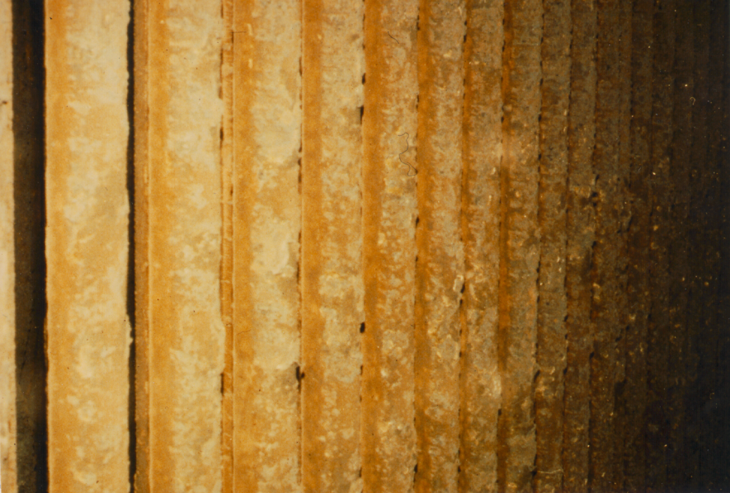
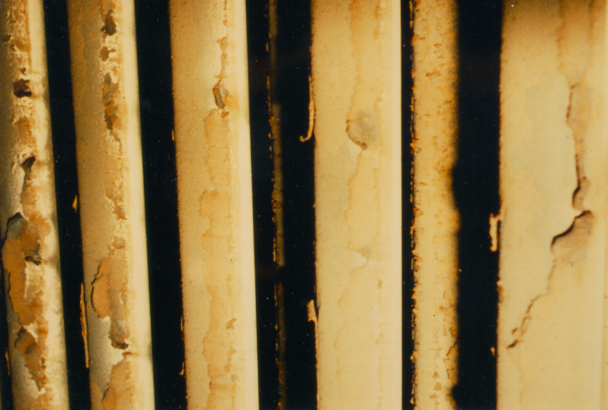
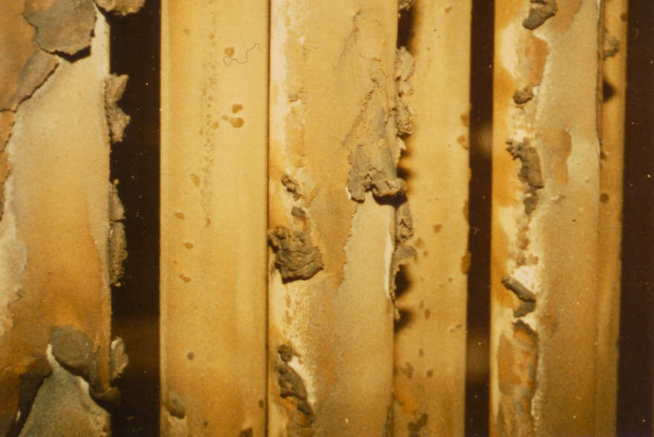
Slagging & ATX Clean Up Effect in Boilers
Before Trial
6 month in during trial
3 month in during trial

Slide 92
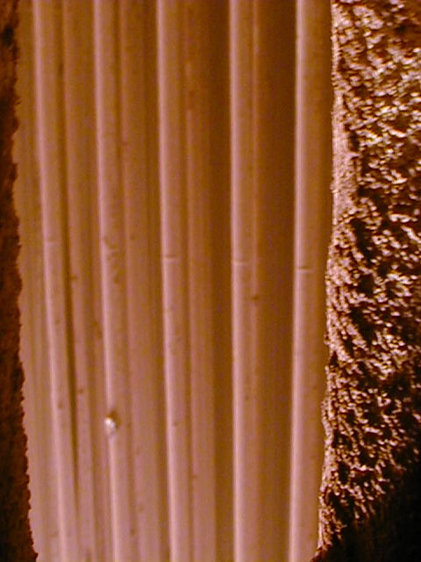
Superheater Deposits – Before & After Mg Treatment
September 30

Slide 93
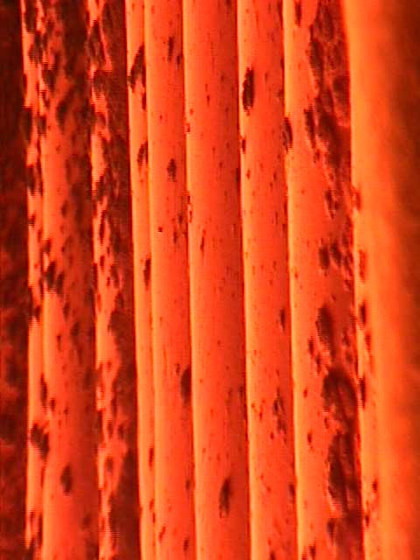
Front Water Wall Tube Deposits – Before & After Mg

Slide 94
ATX Mg Treatments – Solving Corrosion Problems
Corrosion Solution – Oil-soluble Mg neutralizes formation of excessive SO3 and subsequent sulfuric acid.
Through both remediation of catalytic deposits & neutralization of acid formation with resulting production of Mg salt(s).
Increase eutectic melting points of hot slag deposits cuts down on hot corrosion of surfaces.

Slide 95
ATX Mg Treatments – Solving Corrosion Problems
Corrosion Solution – Oil-soluble Mg neutralizes formation of excessive SO3 and subsequent sulfuric acid.
Through both remediation of catalytic deposits & neutralization of acid formation with resulting production of Mg salt(s).
Increase eutectic melting points of hot slag deposits cuts down on hot corrosion of surfaces.

Slide 96
ATX MFAs – Solving The Excess Air Dilemma
Better Combustion Through Reduction of Unburned Carbon – Catalytic combustion improvers in ATX multifunction formulations produce more and greater combustion reactions.
Better control of excess air – better combustion allows for same combustion production with less excess air.
No wasted energy from excessive air heating
Less SOx production from lower available oxygen

Slide 97
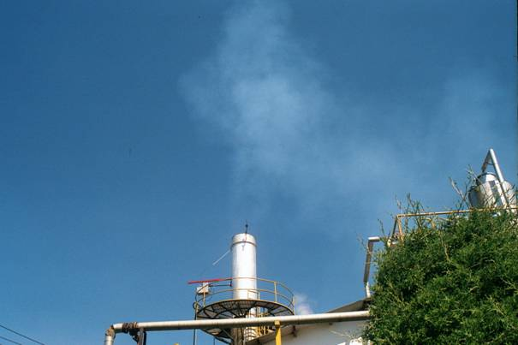
Opacity caused by SO3
Caused by condensation of SO₃ + H₂O(aq) that forms very small droplets, aerosols, causing an optical affect
Occurs at SO₃ levels > 5 ppm
Dirty units have more problems with opacity compared with clean units.
High excess of air (oxygen) and deposits containing V on boiler surfaces prohibits formation of SO2 to SO3
Vanadium
SO₂ + ½O₂
SO₃
NOTE: Opacity can also be caused by soot, particles and oil smoke (unburned heavy carbons)

Slide 98
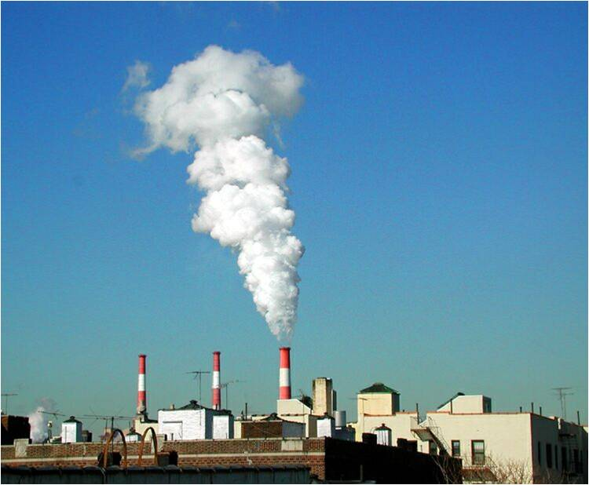
Opacity/Plume Visibility
Definition: The percentage of light transmission through an emissions plume.
Major sources of opacity:
Particulates
Sulfuric acid
Mixture of both

Slide 99
Opacity Measurements
Notes:
The opacity meter consist of a light source (wavelength 850nm) and a detector situated on the opposite side of the the stack. The light transmitted through the plume is then detected and measured as opacity.

Slide 100
Opacity/Plume Visibility
Opacity-measured by opacity meters situated in the stack
Plume visibility- Studied by certified reader from a specific point below the stack
Note: Usually the stack visibility is higher than the opacity analyzed in the stack

Slide 101
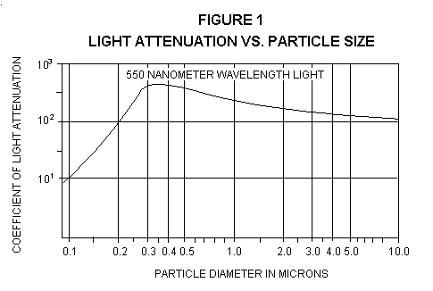
Particulates & Opacity
Particles in a size of 0.2-0.8 µm have the highest influence on opacity.
If we try to have particulates that are outside of this area we may be able to reduce the opacity.
Note that the light attenuation is about the same for a 0.2 µm particle as for a 10 µm particle.
Notes:
What is the problem with sulphuric acid?
Sulphuric acid is formed form the SO₃ in the flue gases. that is in equilibrium with the SO₂ in the flue gases. The equilibrium is very sensitive to temperature and below 500°C. more than 99% of the sulphur oxides present can be in the form of SO₃. The amount of oxygen does also have great influence on the equilibrium.
SO₃ have great affinity for water and and as the gases are cooled in the presence of moisture SO₃ combines with water to form H₂SO₄.
The acid causes opacity problems because it condense to from droplets that will increase the amount of particles with a diameter below 2 µm.

Slide 102
Sulfuric Acid Formation In Plumes
Formation of sulfuric acid aerosols
  SO₂ + O <==> SO₃
  SO₃ + H₂O <==> H₂SO₄
Acid condenses to form small droplets that increase the amount of small particulates in the flue gases.
Acid condenses to form small droplets that increases PM_{2.5}
Acid condenses on small particles (<2µm) and increases PM_{2.5}
Notes:
What is the problem with sulphuric acid?
Sulphuric acid is formed form the SO₃ in the flue gases. that is in equilibrium with the SO₂ in the flue gases. The equilibrium is very sensitive to temperature and below 500°C. more than 99% of the sulphur oxides present can be in the form of SO₃. The amount of oxygen does also have great influence on the equilibrium.
SO₃ have great affinity for water and and as the gases are cooled in the presence of moisture SO₃ combines with water to form H₂SO₄.
The acid causes opacity problems because it condense to from droplets that will increase the amount of particles with a diameter below 2 µm.

Slide 103
Sulfuric Acid in Combination with Particulates
The acid condenses on small particulates, which results in increased particulate size.
Notes:
The acid will also condense on existent small particulates. The condensation does mostly occur on smaller particles with a diameter around 0.5 µm. the condensation will cause an increased diameter of the particulates and cause higher opacity. particulates with a diameter of 1-2 µm do not favor the condensation. The condensation on particles is explained on the following figure.

Slide 104
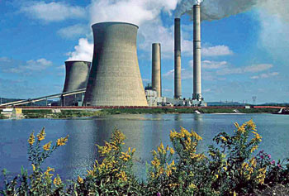
Actions of ATX of Plume-Forming Elements
Use effective catalysts to minimize the particle load.
Use magnesium containing additives to minimize the formation of acid.

Slide 105
What Kind of Mg Choices Are Available?
What To Choose?
Slurry or Oil-Soluble Formulation?

Slide 106


Problem - The Wear & Tear Of A Mg Slurry Formulation
One of the most important drawbacks with using a slurry is that it will wear out the nozzles of the burner tips.
A slurry has abrasive particles that wear out nozzle tips.
Compare the spherical holes of the new tip with the deformed holes of the damaged tip from slurry use.
The result? Inability to properly atomize and combust fuel – increased unburned carbon &coke particles.
New
Nozzle
Damaged
nozzle
after using
slurry

Slide 107
The Whitening Effect
When a slurry is dosed into the fuel and sprayed into the combustion chamber it is released in the flue gases as a particle.
Some of these particles will form deposits in the furnace covering the wall and tubes with white slurry deposits. This has two negative effects:
The whitening of the tubes mean that the heat transfer will be impaired and this means less efficiency.
There will be carry over of heat to the super heater area that may be overheated and cause premature shutdown to wash the furnace wall free from the slurry deposit.

Slide 108
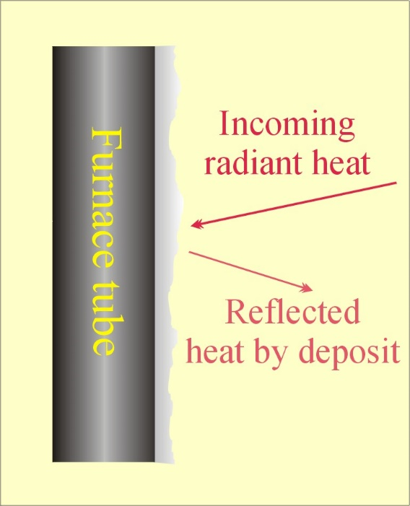
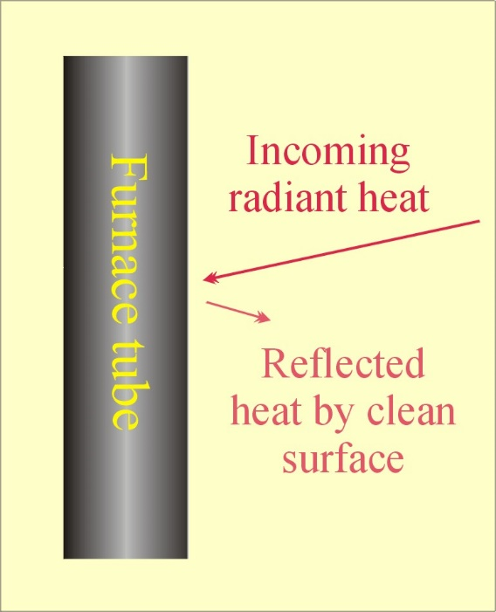
The Whitening Effect
Tube with deposits from slurry, more heat is reflected back
Tube with clean surface from treatment, less heat is reflected back

Slide 109
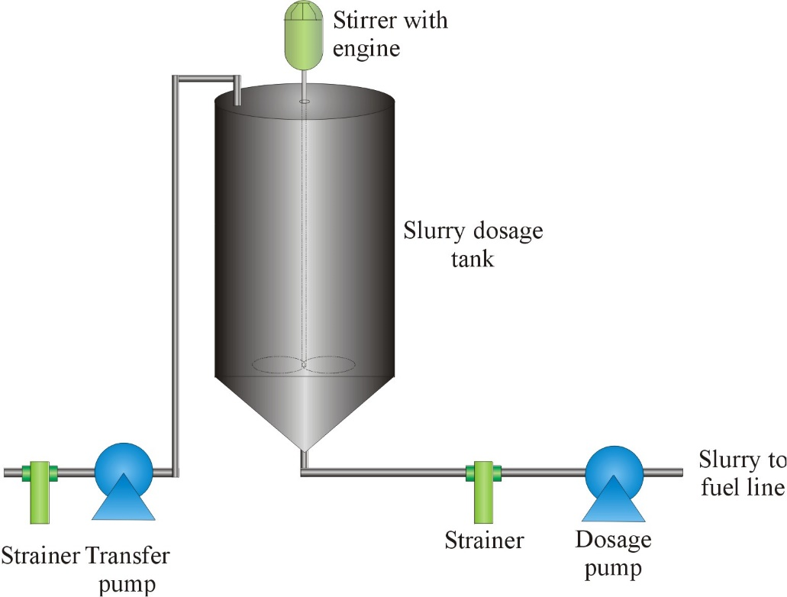
Dosage challenges with Mg-slurries
The slurry type of Mg product has one very important drawback.
If the tank with the slurry is not stirred it will separate to the bottom of the tank. How do we know that the slurry is homogenous?
Another hazard is that the slurry tank is small and frequently has to be topped up with new product. A slurry tank is between 1-2 m³.

Slide 110

Treatment Techniques – How Slurries Work
The technique an Mg slurry (like MgO) uses is very different from that of an oil soluble treatment.
The MgO slurry consists of small particles where only the surface is active and works by encapsulating the contaminants.

Slide 111
Treatment Techniques – How Slurries Work
Slurries must build a deposit to treat the problem.
Negative consequences for the overall boiler efficiency since the deposit is highly isolating and will hamper heat transfer.

Slide 112
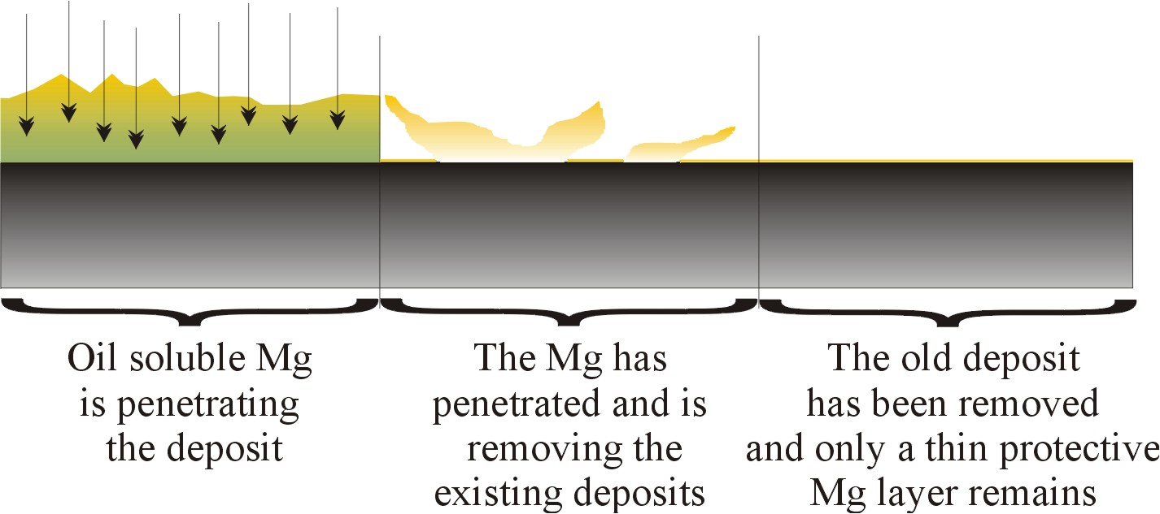
Comparisons With How Oil-Soluble Mg Works
The unique clean up effect of oil-soluble Mg cannot be achieved by using a slurry.

Slide 113
Solubility Problems – Solved by Bell Performance!
Bell Performance oil-soluble Mg is readily dissolved in the fuel and finely dispersed in the fuel moments after dosage.
This ensures a perfect functionality when the product reaches the combustion chamber and interacts with the ash contaminants.

Slide 114
Comparisons With How Oil-Soluble Mg Works: Deposit Clean-Up
Clean up effect means that the efficiency of the boiler will be improved as the heat transfer surfaces will be cleaner.
The conversion of SO2 to SO3 will also be reduced due to less catalytic conversion by the Na-V deposits.

Slide 115
Corrosion reduction with Oil-Soluble ATX Magnesium

Slide 116
SO3 comparison between Slurry and Oil-Soluble ATX

Slide 117
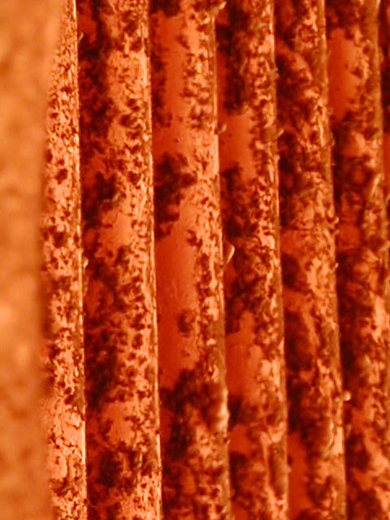

Oil Soluble Additives Yield Markedly Better Deposit Results
Bell Cleanliness (Long Island)
Slurry Cleanliness

Slide 118

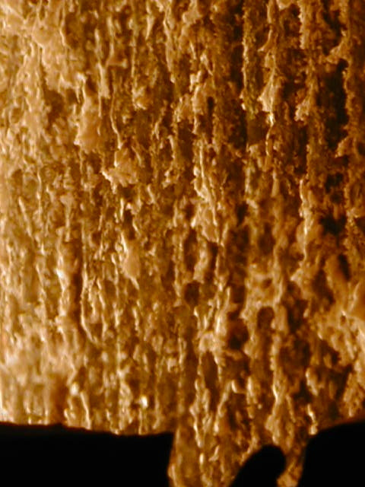
Oil Soluble Additives Yield Markedly Better Deposit Results
Bell Cleanliness (Long Island)
Slurry Cleanliness

Slide 119
ATX Value Propositions
Potential value points
for treatment?

Slide 120
Fuel Treatment Value Points To Be Realized– Fuel Usage Reduction
EXAMPLE: Improved heat transfer, reduction of slagging & catalytic heat reaction improvement from ATX yielding estimated 1.0% improvement in fuel usage
1.0% improvement = 10MT savings per day = $10,000 USD equivalent
Cost/savings figures may vary, but the principle is the same: substantial ROI is realized

Slide 121
Fuel Treatment Value Points To Be Realized - Shutdown Reduction
What is the value in extending shutdown intervals for problem remediation such as VBU Heater Tube de-coking?
How much value can be reclaimed by extending intervals by one month? Three months?
For many operational facilities, the greatest ROI is realized in this area, not fuel usage reduction.

Slide 122
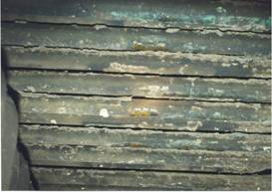
To choose product and treatment level
Parameters to be considered when choosing product:
SO3 levels – measure SO3 and/or acid dew point
Fly-ash
Previous experiences
Boiler condition
Air excess
Slag formation
V/Na/P content in fuel
Analysis of deposits
Operating conditions, etc

Slide 123
ATX & Customers
Who’s Been Using These Solutions?

Slide 124
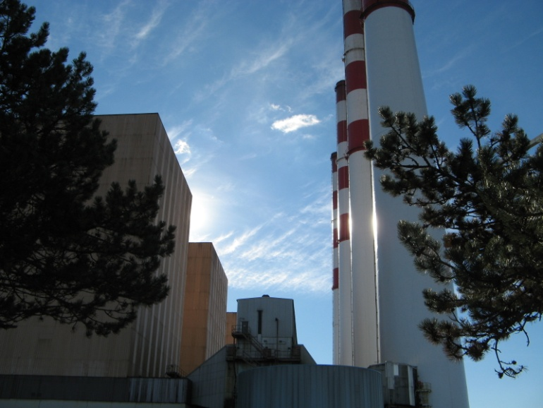
Who’s Been Using These Solutions - ATX
Northport Power Station (4 x 375MW units)
Largest oil-fired electric-generation power station on United States East Coast (Long Island)

Slide 125

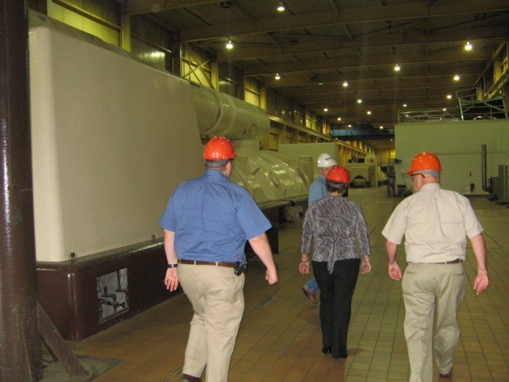
Who’s Been Using These Solutions - ATX
Northport Power Station
Users of ATX since 2001 for deposit control in boilers

Slide 126
Who’s Been Using These Solutions - ATX
Tarbert Generating Station (Ireland)
Better sootblowing, boiler tube corrosion remediation
Boiler availability
Heat transfer & efficiency
$946,000 savings per year.

Slide 127
Who’s Been Using These Solutions - ATX
Industrial customers domestic & international
Ireland customers (Southern Milling, C&C Soft Drink, Purcell Wilson)
  fuel savings between 3.8% - 5.3%.
MC Terminal (Mitsubishi-Hiroshima)
  Reductions in acid smut emissions 19.12% – 50.51%
Taiwan industrial customers (Color Ring Dyeing, Howard Hotel, Hualon Group, Seaspire, Everset Textile)
  Fuel savings between 5% - 9%
  Reductions in SOx and Nox emissions about 10-50% per output unit

Slide 128

Review – What Did We Learn?
Heavy fuel oil brings inherent problems of corrosion, heavy deposit formation and sludge dropout.
There are effective solutions to remediate these problems and give back positive ROI to these users.

