Slide 1

Fuel Overview
What’s Going On In The Market With Gas And Diesel?
New Dimension Logistics
January 27, 2015

Slide 2
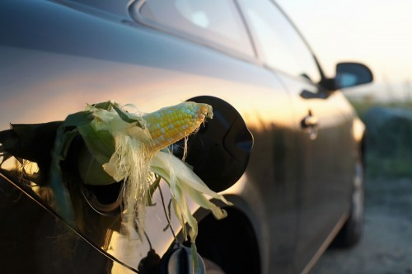
Ethanol Fuel
How does it affect me and why should I care?

Slide 3
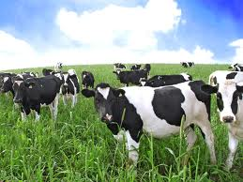

Over 40% of the US corn crop is dedicated to ethanol production
If you converted all the corn in the USA to ethanol, it would only supply 12% of our total fuel needs.
Meat prices have increased 25%
I don’t think this is true

Slide 4


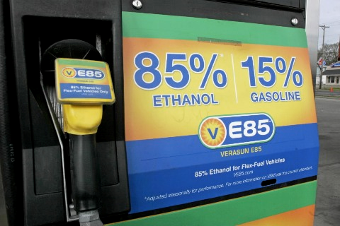
The three most common ethanol blends sold in the USA
E10 is 10% ethanol and 90% gasoline
E15 is 15% ethanol and 85% gasoline
E85 is 85% ethanol and 15% gasoline

Slide 5
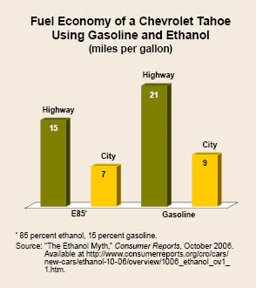
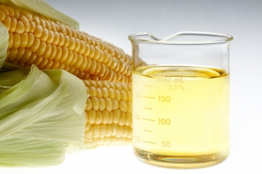
The higher the percentage of ethanol, the lower your fuel mileage
The use of E85 will reduce your overall fuel mileage by 25%

Slide 6
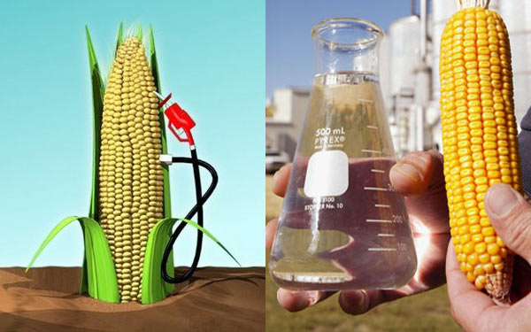
Without government subsides, ethanol is a loser
It takes 131,000 BTU’s of energy to produce one gallon of ethanol
There is only 77,000 BTU’s of energy in a gallon of ethanol
Ethanol only has 75% of the energy that gasoline has

Slide 7
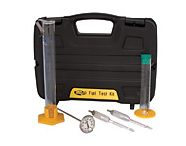
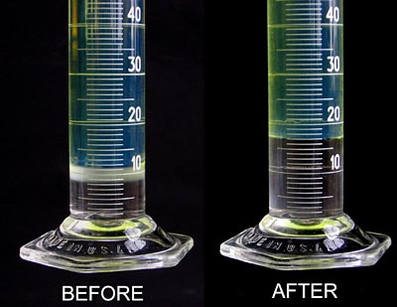
Determining the percentage of ethanol in gasoline is done with water
Knowing how much ethanol is in your gasoline is important because you can prevent damage to your vehicle’s engine

Slide 8
A good reason to test the ethanol percentage in your gasoline
Fleet dollar loss for supplier adding additional 6% ethanol to 10,000 gallons of gasoline
10,000 Gallons of Gasoline
X 6% Additional Ethanol
600 Gallons of Ethanol
600 gallons of Ethanol
X $2.70 Cost of ethanol
$1,620.00 Cost of additional ethanol
$1,830.00 @ $3.05 per gallon cost of Gasoline
Difference = $210.00
Supplier gain by adding 6% additional ethanol
10,000 Gallons of Gasoline
Loss of 1 mile per gallon
10,000 miles with loss
Average mileage 16 divided into 10,000 miles = 625 gallons of gasoline
625 gallons of gasoline
X 3.16 Cost of gasoline
$1,975.00

Slide 9

Lean air fuel mixtures are very hot
Fuel systems on non-flex fuel engines are calibrated for the energy level of gasoline
When you have less energy in the fuel and the same amount of air, that equals a hot lean air fuel mixture
Hot lean air/fuel mixtures can burn valves, pistons spark plugs and cause pre-ignition or detonation

Slide 10
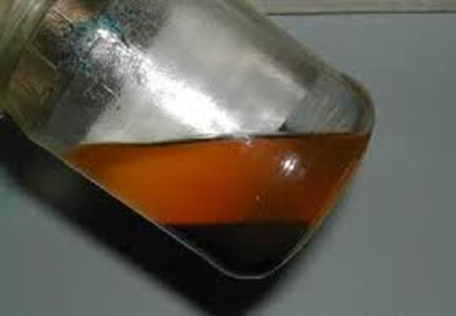
Four major problems with ethanol-blended gasoline
Ethanol is hygroscopic and will attract water. Once water is introduced, the shelf life is only a few weeks
Ethanol is highly corrosive
Ethanol is a powerful solvent
Causes loss of power & performance

Slide 11
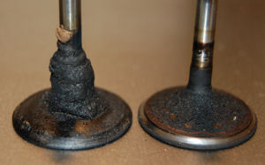

Marine applications are at a higher risk of ethanol damage
Dissolved fiberglass resin on intake valves can result in severe engine damage and require fuel tank replacement

Slide 12
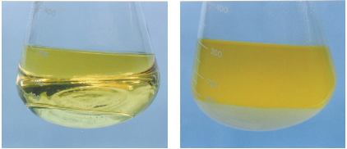
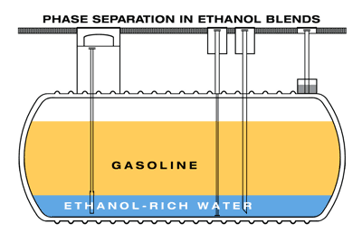
Phase separation will ruin your gasoline
E-10 gasoline will hold about two teaspoons of water in suspension before it goes through phase separation

Slide 13
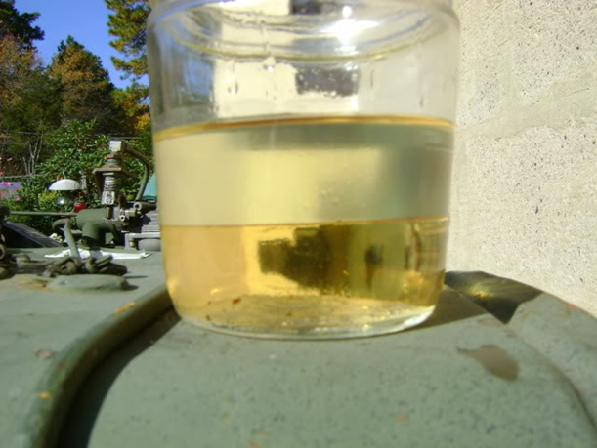
Gasoline additives that reduce phase separation must be used when fuel is in good condition
There is no product on the market that can economically fix phase-separated gasoline
Phase-separated gasoline should be discarded to prevent engine damage or vehicle breakdown

Slide 14
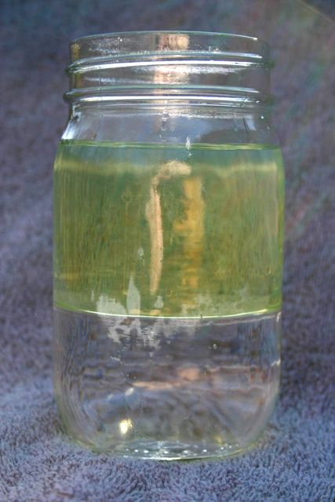
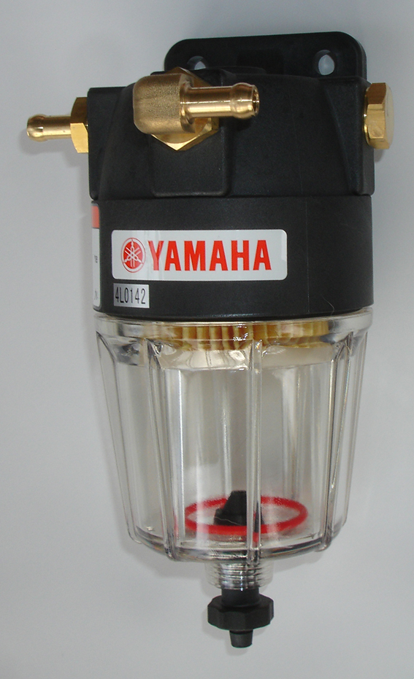
Water separators remove free water only
This is an example of free water
Water is heavier than gasoline, so water falls to the bottom of the separator

Slide 15


Watercraft work in a high moisture environment, putting them at a higher risk of damage
Boats tend to store fuel for longer periods of time
Fuel tanks in most boats are vented, which is a problem
Store watercraft either completely empty or completely full of fuel

Slide 16
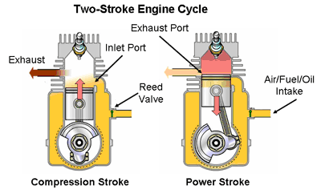
Three ways ethanol can damage two-cycle engines
1. Ethanol can interrupt normal lubrication, causing engine damage
2. Lack of energy in ethanol results in hot/lean fuel mixtures
3. Seasonal storage can result in corrosive damage

Slide 17


Corrosive ethanol damage caused by seasonal storage
Brass fuel system components are highly susceptible to the corrosive effects of ethanol
Fuel jets can be blocked by corrosion causing a no-start condition

Slide 18
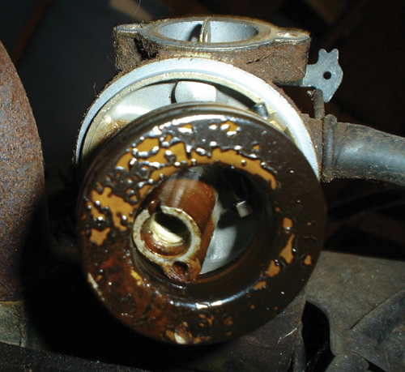
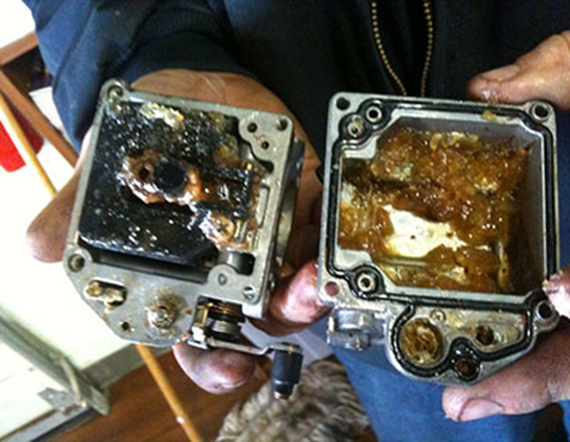
Ethanol can be very destructive to different materials
Carburetor floats can be damaged or dissolved by ethanol-blended gasoline

Slide 19
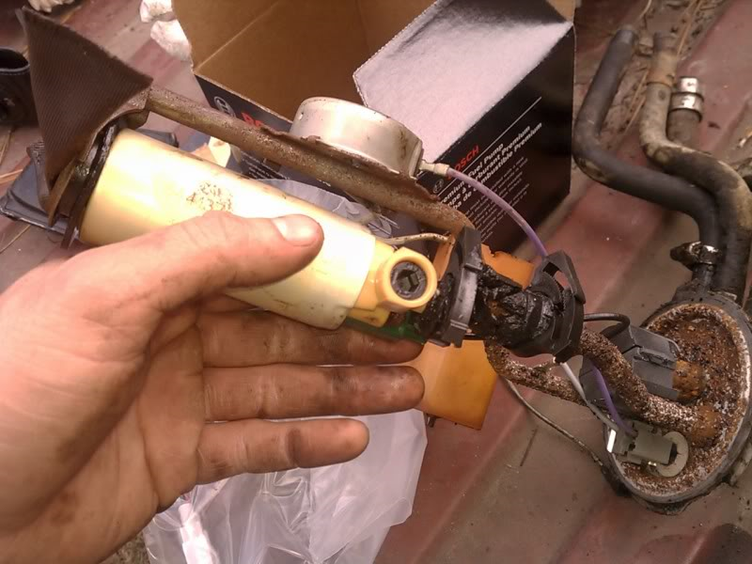
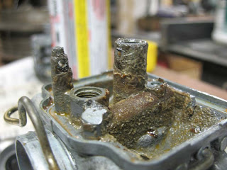
Older vehicles are more susceptible to ethanol damage
The fuel systems of older classic cars were not made of materials that can withstand the highly corrosive effects of ethanol

Slide 20

“Octane” What is it and what does it do for vehicles?
Does octane make your vehicle fly?
Do you occasionally treat your vehicle with premium gasoline thinking it is beneficial?
What do you think octane does for your vehicle?

Slide 21
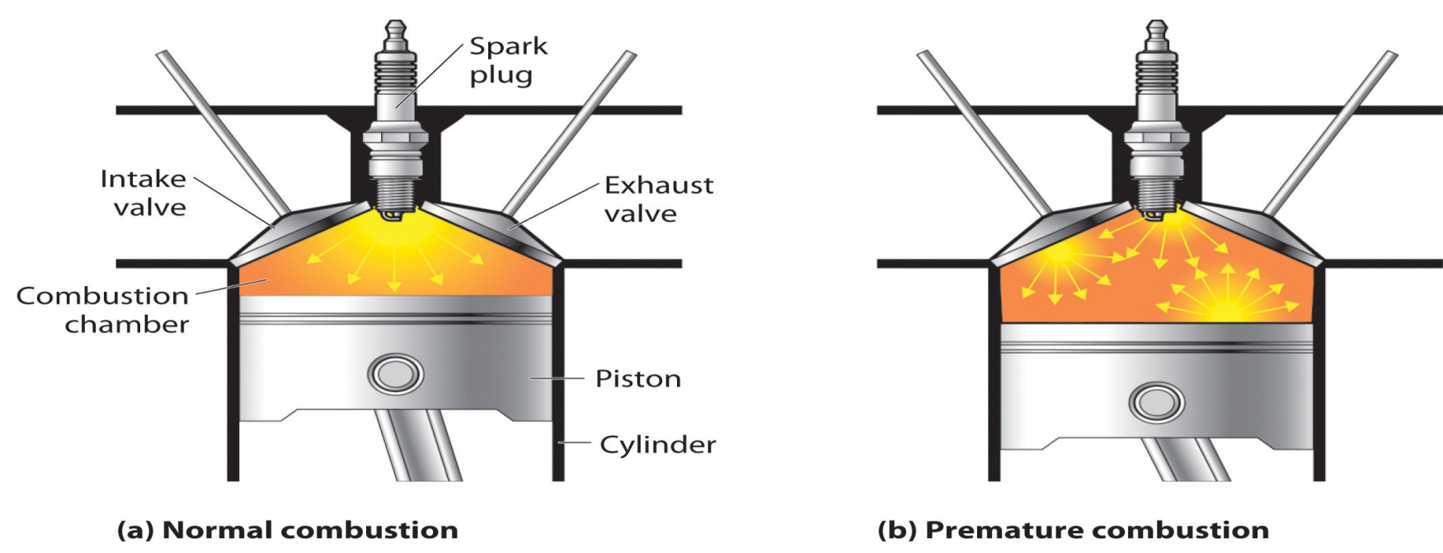
“Pre-ignition” What causes the knocking sound?
Pre-ignition reduces fuel mileage and engine performance

Slide 22

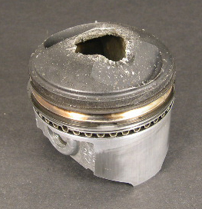
Pre-ignition can damage your engine
Pre-ignition can cause a bent connecting rod
Pre-ignition can punch a holes in the top of a piston
Computer controlled ignition can prevent this damage

Slide 23
At this point you are probably wondering – why is ethanol being added to gasoline?
They say ethanol reduces our dependency on foreign oil
Ethanol reduces CO (carbon monoxide) emissions
MTBE (Methyl Tert-Butyl Ether) octane booster in gasoline had to be replaced
MTBE was replaced with ethanol which raises octane & oxygen content
Ethanol is 119 on the octane scale

Slide 24
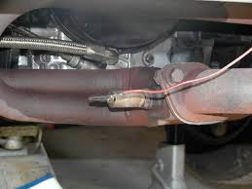
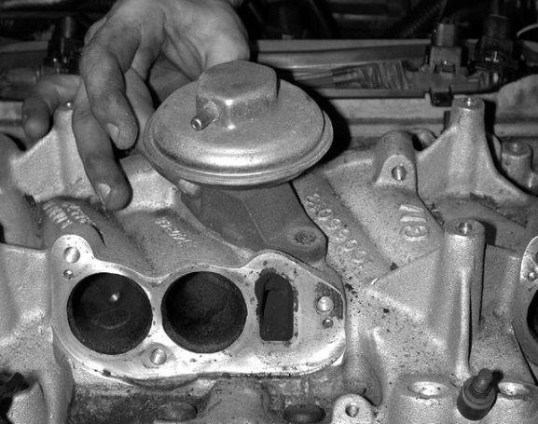
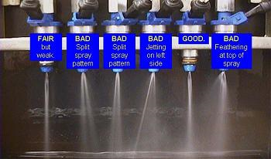
The three components that have the biggest negative effect on fuel mileage
To achieve maximum fuel mileage, fuel injectors must be kept clean
Exhaust Gas Recirculation Valves (EGR) can stick open
Oxygen Sensors must also be clean to achieve maximum mileage

Slide 25
Can fuel additives solve or prevent problems caused by ethanol?
There are over 4,500 fuel additives on the market
Only about 25 of them do everything they claim
No additive will eliminate ethanol in gasoline
You can only counteract the negative effects of ethanol
Do not use an additive that contains alcohol to treat an ethanol problem

Slide 26

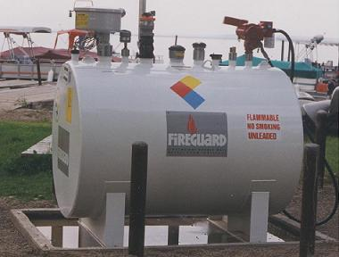
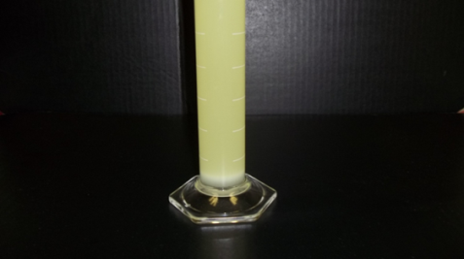
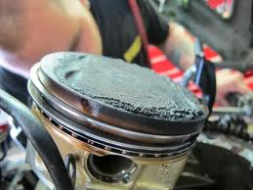

Things a gasoline additive should do to have a positive impact on your vehicle
Water removal to reduce the chances of phase separation
Inhibit corrosion caused by ethanol-blended gasoline
Boost power and engine performance, improving fuel mileage
Clean internal engine components, improving mileage, reducing wear and engine octane requirements
Extend the life of gasoline in long-term storage

Slide 27
Questions

Slide 28
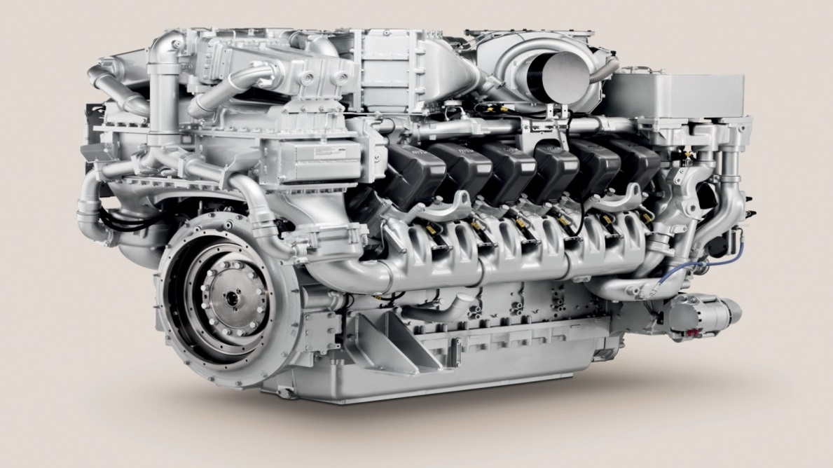
Diesel fuel
What you need to know about diesel fuel to maximize performance and reduce chances of equipment failure

Slide 29
Diesel equipment failures
Fuel problems are the number one cause of diesel-powered equipment failures
Microbial growth of fungus, mold and bacteria is the number one cause of these failures
It’s not algae which requires sunlight to grow
Asphaltenes forming from degraded fuel are the second most common cause of engine failure

Slide 30
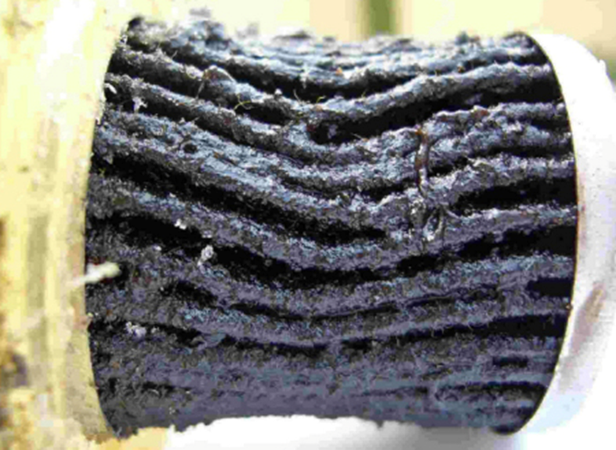
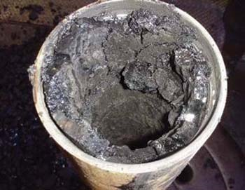
Causes of fuel filter plugging
Plugged fuel filter caused by microbe excreted waste
Fuel degradation forms Asphaltenes, clogging lines and filters

Slide 31
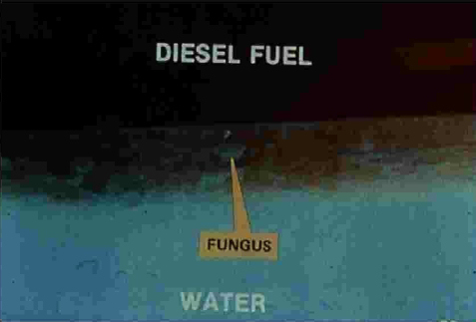
The culprit is water in the tank
Growth occurs when you have a water-diesel interface
Microbes live in the water and use diesel as a food source
A drop of water is a lake to a microbe

Slide 32
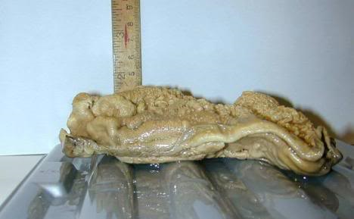
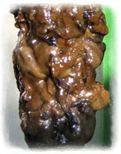
Monsters in your diesel tank
Bacteria can multiply from one cell to 246,000 in six hours
Bacteria can come from the air, moisture or during tank filling

Slide 33
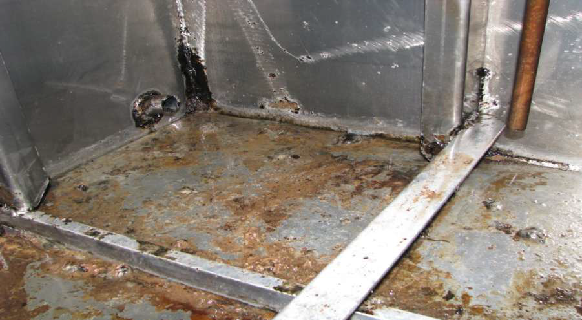
Corrosion caused by bacteria
Bacteria excrete acids that can corrode metal parts
Fuel tanks, pipes, injectors, injector pumps & fuel lines can be damaged - as seen by this example

Slide 34
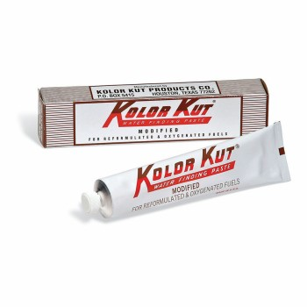
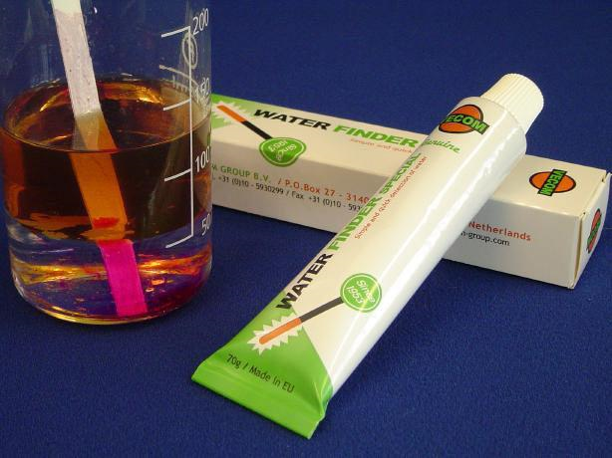
How to test for water in fuel

Slide 35
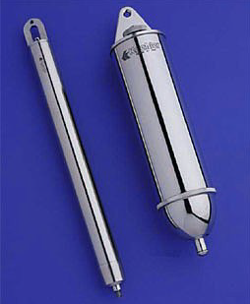
Testing begins by taking a fuel sample
A Bacon Bomb as seen on right is used to collect a fuel sample
For best results the fuel sample should come from tank bottom of the fuel tank where microbes live

Slide 36
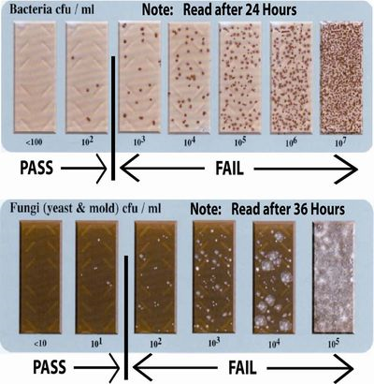
Testing for microbes in diesel fuel
There are a number of test kits on the market
Fungus mold tests are separate from bacteria tests
The quicker the results the more expensive the test kit

Slide 37
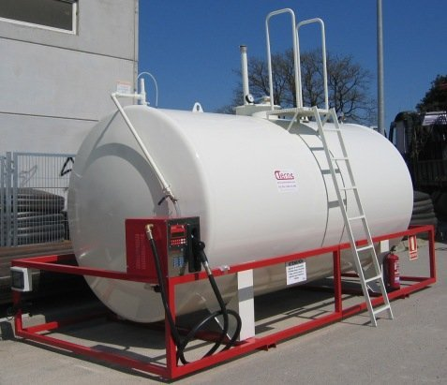
How water ends up in diesel fuel
Condensation forming on tank walls
Most fuel tanks are vented, exposing the fuel to humidity and water absorption
Seven degrees difference in temperature will trigger condensation
Water intrusion into tanks from rain and ground water
Water brought in the tanker from the supplier

Slide 38
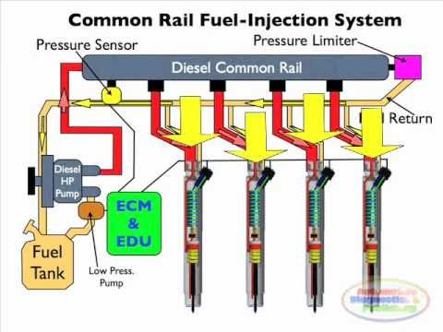
How diesel engines generate water
Hot un-used diesel fuel returns to the fuel tank, causing a temperature differential and setting the stage for condensation in the fuel tank

Slide 39

EPA-mandated changes to diesel fuel have caused problems
The EPA required the reduction of sulfur in diesel fuel to reduce emissions
Sulfur was reduced from 500 parts per million to 15
Sulfur is a natural biocide that suppresses microbial growth in fuel
Sulfur was a lubricant for injectors and seals

Slide 40
Cetane & why it matters
Cetane is the opposite of octane
Higher cetane means better performance, lower emissions, quicker starting, and less noise
Higher cetane than manufacturer specifications yields no additional benefit
Modern diesels run best on a cetane rating between 45 & 50

Slide 41
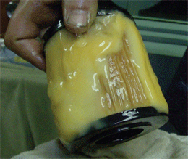
How cold weather affects diesel fuel
Diesel fuel contains wax which will cause it to gel at low temperatures
What is meant by diesel fuel cloud point and pour point?
Winter fuel contains a mix of No#1 & No#2 diesel to lower the fuel gel point
Anti-gels will be needed in cold climate areas
What do you do if the fuel system is completely gelled?

Slide 42
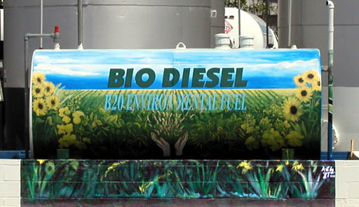
Going green with biodiesel: Benefits and problems

Slide 43
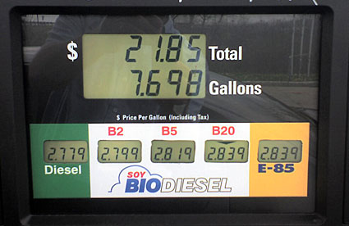
Four things you need to know about biodiesel
Most common biodiesel concentrations are B2, B5, & B20
Biodiesel has a higher lubricity rating than straight diesel but contains less energy
Biodiesel has one-fourth the shelf life that straight diesel has and is more susceptible to microbial growth
Biodiesel tends to gel at higher temperatures than straight diesel

Slide 44
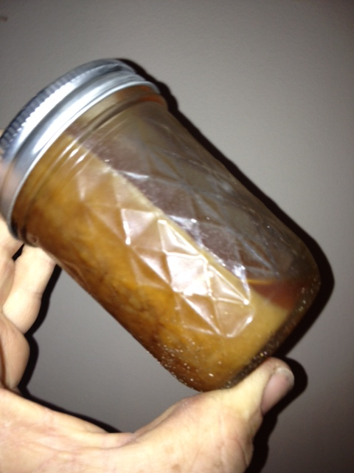
B99 made from animal fat at 45 degrees Fahrenheit

Slide 45
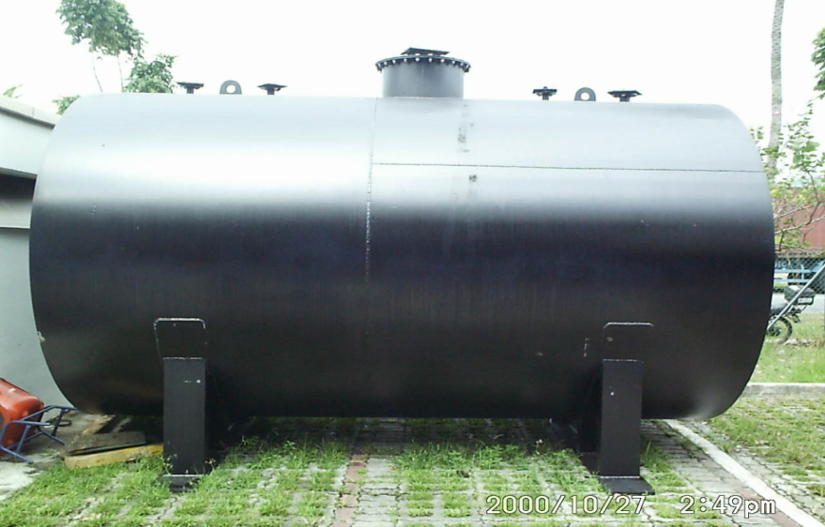
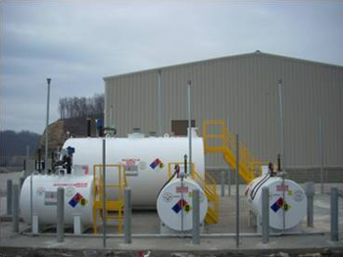
Improper storage can cause problems with diesel fuel
Dark color storage tanks damage fuel because they absorb heat from the sun
Light colors should be used to reflect the suns rays to reduce evaporation

Slide 46
Preventive maintenance can minimize storage problems with diesel fuel
Drain or pump water from your diesel tanks as soon as it is detected because microbes need water to grow. Test for water every 30 days at a minimum.
Keep diesel tanks as full as possible to prevent condensation
Add biocide in maintenance dosage every 90 to 120 days and always treat the tank as if it were full.
Use fuel stabilizer to reduce fuel degradation with long term storage
If possible, try to ensure your supplier maintains their system well

Slide 47
Questions

